Slide 1
We Believe
Miracles of Jesus
Chapter 16

Slide 2
Miracles
Show that Jesus is God
Help to strengthen our faith
Show Jesus’ love for others
Show He answers our prayers

Slide 3
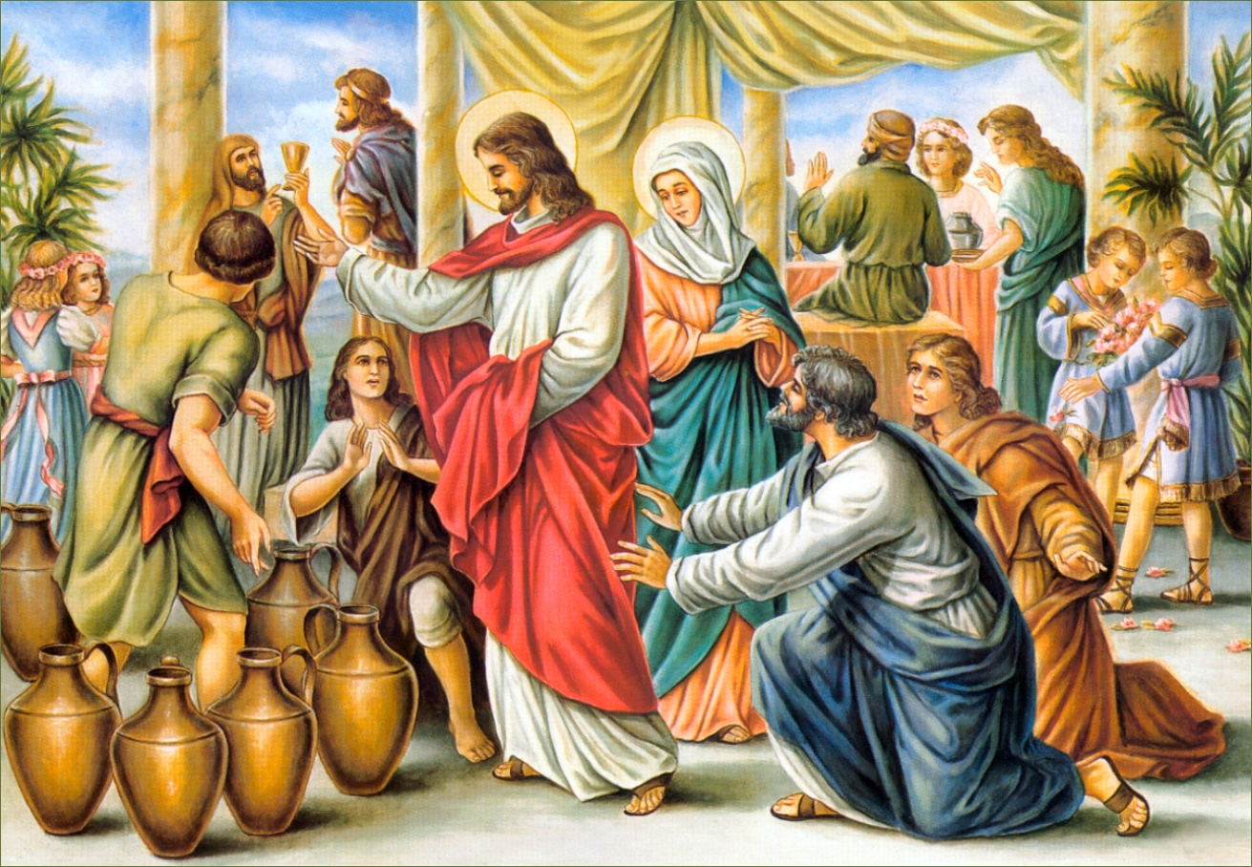
The Wedding Feast at Cana
The first public miracle was the changing of water into wine at the wedding feast of Cana.

Slide 4
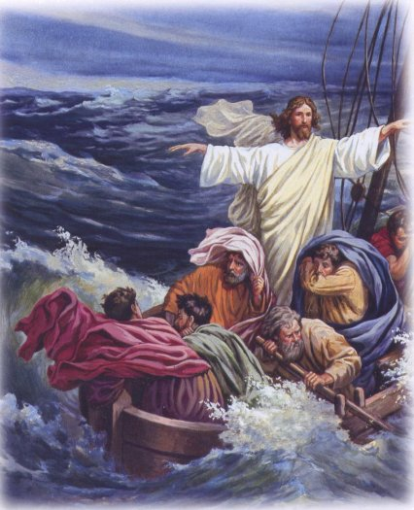
The calming of the storm at sea
Jesus calmed a storm at sea.

Slide 5
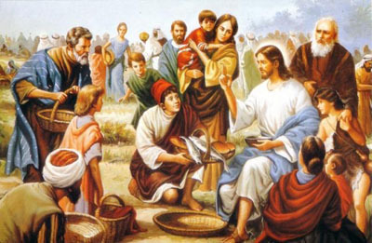
The Multiplication of the Loaves and Fish
Jesus multiplied the five loaves and two fishes to feed 5000.

Slide 6
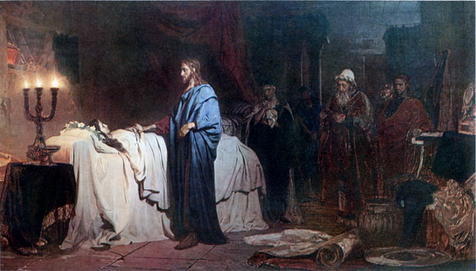
The Rising of Jairus’ daughter
Jesus’ miracles also directly healed people: the blind, the paralyzed, the sick, and the hurt.

Slide 7
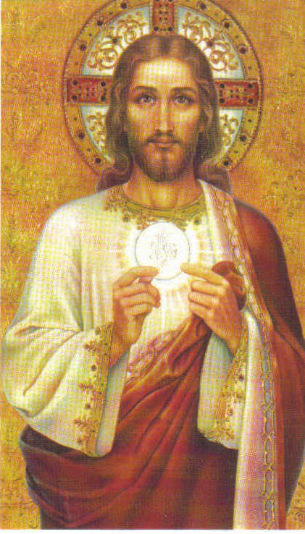
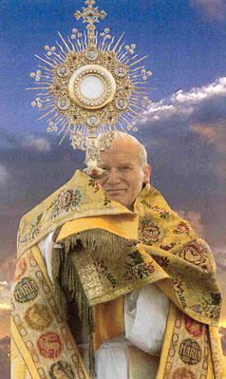
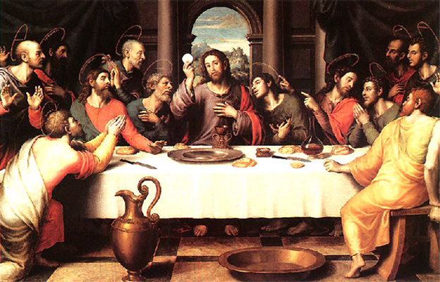
The greatest miracle of all!
The Holy Eucharist!

