Slide 1
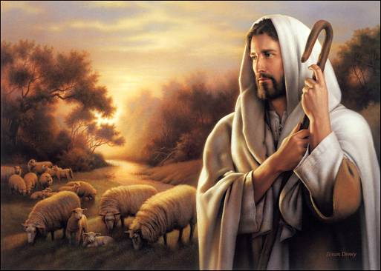
The Good Shepherd
Chapter 21

Slide 2
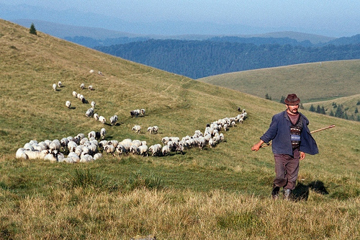
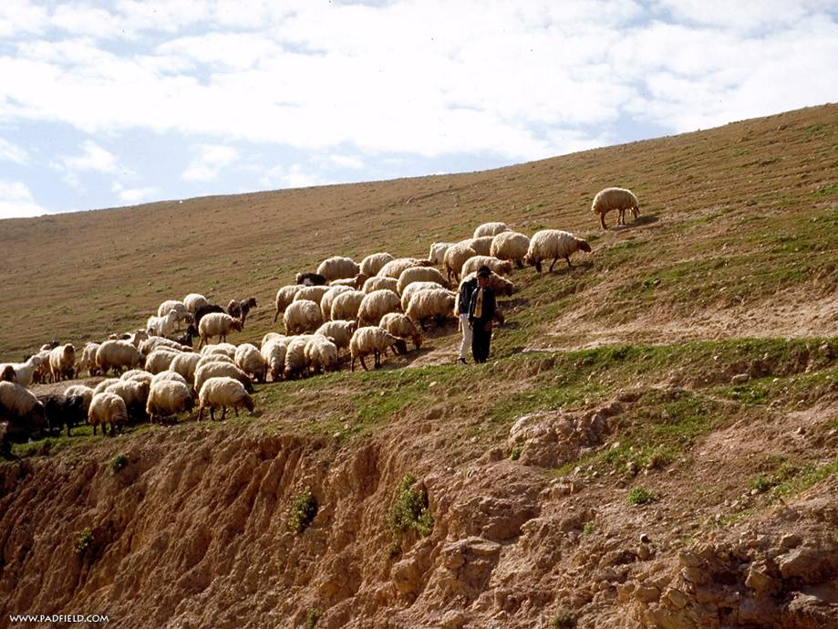
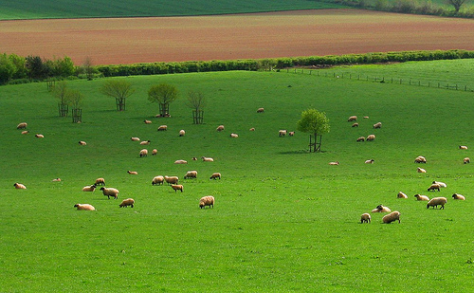

Slide 3
Jesus our Good Shepherd
Shepherd
knows his sheep
protects his sheep
feeds his sheep
finds lost sheep
leads his sheep
lays down his life
Jesus
knows us best
protects us from sin
feeds our souls
forgives us
leads us to Heaven
dies for us

Slide 4
Jesus is our Shepherd
Jesus feeds, protects, leads, and strengthens us in the Sacraments.
Jesus laid down His life for us on the cross.
We must be like Jesus the Good Shepherd in our daily lives.

Slide 5
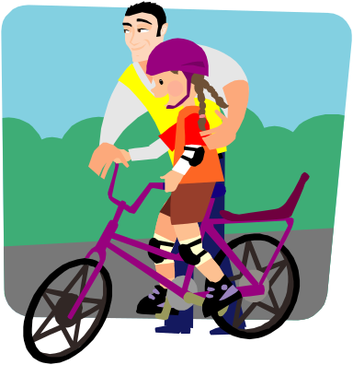

Habits
What is a habit?
  Something you do all the time without thinking about it.
How do we get into habits?
  By doing them over and over and over again.

Slide 6
Virtue
A habit of doing good
Examples:
  Making your bed every day without being asked
  Talking politely to people
  Saying your prayers each day
  Telling the truth even when it is hard
  Others?

Slide 7
Vice
A habit of doing bad
Examples:
  Talking back to your mom or dad whenever they ask you to do something
  Lying
  Blaming someone so you don’t get in trouble
  Not playing with someone you don’t like
  Being selfish
  Others?

Slide 8
Virtue or Vice?
Disobeying
Fighting
Lying
Speaking in a mean voice
Jealousy
Selfishness
Pride
Laziness
Telling the truth
Obeying
Humility (not proud)
Putting others first
Speaking kindly
Gentleness
Sharing friends
Working hard

Slide 9
What can we do?
Growing in virtue is hard, it takes work
Getting rid of vice is hard, it takes work
Why should we do it? Why shouldn’t we just do what is easy?
  Because we love Jesus and we know that He loves us
  We will be happier if we do good than if we do bad
How can we grow?
  Hard work, trying again and again
  Praying for God’s grace to help us grow in virtue
  Saying we are sorry to God (Sacrament of Penance)
  Saying we are sorry to others
  Doing penance

Slide 10
Jesus will help!
Jesus said, “My yoke is easy and My burden is light.”
Jesus helps us to do our hard work. If we ask His help and work with Him, He will help change our vices into virtues!
The best way to start doing this is by receiving the Sacrament of Penance.

Slide 11
Effects of Confession
This is what a good confession will do for my soul:
  My sins will be forgiven
  I will receive grace in my soul
  I will be stronger to be a good Christian
Go, Jesus!

