Slide 1
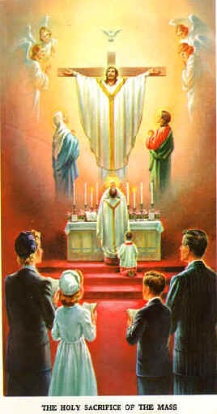
The Holy Mass
Chapter 25

Slide 2
The Sacrifice at Calvary
Read the 3rd paragraph on page 121-122.
Jesus offered Himself once and for all on the cross.
Mass is making present the one sacrifice of Jesus on the cross.

Slide 3
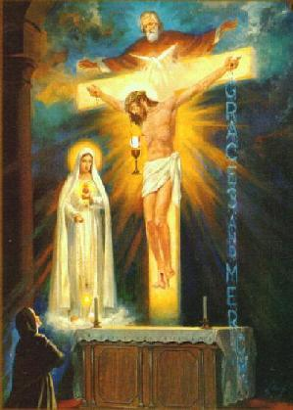

Slide 4
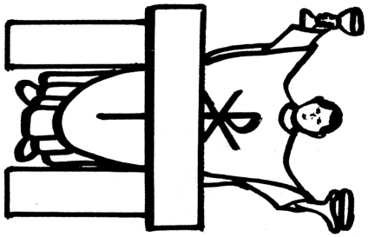

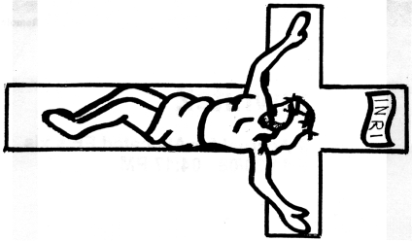

Is Mass a Sacrifice?
Crucifixion
Mass
Heaven
Jesus offers His Body to God the Father for us by the power of the Holy Spirit (Love)!

Slide 5
“Do this in remembrance of Me”
remember=make present now
“Do this…” ~ Jesus tells the Apostles, the first priests
At Mass…
  we are with Jesus at the Last Supper,
  on the Cross,
  at the Resurrection,
  and in Heaven!

Slide 6
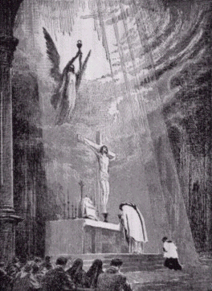

Slide 7

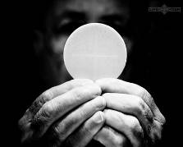
Why do we go to Mass on Sunday?
Think of the 10 Commandments
  Which one do we keep by going to Mass on Sunday?
What did Jesus do on a Sunday?
  Rose from the dead
What do we call that day?
  Easter
So, each Sunday is a “little Easter”!

Slide 8
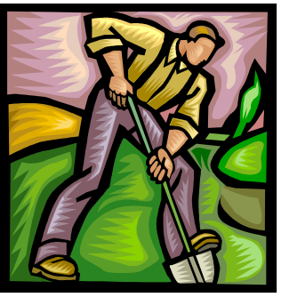


What day did Jews “keep holy?”
The Sabbath
  Saturday, why?
  What happened on the Saturday of the days of Creation?
God “rested on the Sabbath and made it holy”

Slide 9
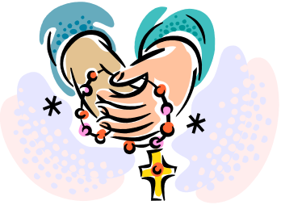
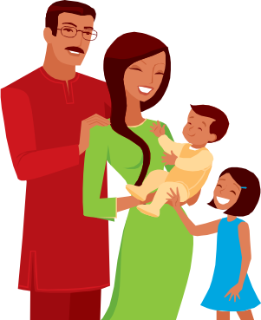
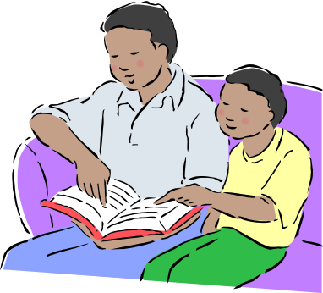
How can we keep Sunday holy?
Go to Mass—of course!
Take extra time to pray
Spend time with family
Try not to do unnecessary work (making meals, setting the table and taking out trash are fine)
  Sometimes adults need to work (doctors, nurses)
Play games and relax
Do extra kind things for others
(not a day to be selfish!)

