Slide 1
^{Jesus Returns to the Father}
Chapter 29

Slide 2
After the Ressurection
Read the first paragraph on pg 140
What power did Jesus give His Apostles?
Read the second paragraph on pg 140
Was it easy for them to lift up the net filled with fish?

Slide 3
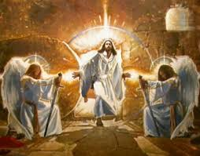
After Jesus rose from the dead, he stayed on earth for 40 days.
  Appearing to His disciples
  Giving them the power to forgive sins
  “Go out into all the world and preach the Gospel to the whole creation” Mark 16:15

Slide 4
Jesus Leaves His Disciples
The Disciples were sad that Jesus was leaving earth.
Jesus promise to send the Holy Spirit to lead them and guide them.
Jesus gave the command to baptize everyone.

Slide 5
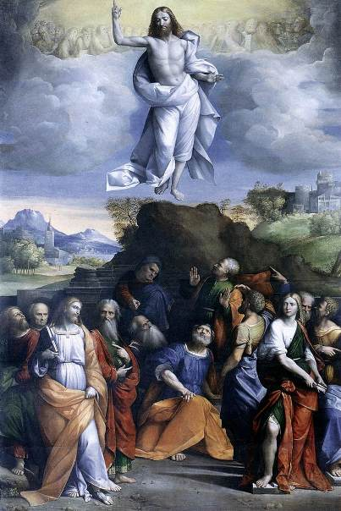
"Baptize them in the Name of the Father, and of the Son, and of the Holy Spirit. I will be with you always."

Slide 6
Ascension
Ready the last paragraph on pg 141.
True or False: At the end of time Jesus will come to judge the living and the dead.

