Slide 1
Ch. 33
JESUS IS ALWAYS PRESENT

Slide 2

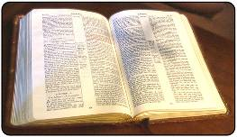
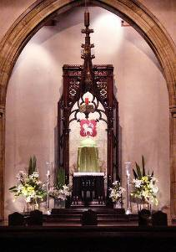
Jesus is always present
When people gather in His name
When you read the Bible
In the Church

Slide 3
Jesus Resides in the Tabernacle
Jesus waits for us to come and see Him in the tabernacle.
Visiting Jesus helps us grow in our relationship with Him.
We should be open and talk with Him about all aspects of our lives.

Slide 4
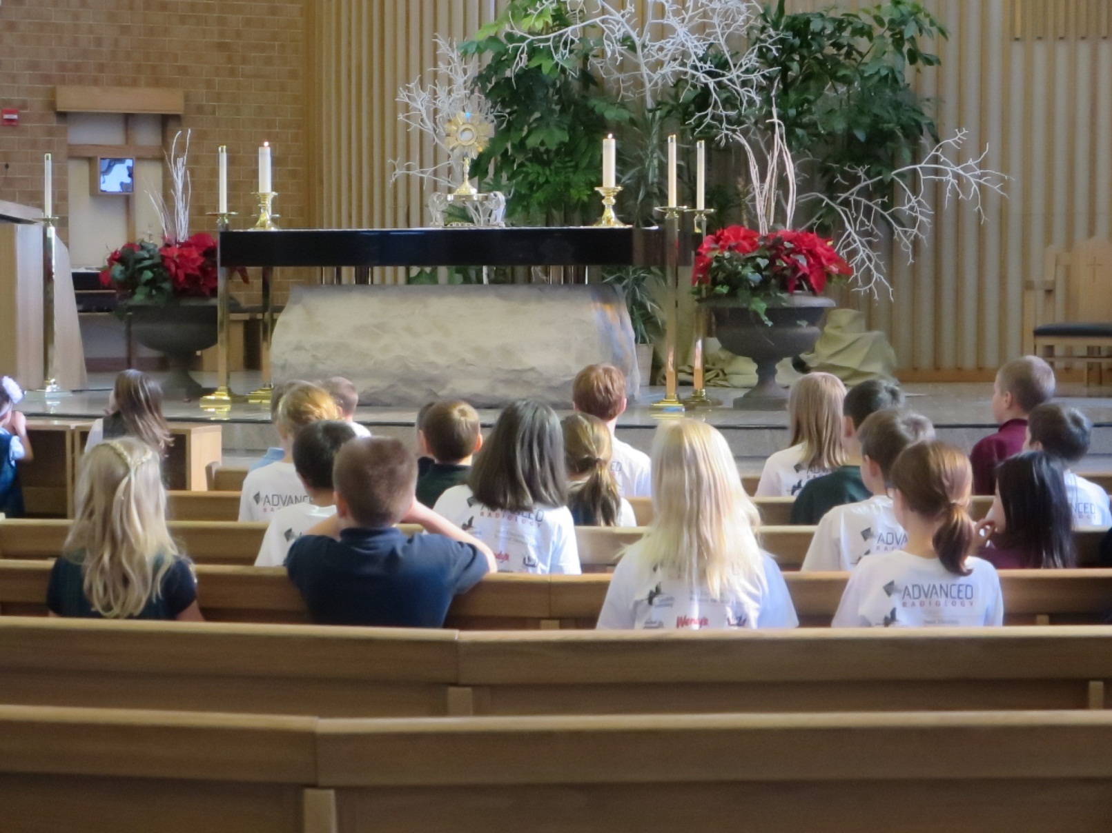
Adoration

Slide 5
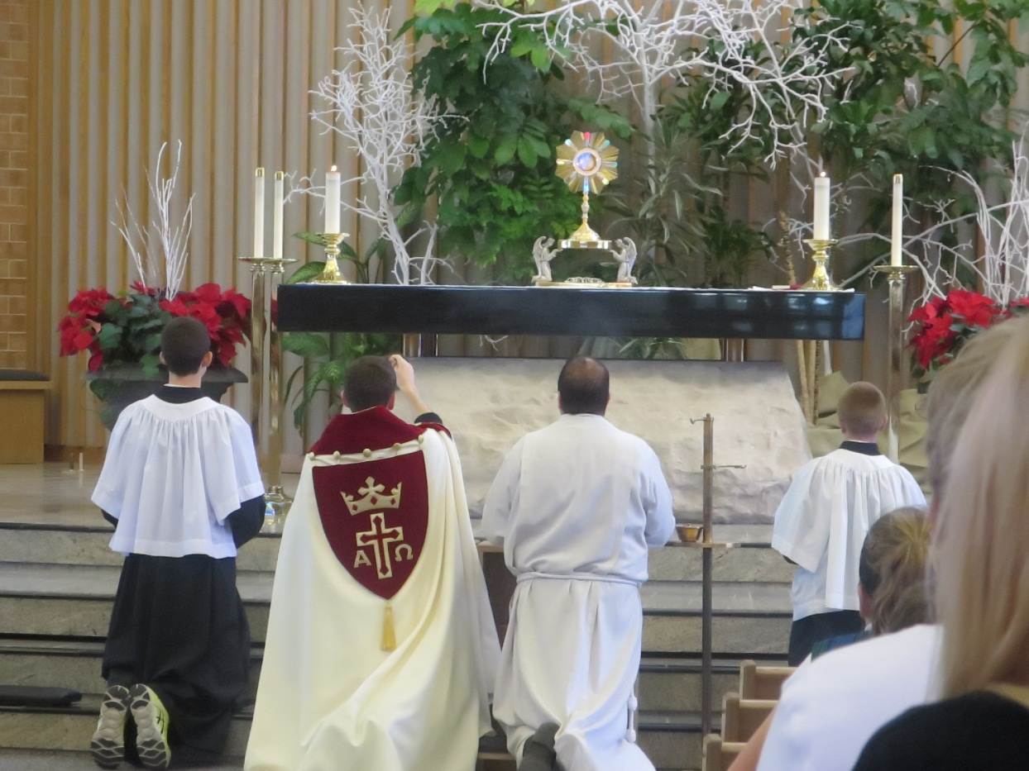
Benediction

Slide 6
How is Jesus with us?
  He is with us in Church in the Holy Eucharist, when we gather to prayer, when we read the Bible, through the teachings of the Church, in the Sacraments, etc.
How is Jesus with us in a special way?
  He is with us in the Holy Eucharist
What is in the tabernacle?
  There are Consecrated Hosts in the Tabernacle.
How can you tell Jesus is in the Tabernacle?
  The Sanctuary lamp will be lit.
Is Jesus really in Church?
  Yes

Slide 7
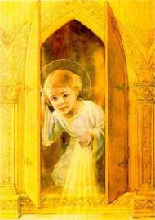
1. Jesus is with us in the sacraments and most especially in the Eucharist.
        2. Jesus waits for us to visit Him in the Blessed Sacrament; graces can be received by such visits.
  3. We are called to be reverent in the presence of the Lord. Such reverence includes church etiquette, such as genuflecting, silence in church, and devotion and attention at Mass.

Slide 8
When entering Church we should…
Before you enter your pew…
As you walk in Church
When Jesus is in the Monstrance
Walk Quietly
Make the sign of the Cross with Holy Water
Genuflect on both knees
Genuflect

