Slide 1
God is Offended
Chapter 5

Slide 2
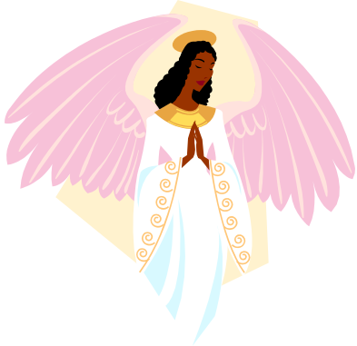
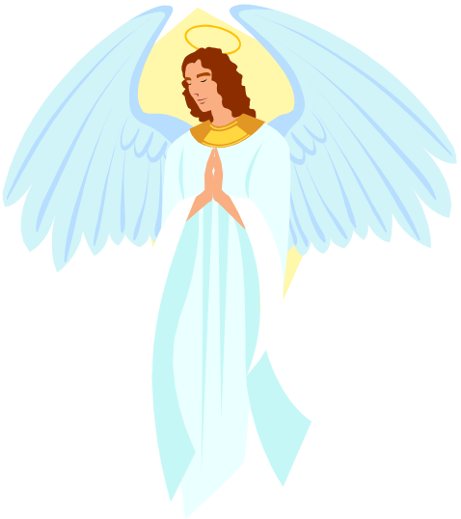
Angels
Pure spirits (no bodies)
Can think, choose and love
God created them in heaven before He created the earth
God gave them a test to see if they would love and obey Him
The smartest, strongest angel was Lucifer

Slide 3
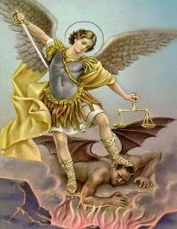

Angels
Lucifer thought he was just as good as God!
He did not want to obey or serve God
Other angels followed Lucifer
God sent them out of Heaven to a place called hell
St. Michael fought Lucifer to help send him out of Heaven
These fallen angels are called devils or demons

Slide 4
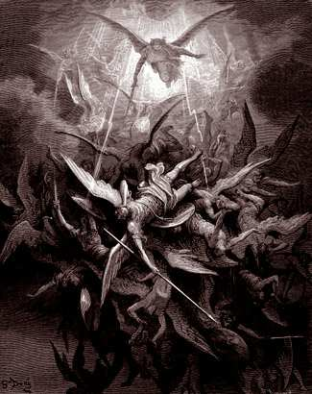
The
Fall of the
Angels

Slide 5
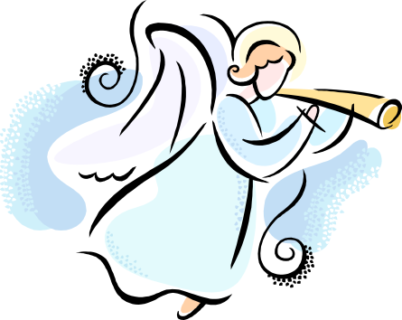
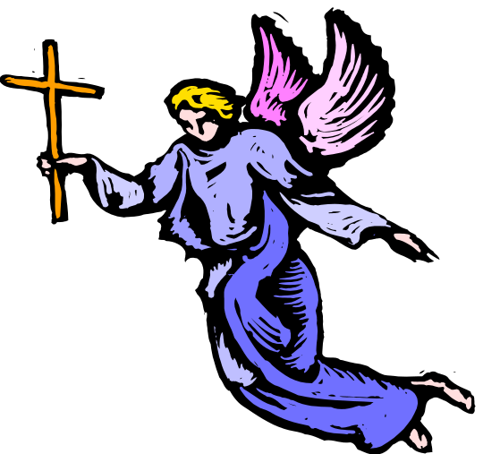
Guardian Angels
God created many angels
He gives each of us a special angel to watch over and protect us
Our Guardian Angel protects our
souls and sometimes our bodies
Our angels are with God in Heaven and with us at the same time!
We should love and thank our angels!

Slide 6

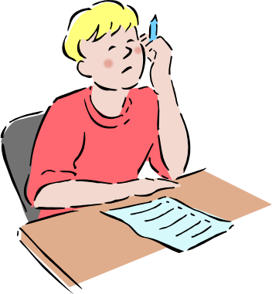
Tests
Why do we have tests?
  To remind us to study
  To show what we have learned
  To make us smarter
Why does God give us tests?
  To remind us to study
  To show what we have learned
  To make us smarter
  To show if we love and obey Him

Slide 7
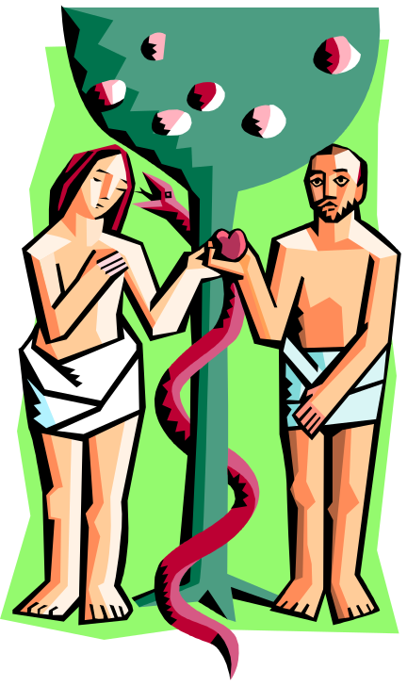
Adam and Eve
Remember, they were created…
God gave them many gifts (name some)
God gave them a test
  “You may eat from any of the trees of the Garden. Only the tree in the middle of the Garden, you shall not eat or you will die.”
Was it mean for God to give them this test?
What do rules do for us?

Slide 8

Original Sin
Is obeying God important? Why?
Tell the story of Eve and the serpent, then of Adam.
  Did the devil make them sin?
  Could they have said “No” to the devil?
Adam and Eve offended God—they sinned!
This first sin is called Original Sin

Slide 9
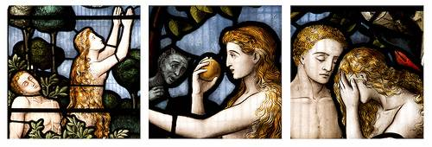
A snake told Eve to eat the forbidden fruit.
Eve ate the fruit and gave it to Adam to eat.

Slide 10
Effects of Original Sin
Before the Fall
After the Fall
were friends (never fought)
were happy all the time
had all the food they wanted
did not need to go to school to learn
were friends with all the animals
never got sick or hurt
would never die
had God talk with them
HAD GRACE!
Blamed each other (fought)
Were sad
Had to work hard for food
Needed to learn the hard way
Animals afraid of them
Got sick and hurt
Would die
God didn’t talk with them each day
LOST GRACE!

Slide 11
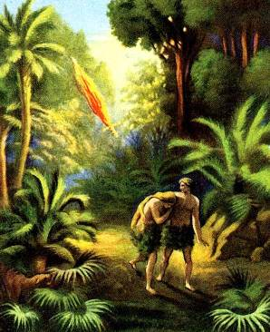
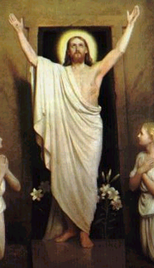
Adam and Eve had to
leave the Garden of Eden.
God promised to send a Savior.

Slide 12
St. Michael Prayer
Saint Michael the Archangel,
defend us in battle.
Be our protection against the wickedness and snares of the devil.
May God rebuke him, we humbly pray;
and do Thou, O Prince of the Heavenly Host -
by the Power of God -
cast into hell, Satan and all the evil spirits,
who prowl throughout the world seeking the ruin of souls. Amen.

