Slide 1
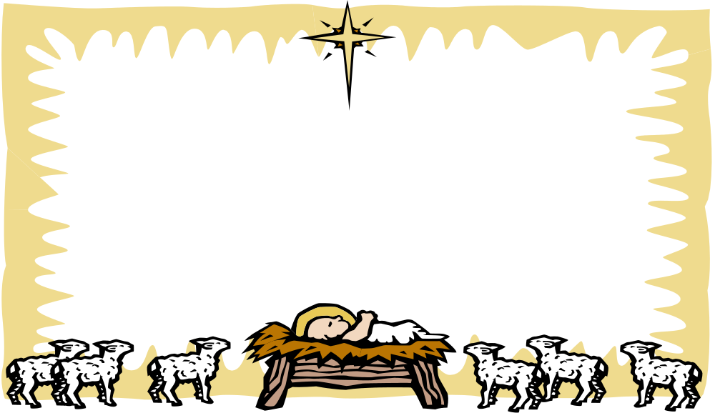
Obeying God Our Father
Chapter 7
God always keeps His promises

Slide 2
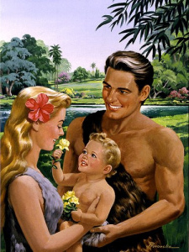
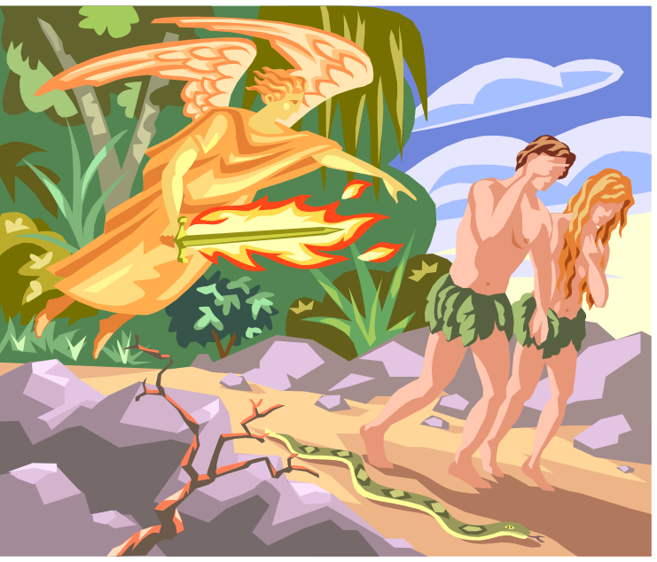
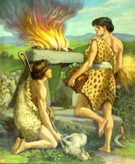
Adam and Eve

Slide 3
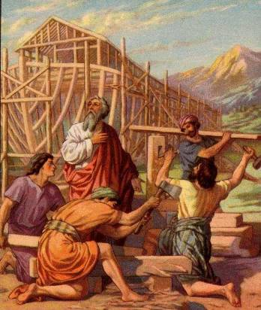
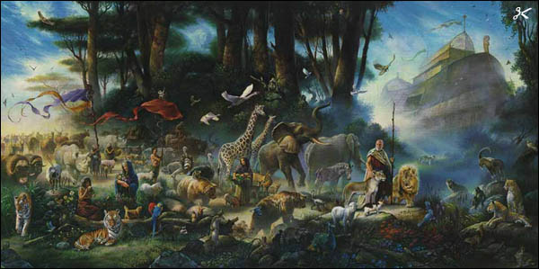
Noah
Noah responded faithfully when God asked Him to build an ark in order to save His creation.

Slide 4
Seth
Enosh
Noah was the 8th Generation after Seth!
Kenan
Mahalalel
Jared
Enoch
Methuselah
Lamech
Noah

Slide 5
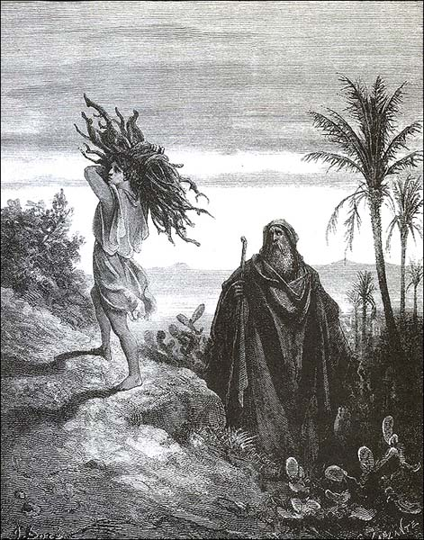
Abraham and Isaac
Abraham responded faithfully when God asked him to sacrifice his beloved son. God blessed him for his obedient love.

Slide 6
Parallels between Isaac and Jesus
Isaac
Offered by his father
Offered as a sacrifice
Carried the wood for the sacrifice
Offered on Mt. Moriah
Covenant was made
Jesus
Offered by God the Father
Offered as a sacrifice
Carried the wood of the cross
Mt. Moriah is on Calvary
New and everlasting covenant was made

Slide 7
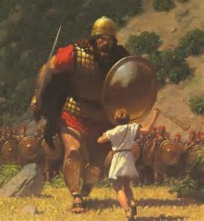
David
God called David to be the king of His nation. David fought Goliath and became king.

Slide 8
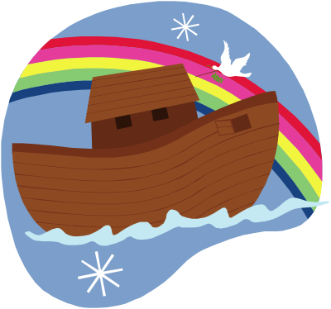
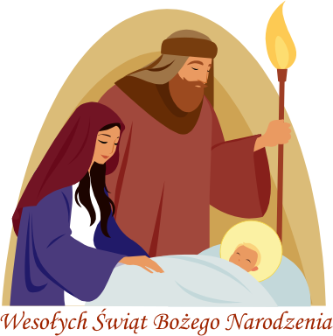
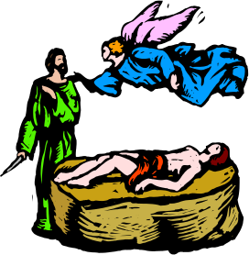
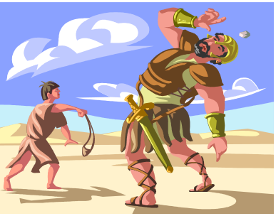
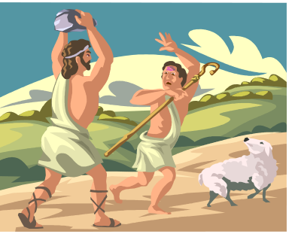
Adam and Eve
Abraham and Isaac
David
Jesus
Noah

Slide 9
Person
Adam
Eve
Noah
Abraham
Isaac
Goliath
Event
Father’s only Son
Wanted to fight
Named the Animals
Built an Ark
Was sad because no children
Tricked by snake

Slide 10
____________ God promised him a large family. He
loved God so much he would even give up his son.
____________ God asked him to build the ark.
____________ A child of God.
____________ He offered God his very best. His brother
was jealous of him and killed him.
____________ A shepherd boy who became a king and
defeated a giant.
____________ He was the son of very old parents:
Abraham and Sarah.
____________ She was the wife of Adam.
____________ He was the first Man, and ate the
forbidden fruit.

Slide 11
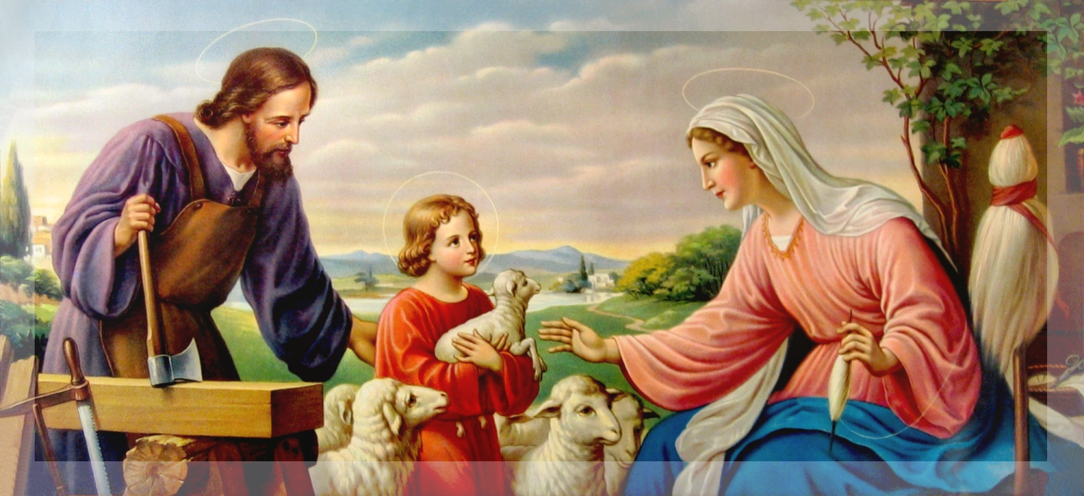
Holy Family
Mary, Joseph, and Jesus are descendants from the family of David.

