Slide 1
God Made Us
Chapters 4

Slide 2
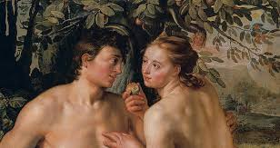
Adam and Eve
God made the first man and woman.
They were named Adam and Eve.
Adam and Eve had original justice.
They were completely happy.

Slide 3

The Garden of Eden
Adam and Eve…
  were friends (never fought)
  were happy all the time
  had all the food they wanted
  did not need to go to school to learn
  were friends with all the animals
  never got sick or hurt
  would never die
  had God talk with them

Slide 4
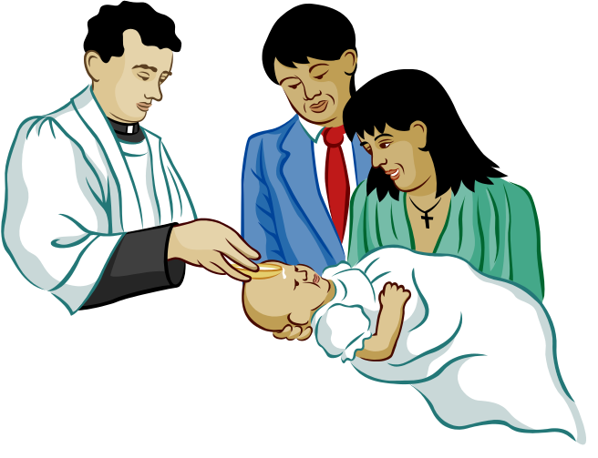
Grace
Best of all, Adam and Eve had…
A share in God’s life!
When did we first receive a share in God’s life?
  Baptism
Grace

Slide 5
God made us to know him.
Study religion
Pray
Go to Mass
Read the Bible
Read about the saints’ lives

Slide 6
God made us to love Him
Keep the Commandments
Receive the sacraments
Make sacrifices
Praise and Thank Him
Pray
Do everything the best that you can for God!

Slide 7
God made us to serve Him
Help your neighbors
Do good works
Share your love for God with others
Teach others about Jesus by your example
Clean Church
Help at Mass
Help your family
Homework: Think of one way you can know, love, or serve God and do it by tomorrow!

Slide 8


