Slide 1
The Christ Child is Born
Chapter 15
God chose Mary to play a special part in His plan to save humankind. Mary’s “yes” to God allowed Him to become man (Jesus) in order to save us from sin.

Slide 2
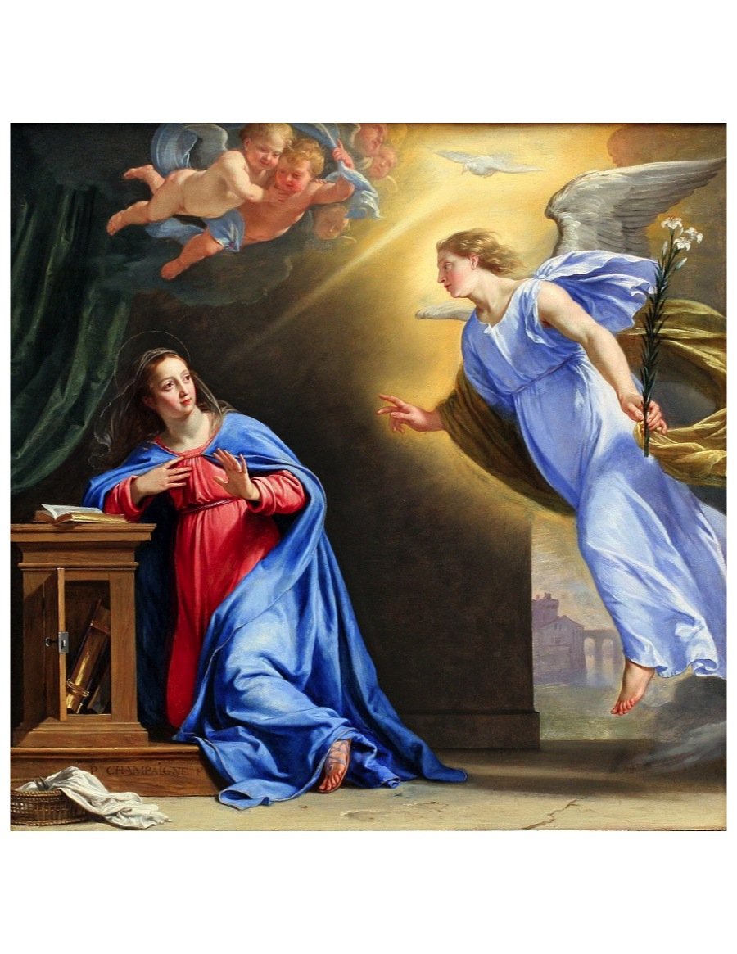
The Annunciation
The Annunciation is when God, through the angel Gabriel, invited Mary to be the mother of His Son
Notes:
Who is the woman in the picture?
Who is the angel? (Gabriel)
Gabriel told Mary of God’s plan to save the world from sin.
“Hail Mary, full of grace. The Lord is with thee!”
Explain that Mary was young and confused how it was possible that she would have a baby, since she wasn’t married yet.
Who does the dove represent? (Holy Spirit- 3rd person of Trinity)
This is called the Annunciation

Slide 3
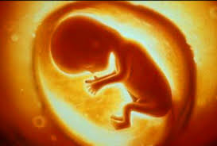
The Annunciation
Mary said “Yes” and conceived by the power of the Holy Spirit, yet remained a virgin. Jesus did not have a human father (Joseph is his foster-father).
This was the beginning of Jesus’ human life.
God becoming human in order to save mankind is called the Incarnation.

Slide 4
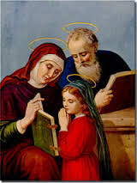
Immaculate Conception
Remember conception means the very beginning of a person’s life.
The Immaculate Conception was when Mary was conceived in the womb of her mother.
From the first moment of her life, Mary was free from Original Sin.
Activity: Cups and dirt
Mary with her parents, Anne and Joachim

Slide 5
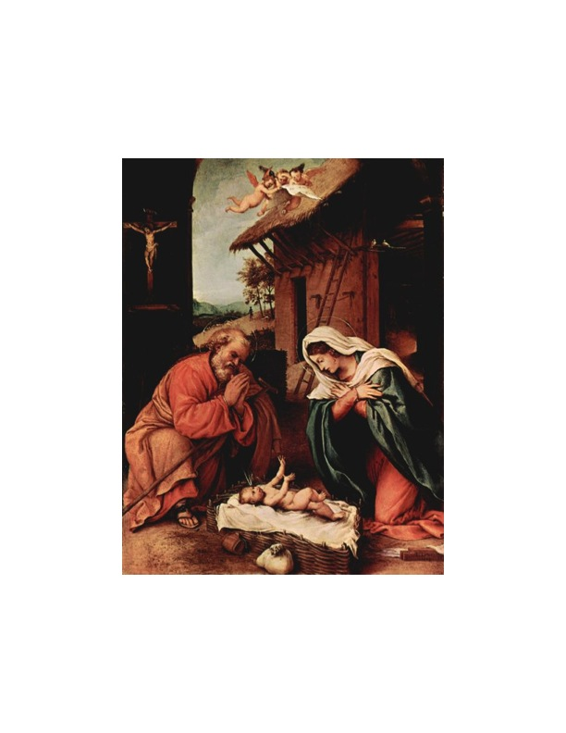
Jesus is Born!
On what special day do we celebrate Jesus’ birthday?
  Christmas
Notes:
Discussion questions:
Where was Jesus born? Jesus was born in a stable in Bethlehem.
Did he have a lot of things? Were Mary and Joseph rich?
Why do you think God chose to come into the world in this way? He wished to be poor so he could teach us to be humble and not to try and find happiness in money and the pleasures of the world

Slide 6
Joseph
Joseph is the foster father of Jesus. Joseph took Mary to Bethlehem, where Jesus was born in a manger.
Because there was no room at an Inn, Jesus was born in a stable.

