Slide 1
The Promise of a Savior
Chapter 4
Adam and Eve fell from God’s grace (Original Sin) and passed this sin on to all people. However, God promised a savior, Jesus, who died for our sins so we could go to heaven. We receive this grace (God’s life in us) through Baptism.

Slide 2
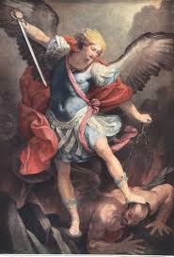
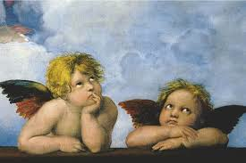
Angels
What do you know about angels?

Slide 3
Messengers of God
“Angel” means messenger
God created angels. Some of the angels refused to serve God and became evil.
Some important angels:
  Michael- led the battle against the angels who chose not to serve God (Lucifer).
  Raphael- helped Tobias meet his wife and heal his father.
  Gabriel- told Mary she was chosen to be the Mother of God.

Slide 4
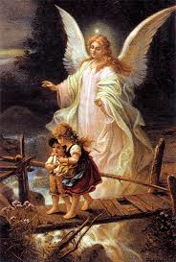
Guardian Angels
Every person has a guardian angel to protect them
Guardian Angel Prayer:
Angel of God, my guardian dear
to whom God’s love commits me here
Ever this day, be at my side
To light and guard, to rule and guide.
Amen.

Slide 5
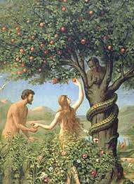
The Fall from Grace
Genesis 3: The fall of man.

Slide 6

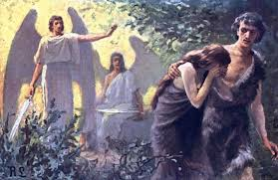
Life in the Garden of Eden
BEFORE SIN:
AFTER SIN:
  perfect weather
  beautiful surroundings
  they got along with one another and the animals
  they knew everything they needed to know
  no sickness or death
  God walked with them in the garden
weather destroyed crops
they started blaming each other
they hid from God because they were afraid
they had to leave Paradise
pain and suffering entered the world
they lost grace; their relationship with God was hurt

Slide 7
After the Fall
Because of Adam and Eve’s sin, all people inherited Original Sin.
They had grace (a share in God’s life), but they lost it when they chose to disobey God.
We need grace to be able to go to Heaven.
So how do we receive grace again? How is our relationship with God restored?

Slide 8
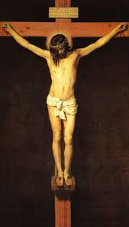
The Promise of a Savior
Even though Adam and Eve sinned, God promised to send a Savior.
The Savior is Jesus!
Jesus died on the
cross to save us from
sin and death.
He died to win
Heaven for us, so that
we could be with God again.
Grace is a gift. It is given to us because God loves us.

Slide 9
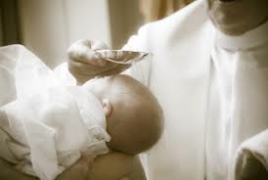
Baptism
Baptism is the sacrament Jesus gave us so we can have the life of grace He won for us on the cross.
What happens at a baptism?
What have you seen?

Slide 10

The water used at baptism is a sign of what is happening in our soul: Original sin is washed away and God’s grace is poured back into the soul.
We receive the grace we need to get to Heaven.
We become part of God’s family.

Slide 11
Can we lose grace again?
Sin causes us to lose grace; we hurt our friendship with God.
We have free will, which means we can choose to obey and follow God’s plan, or we can choose not to.
Activity

