Slide 1
Abraham- The Father of God’s People
Chapter 5
God used Abraham to help prepare His people for the coming of the Savior. He called Abraham to leave his homeland in faith, He tested His obedience, and He rewarded him with many blessings.

Slide 2
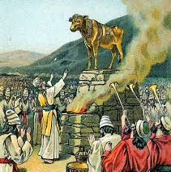
Waiting
Don’t open the gift on your desk! Wait for permission.
Waiting can be difficult. After the Fall, when Adam and Eve sinned, people had to wait a long time for the coming of the Savior.
Many of them got tired of waiting and began to worship false gods.

Slide 3

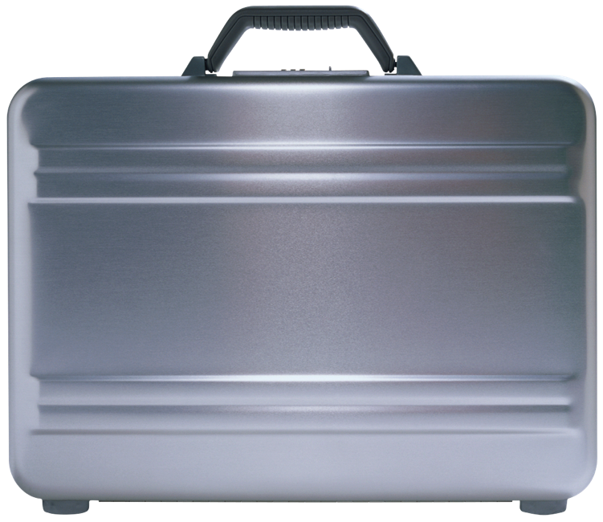
A Call and a Promise
God called Abraham to leave his homeland in faith, and promised that his descendants would live in the land of Canaan.
Imagine that God has asked you to pack up and leave your home to move to a new country. How would you feel? What would you take with you, and why?
???

Slide 4
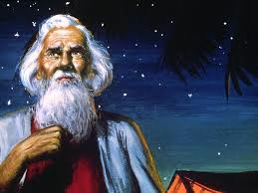
Father of Faith
God gave Abraham the great gift of faith. Because Abraham trusted God, he did what He asked. He moved with his family to the faraway country of Canaan.
But Abraham was worried because he and his wife, Sarah, were old and did not have any children.

Slide 5
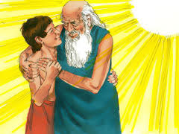
Isaac
God made Abraham and Sarah wait for a child, but He eventually blessed them with a son, Isaac.
Abraham loved Isaac very much!

Slide 6
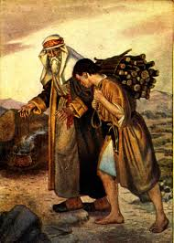
Abraham’s Test
One day, God tested Abraham’s faith and obedience. He told Abraham to offer his son, Isaac, as a sacrifice.

Slide 7
Discuss
What would you have done if you were Abraham?
Did God really want Abraham to kill his son?
God might ask you to give up something you love or want in order to follow Him.
  What are some examples of sacrifices God calls us to make every day?
  God rewards those who obey Him in faith, like Abraham.
  You may now open and enjoy your gift!

