Slide 1
Loving God Most of All
Chapter 9
The first and second commandments help us love God above anything else, and use His holy name with love and respect.

Slide 2
Discuss:
Why do you love God?
Can you ever love Him too much?

Slide 3
Let’s review what we know about God.
    God is…
    Eternal (make circles with index finger)
    All Perfect (thumbs up)
    All Powerful (flex biceps)
    All Beautiful (hands frame face)
    All Holy [All Good] (make halo above head)
    All Loving (hands over heart)
    All Knowing (touch head)
    All Merciful (sign language: I’m sorry)

Slide 4
The First Commandment
The first commandment tells us not to put anyone or anything above God.
Read the first three paragraphs on p. 45
Discuss: What are some reasons we should love God more than anything else?
Remember why God made you! We are created to know, love, and serve God in this world and to be happy with Him forever in the next.

Slide 5


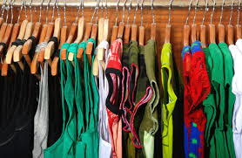
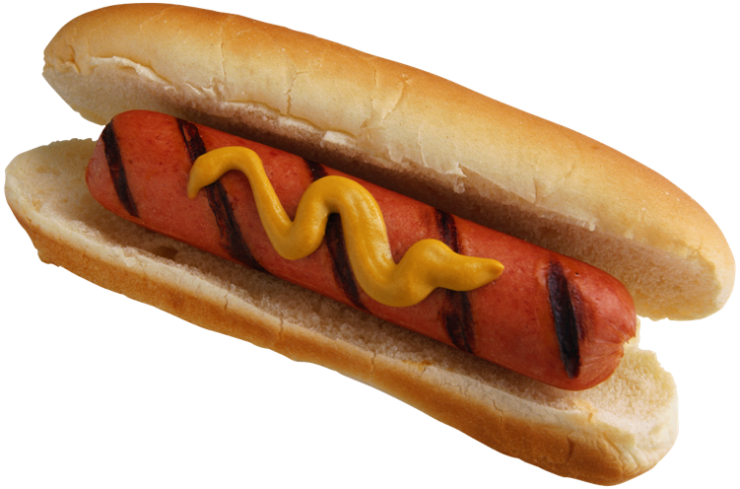

False “gods”
Read the last paragraph on p. 45
Activity: Look through the magazines and newspapers on your desks and find 1 or 2 examples of a false god: something people might put in the place of God.
Explain how it could be a false god, and how it is supposed to be used.
Some examples of false gods or things people are tempted to put above God are money, clothes, toys, friends, and pleasure.

Slide 6

Superstitions
Superstition is believing that created things have powers that they don't truly possess.
Example: Tina believes that if you break a mirror, you’ll have seven years bad luck.
What is a superstition you know of?
Why is believing these things not good for us?

Slide 7
The Second Commandment
The second commandment tells us to speak about God in a reverent way.
Names are important. Saying God’s name gets His attention and brings His presence.
Read textbook p. 47, paragraph 3-5
Saying God or Jesus’ name when we are surprised or angry are ways of breaking the Second Commandment.

Slide 8
God’s name
The way we address someone tells about the relationship.
What do you call your parents? Your friends’ parents?
Jesus taught us to call God “father” or “daddy.” (Mt 6:9-13)
God wants us to be close to Him, because we are His children!
Let’s pray in the way Jesus taught us, calling God our father. Our father…

Slide 9
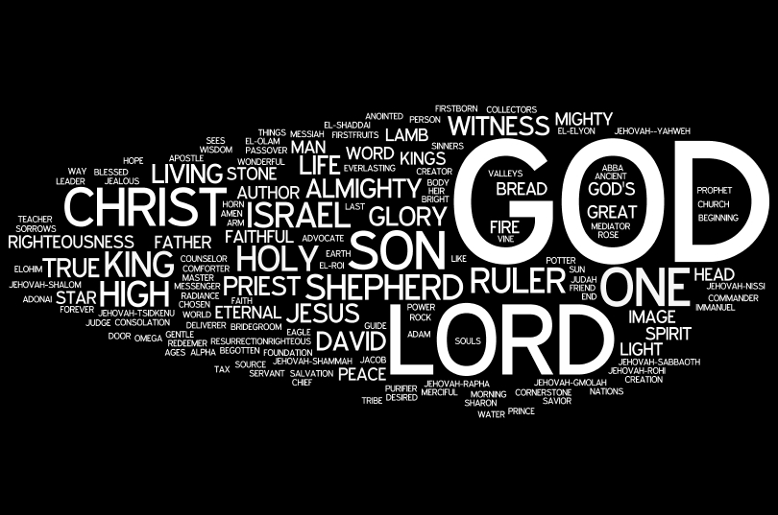
Video: Holy God, We Praise Thy Name
https://www.youtube.com/watch?v=TVBQYnfkiBM

