Slide 1
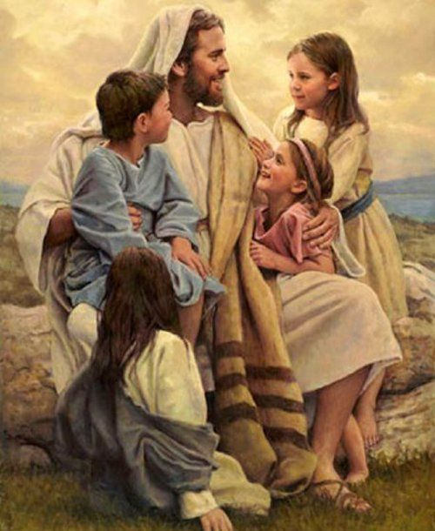
3rd Grade
Chapter 1
God Loves Us
God Loves Us

Slide 2

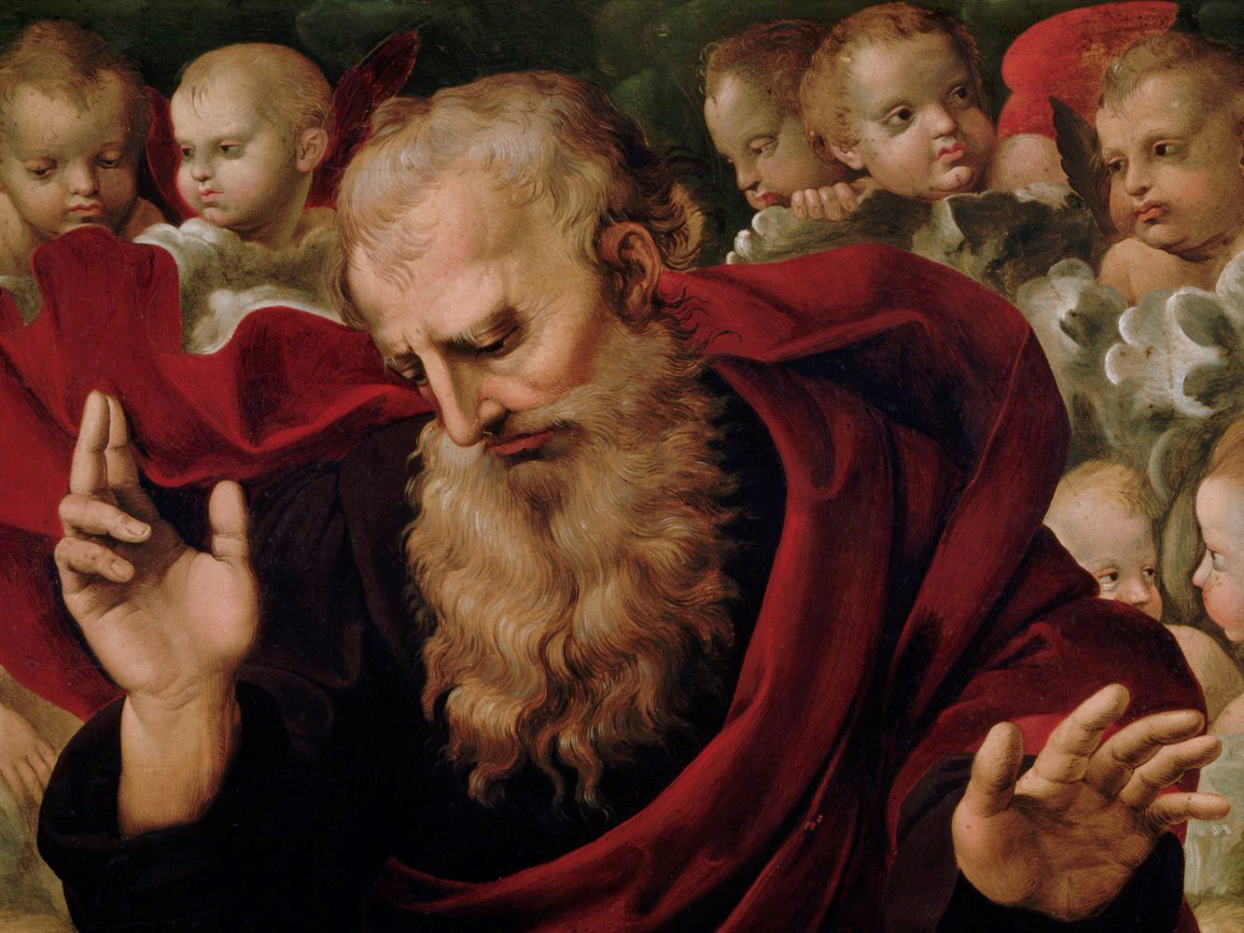
Lesson 1 – Who is God?
The attributes of God are His perfections.

Slide 3
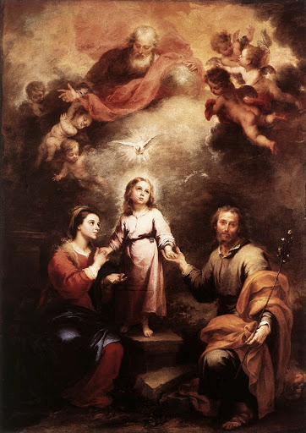
Who is God?
God is perfect in every way.
We call these perfections His attributes.

Slide 4
Attributes of God
God is…
Almighty-more powerful than everything
All Holy-all good and worthy of worship
All Wise-All creation works together according to God’s plan
All Perfect-better than all things
All Loving-always does what is best for us
All Merciful-always ready to forgive us when we sin

Slide 5

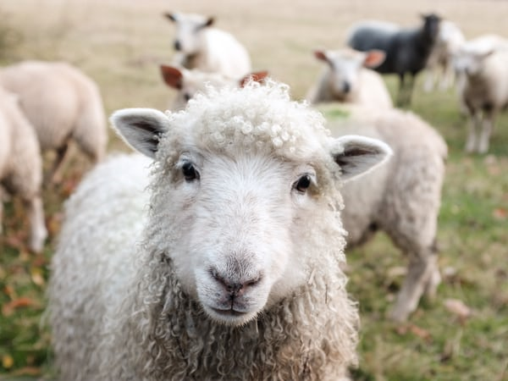
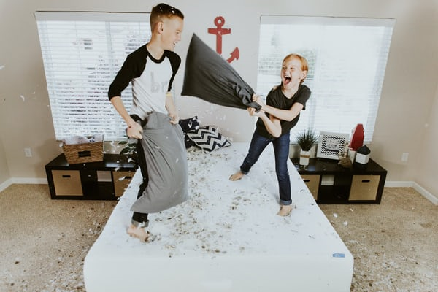
God Creates
God made everything on the earth.
YOU!
Animals
Plants

Slide 6
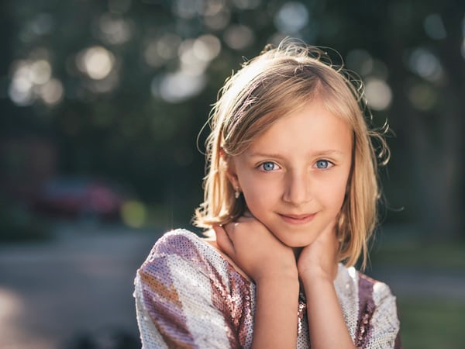
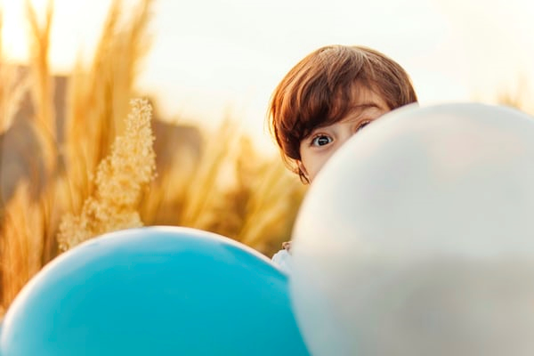
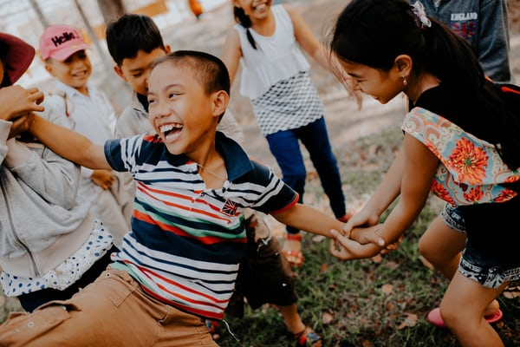
God Creates
Every person on earth us unique and unrepeatable.
There will NEVER be another person just like YOU.

Slide 7

God Creates
God made you because He loves you.
You are created from the love of God the Father.

Slide 8
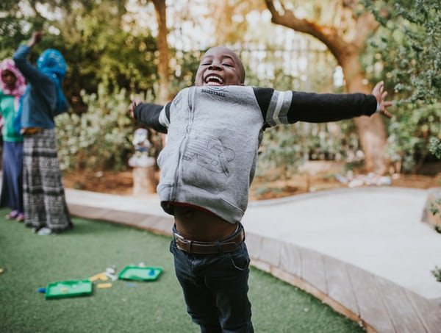
God Creates
God never stops loving you.
He gave you free will so that you can choose to love Him in return.

Slide 9
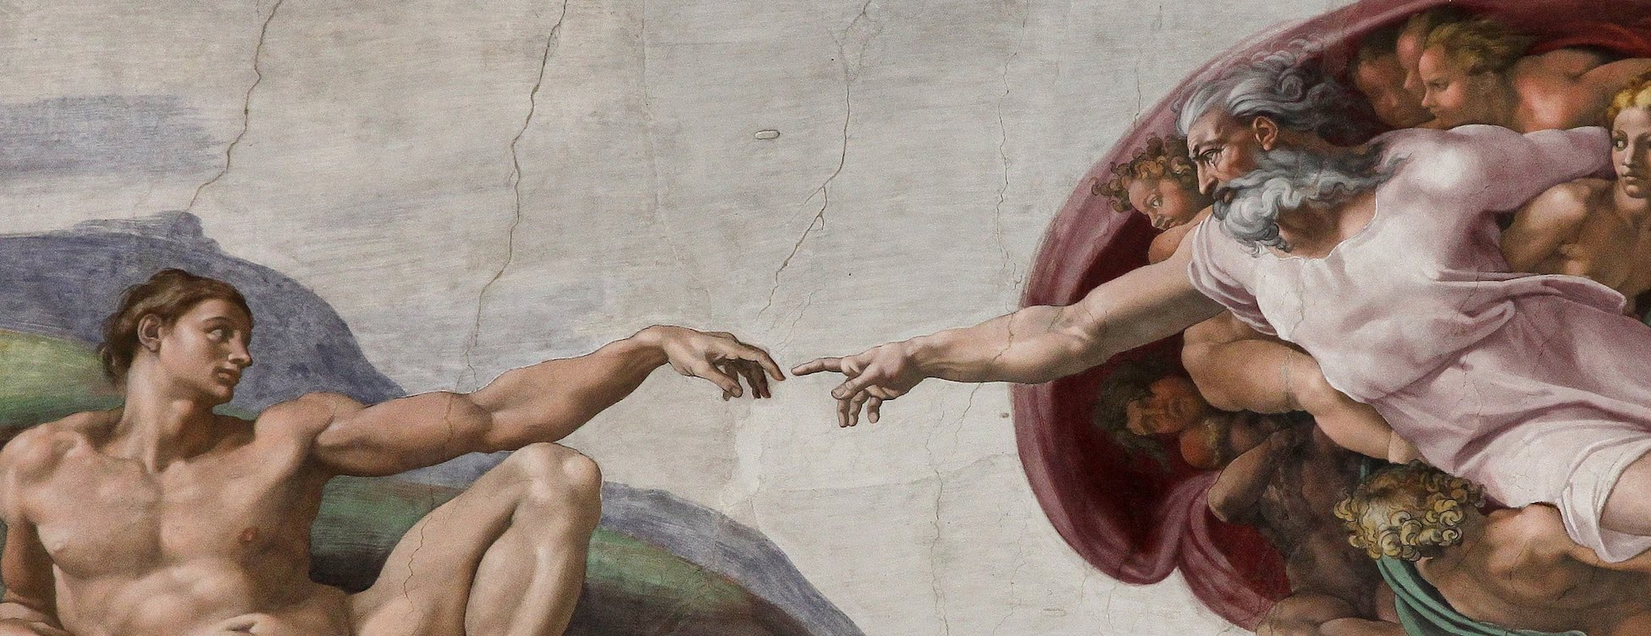
Lesson 1 - Covenant
Lesson 2 – God Made Man
God created people, out of love, to know, love, and serve Him.

Slide 10
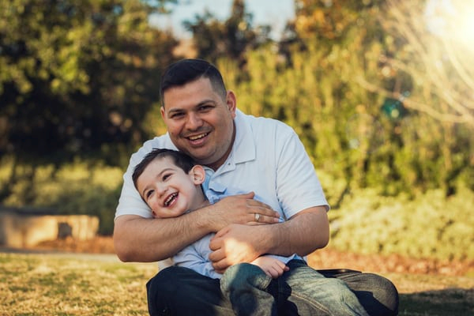
Who is God?
God is our loving Father.
He is a pure spirit.
He is always faithful and always cares for us.
God always keeps His promises!

Slide 11
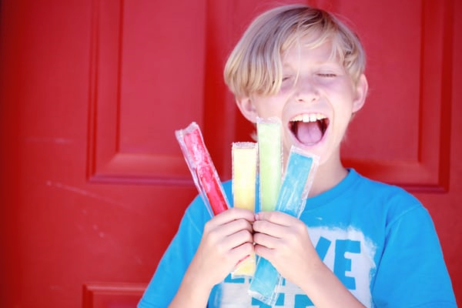
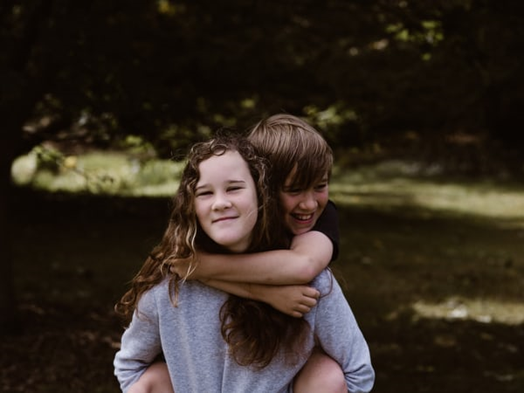
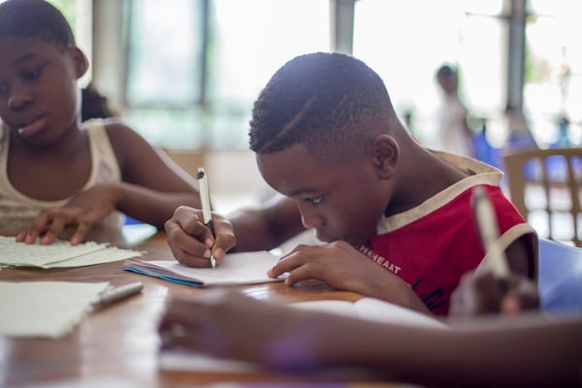
We were created by God
God created all people in His image and likeness.
We have a body and a soul. Our soul gives life to our body.
Our souls were made to…
THINK CHOOSE LOVE

Slide 12
Free Will
God made people to know, love and serve Him.
We do this by choosing to do what is good and not doing with is evil.
If we do this we will be happy on earth and also live forever with God in heaven.

Slide 13
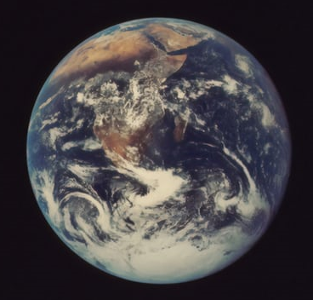
God is real!
By looking at the world around us, we can tell that God is real.
The plants, animals, and planets prove that God created the universe.
The goodness in the people around us prove that God’s love is real.
The Saints prove that God wants us to be in Heaven.

Slide 14

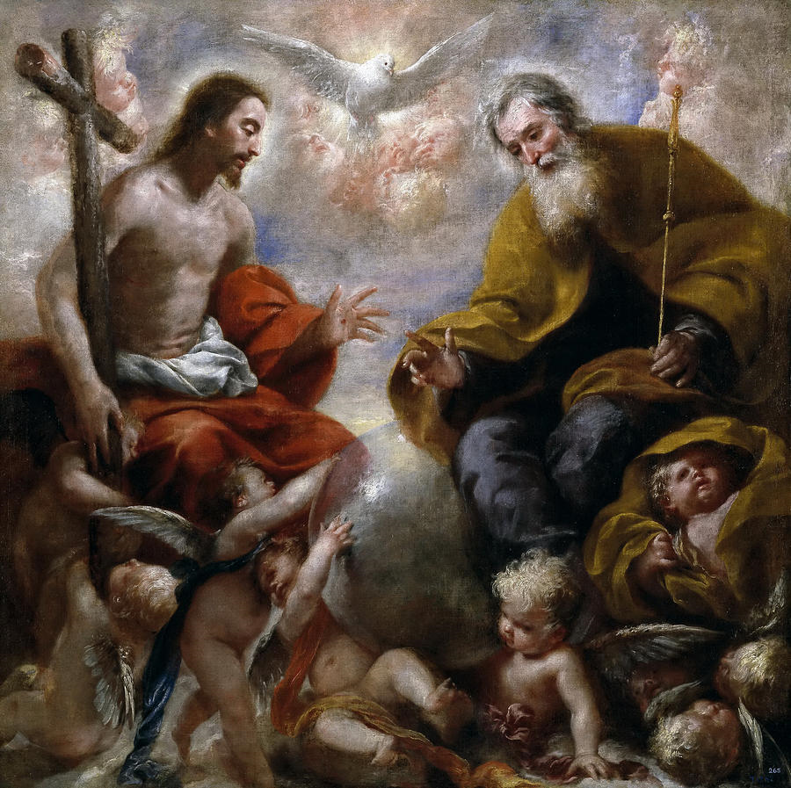
Lesson 3 – Knowing God
God is the Holy Trinity, which is three Divine Persons in one God

Slide 15
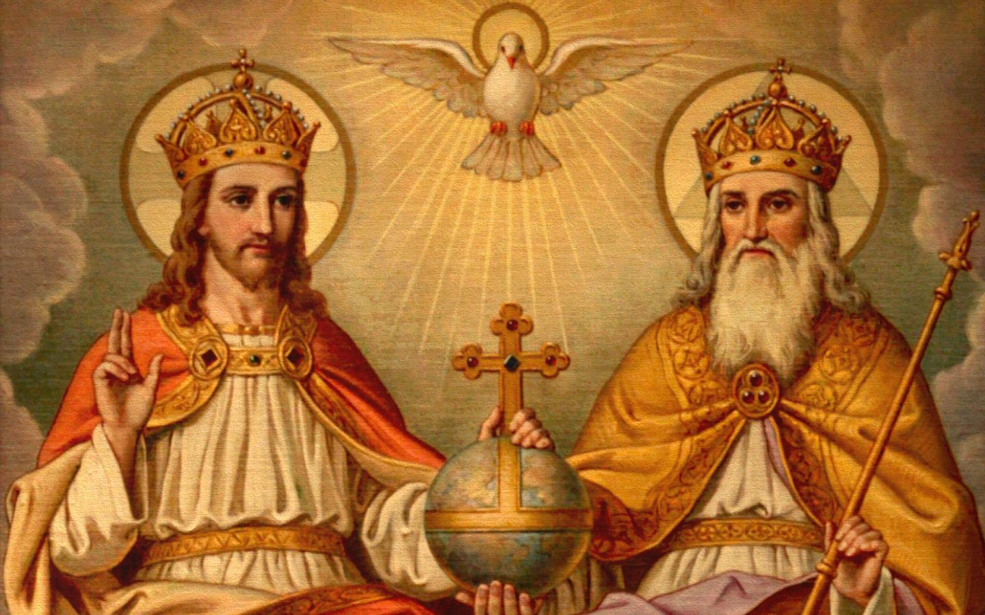
The Holy Trinity
The Holy Trinity-The mystery of three Persons in One God
This is the greatest mystery of the Catholic Faith.
God is: God the Father, God the Son, God the Holy Spirit
AND There is only ONE God.

Slide 16
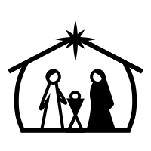


The Holy Trinity
Jesus is the second person of the Holy Trinity.
He became man, and died for our sins so that we could be with God forever in Heaven.

Slide 17
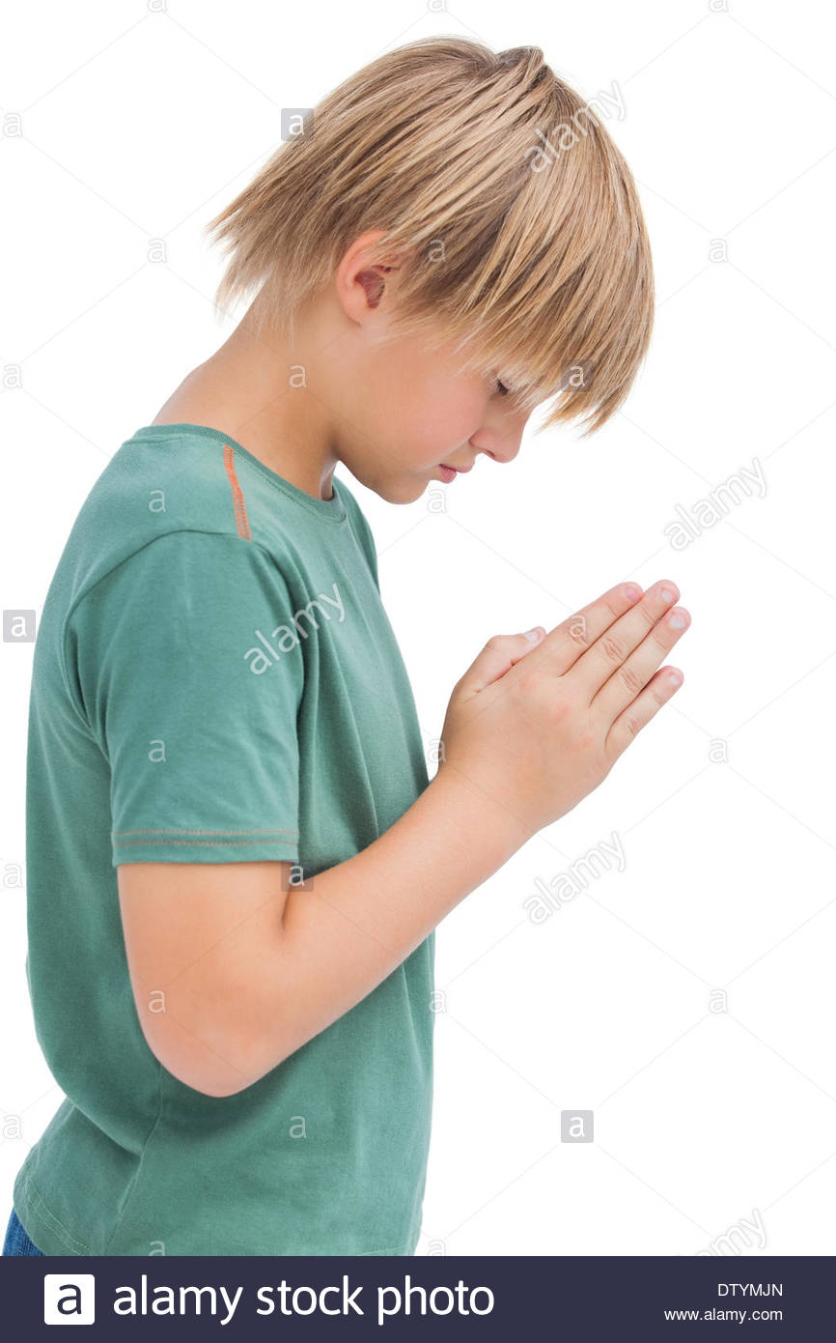
JESUS!
When someone does something kind for us, we should show them that we are grateful. When someone loves us, we should show them love in return.
Jesus did the greatest thing in the world for us and He loves you more than anybody ever could.
WAYS TO SHOW JESUS OUR LOVE AND GRATITUDE:
Bowing our head every time we say or hear His name
Only using His name in a loving way
Following His commandments and loving others

Slide 18
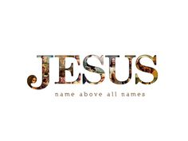
JESUS!
Jesus conquered Satan and even death. There is power in Jesus’ name!
The name of Jesus, when you say or think it in love, is a prayer.
The next time you are afraid or worried or angry, say the name of Jesus.
The next time you are excited or happy or grateful, say the name of Jesus.

Slide 19

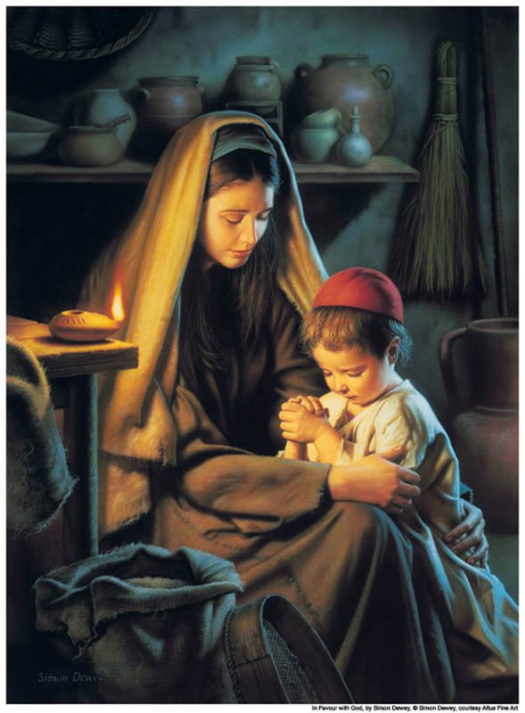
Lesson 4 – Teach Us to Pray
Prayer is raising our hearts and minds to God.

Slide 20
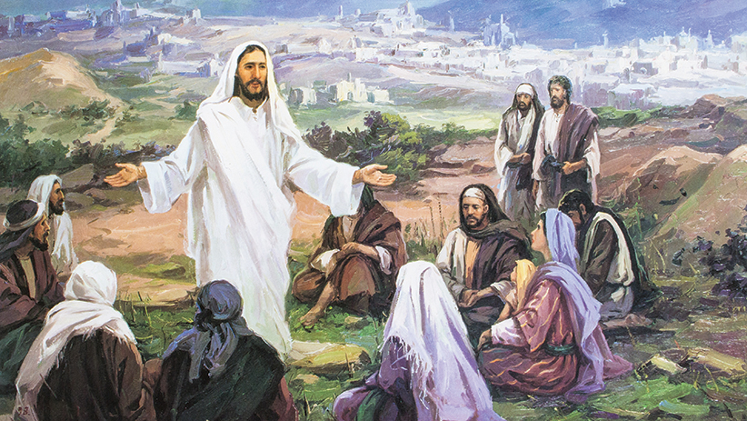
How did Jesus Pray?
Jesus’ disciples once asked Him to teach them to pray.
He then taught them the Our Father.

Slide 21

What is Prayer?
Prayer is raising our hearts and minds to God.
When we pray we talk to God and we listen to God.
Just like when you are with your friends. Sometimes you talk and sometimes you listen.

Slide 22
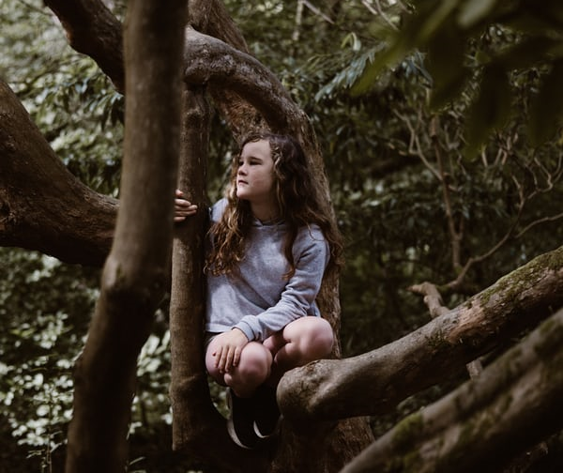
How do you pray?
Pray a memorized prayer: the Our Father, Hail Mary, Rosary
Talk to God about anything you’d like: Ask Him questions, ask for His help, thank Him for what He has given you.
It is OK just to sit quietly and be with God without saying anything. All you have to do is remember that He is right beside you and you are praying!

Slide 23
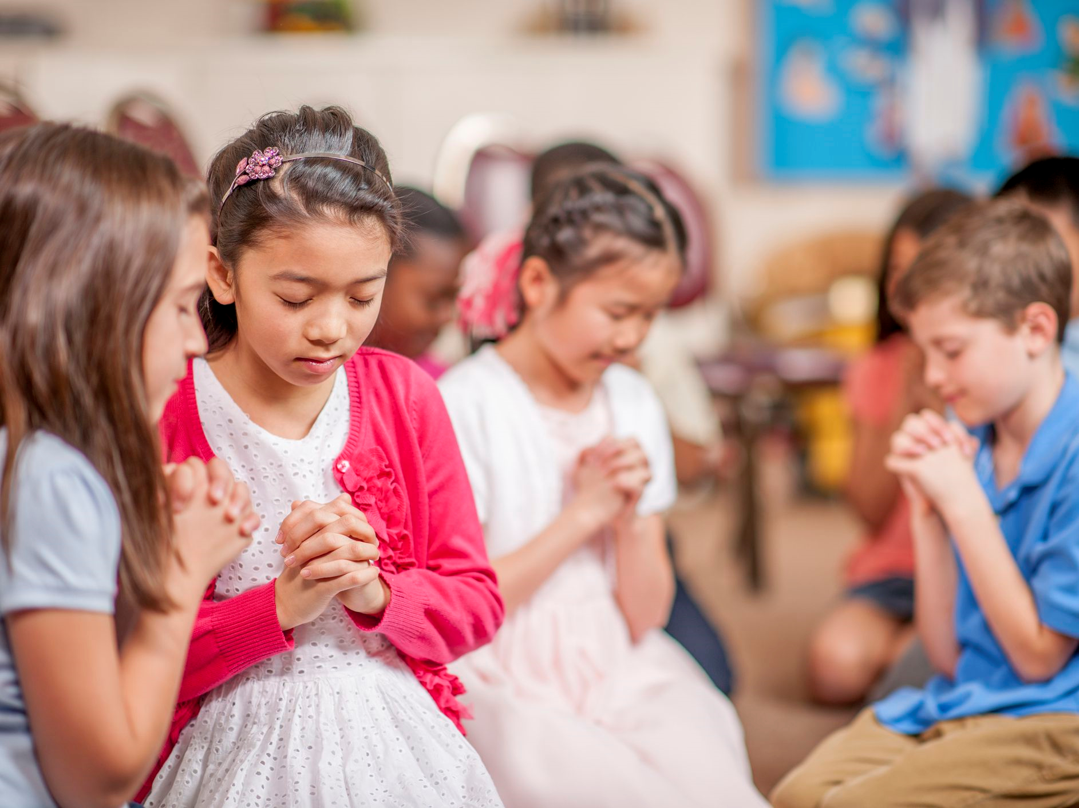
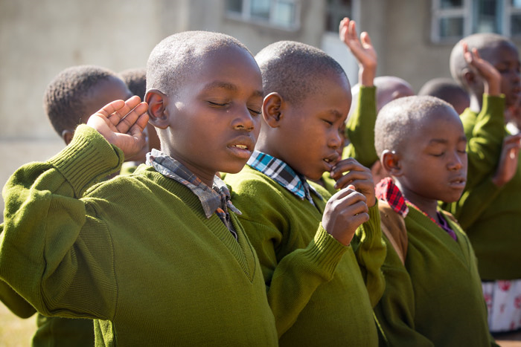
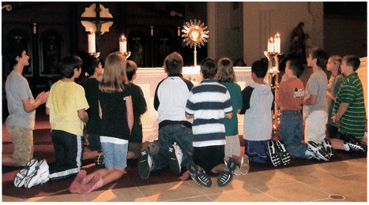
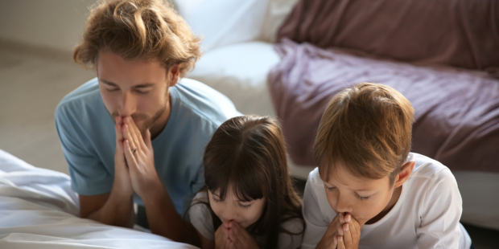
Using Our Bodies to Pray
HANDS-Folded or crossed, raised or on our lap
Kneeling-In a pew, by your bed
Standing-During mass or in the classroom
Genuflecting-Showing reverence for Jesus in the tabernacle
Prostrate-Bowing low to remember how powerful God is

