Slide 1
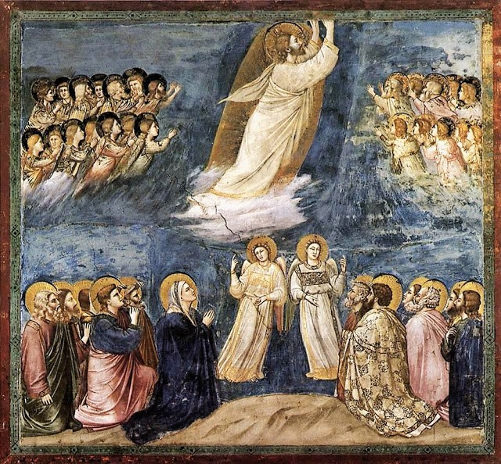
Jesus Rises in Splendor
3rd Grade
Chapter 25
Jesus Rises in Splendor

Slide 2

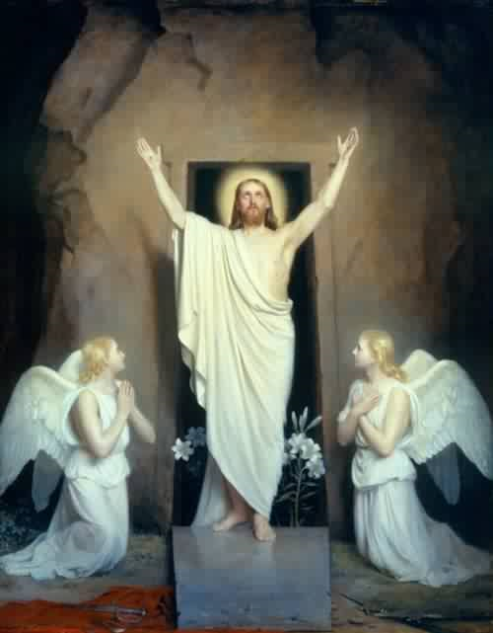
Lesson 1 – He Is Risen!
Jesus saved all people by His death and resurrection.

Slide 3
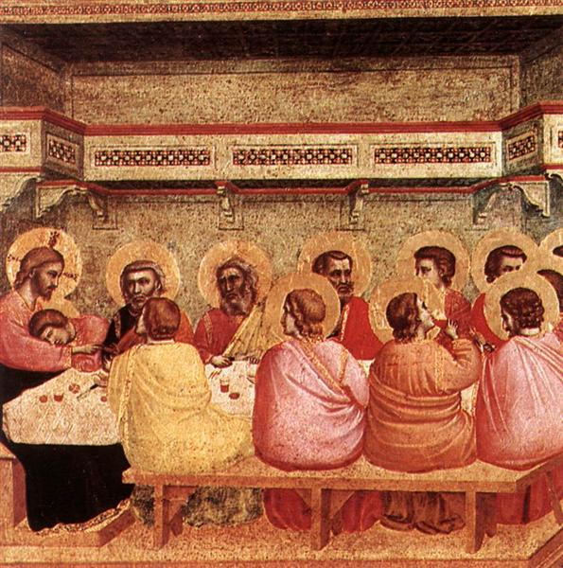
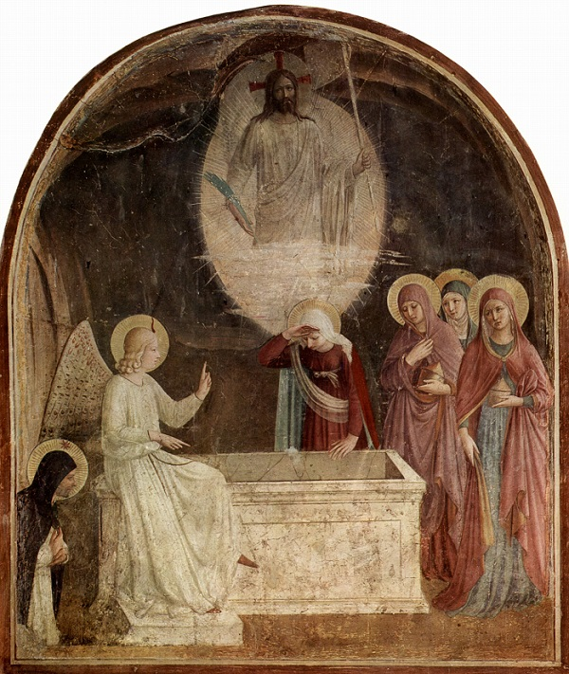
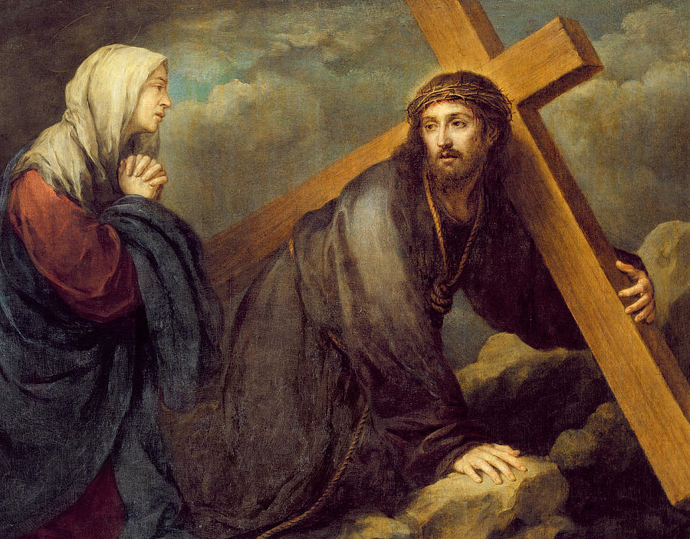
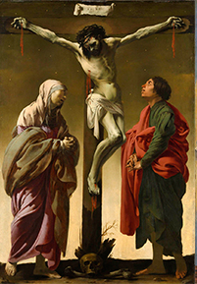
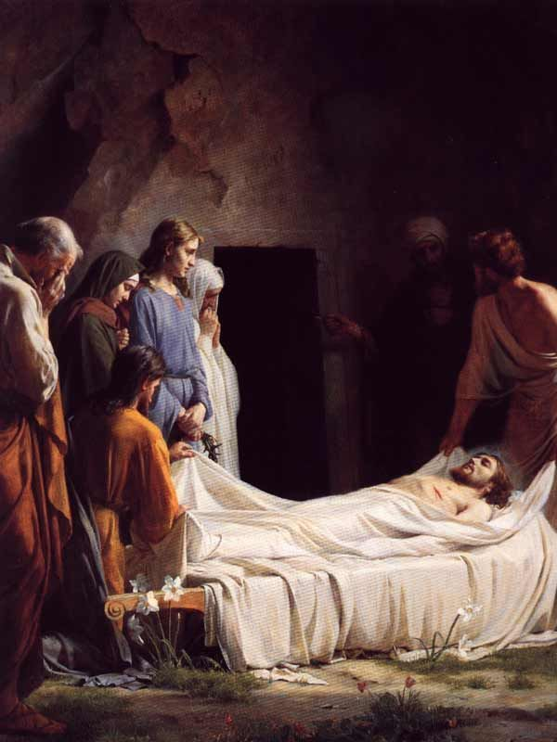
Events of the Paschal Triduum
Last Supper
Jesus Carries His Cross
Jesus Dies
On the Cross
Jesus is Buried
The Resurrection of Jesus
Holy Thursday
Good Friday
Easter Sunday

Slide 4
Jesus saved every soul through His death and Resurrection
Jesus’ death on the cross was a battle between good (love) and evil (sin).
When Jesus died on the cross, Satan thought that he had won the battle and destroyed good forever.
HE WAS WRONG!!!
Easter Sunday proves that the love of Jesus and His love for us is more powerful than any sin.

Slide 5
Jesus saved every soul through His death and Resurrection
On Easter Sunday, Jesus’ body AND soul came to life again.
His suffering and death on the cross were the punishment we deserve for our sin.
He took on our punishment and defeated death to show us the way to eternal life.
This is a BIG DEAL! So every Sunday is like a little celebration of the day Jesus conquered evil-Easter.

Slide 6
Jesus invites every Christian to share in His death and resurrection.
Every suffering, big and small, can be united to the suffering that Jesus experienced on Good Friday. If we do this, Jesus turns our sufferings into resurrections!
Suffering | Glory
Being made fun of | Reward in Heaven
Being sick | Suffering with Christ
Being punished for making a mistake | Gaining grace

Slide 7
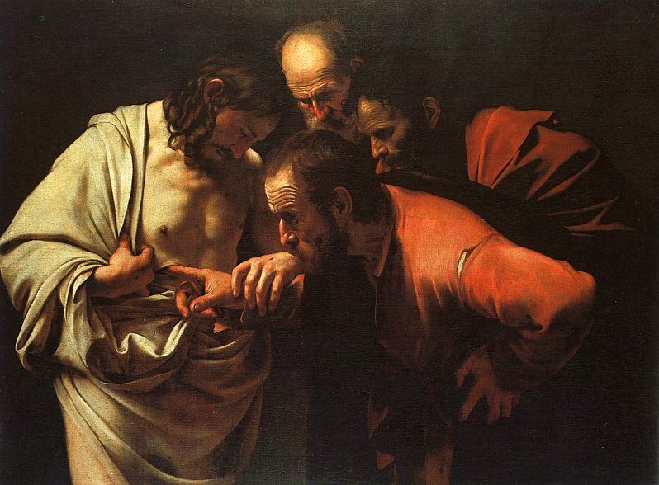
Lesson 1 - Covenant
Lesson 2 – Peace Be With You
Jesus appeared to the disciples after the resurrection and gave them peace.

Slide 8
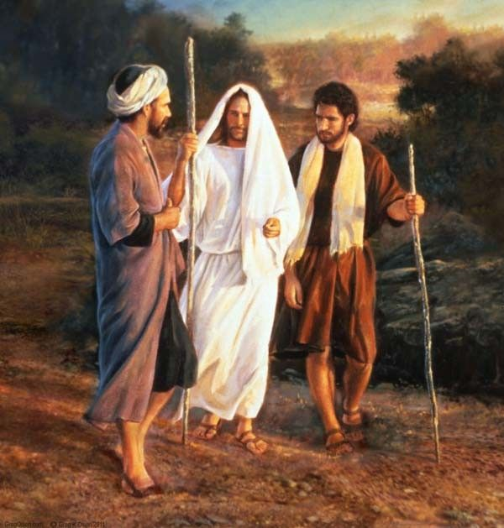
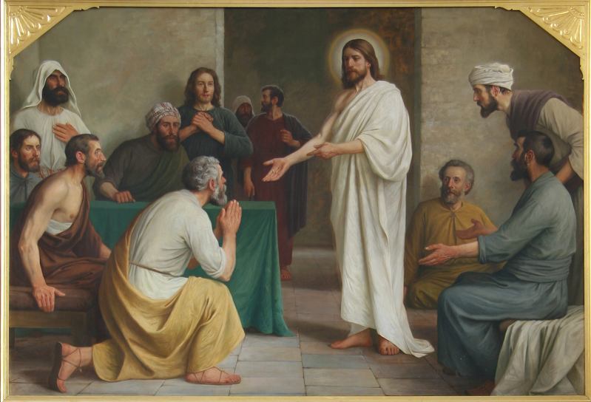
After His resurrection, Jesus appeared to His disciples
On the road to Emmaus
In the Upper Room

Slide 9

After His resurrection, Jesus appeared to His disciples
They were afraid because they thought He was a ghost.
To prove He was totally alive, He said, “Peace be with you.”
He also ate and drank with them.
Thomas didn’t believe that He was real, so Jesus had Thomas touch the nail marks in His hands and side.
Then Thomas believed!

Slide 10
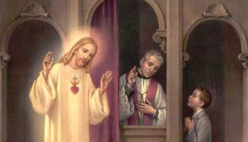
After His resurrection, Jesus appeared to His disciples
Jesus also gave His disciples the power to forgive sins.
All our sins can be forgiven because Jesus died on the cross and rose again. Only Jesus has the power to forgive sins. He gave this power to His disciples and still gives it to bishops and priests today.

Slide 11

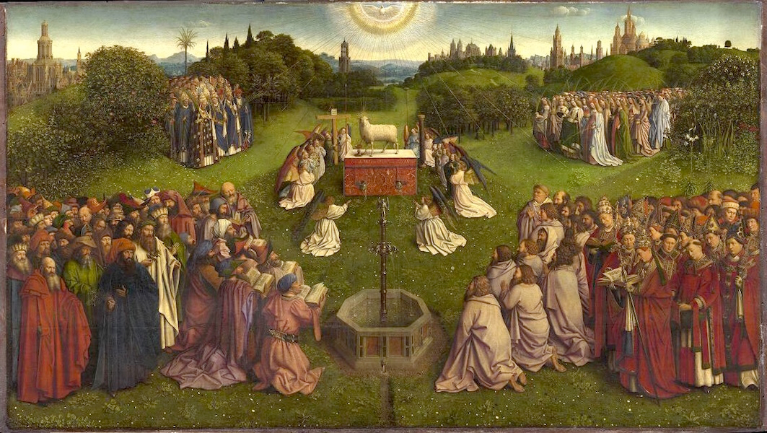
Lesson 3 – Life Everlasting
The suffering and death of Jesus lead to everlasting life.

Slide 12
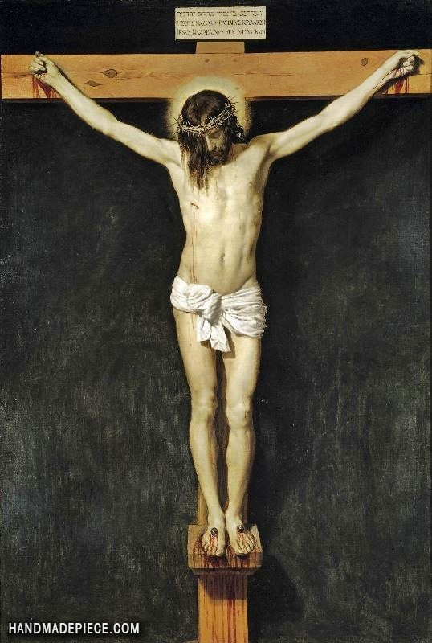
Jesus’ suffering lead to everlasting life.
Jesus CHOSE to suffer and die on the cross.
Jesus’ suffering and death lead to eternal life, like a door leads into the next room.
The cross is our doorway into heaven.

Slide 13

Easter Sunday is a happy day.
On Easter Sunday, and every Sunday we rejoice because:
-Jesus took the punishment we deserve for our sins
-All our sins can be forgiven
-Jesus defeated death once and for all
-He made the doorway for us to go into heaven with Him forever.
-He did all of this because HE LOVES YOU!
All of this is called the “Good News” and we want to share this with everybody.

Slide 14
Everybody dies
Even though Jesus conquered death, everyone must still leave this life.
Death-When your body and soul separate.
Your body dies and your soul lives forever!
Judgement-Each person is judged by God on how much they loved God and others during their time on earth.
Heaven-Everlasting union with God
Hell-Everlasting suffering and separation from God
Purgatory-Time when a soul is purified because it is headed for heaven but not ready to go quite yet.

Slide 15

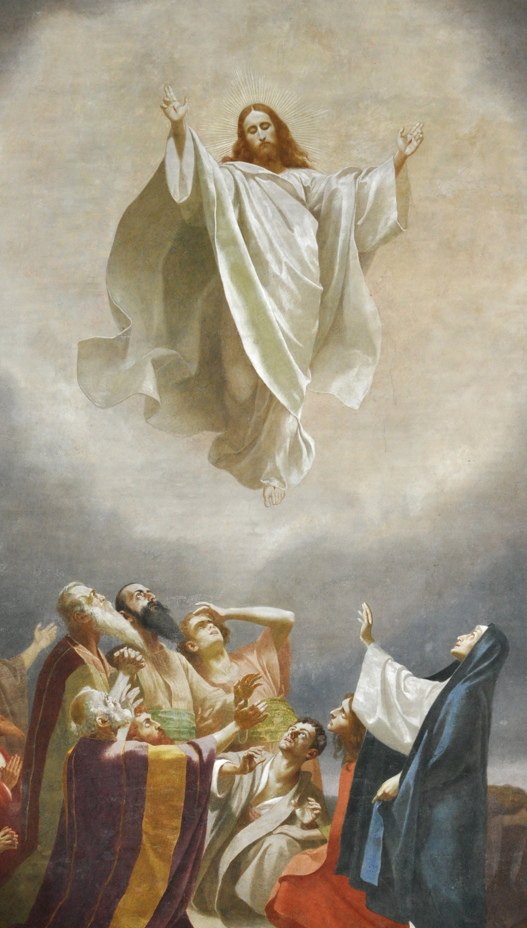
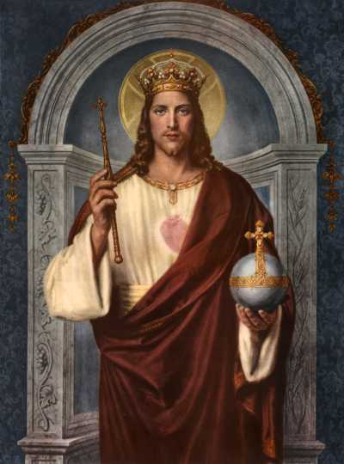
Lesson 4 – Forty Days
Forty days after Easter, Jesus ascended into Heaven to begin His reign as King of Heaven and Earth.

Slide 16
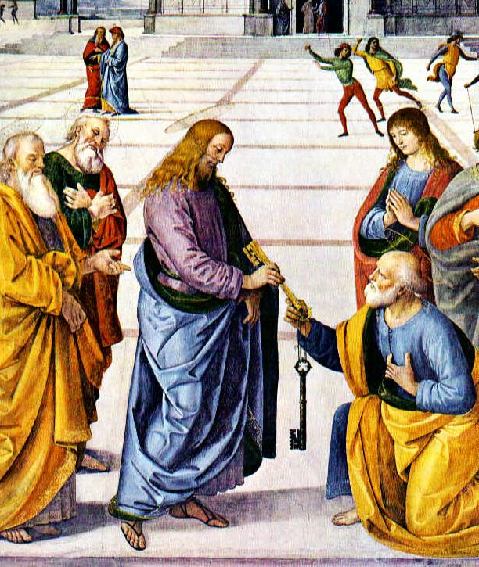
Jesus made Peter the First Pope

Slide 17
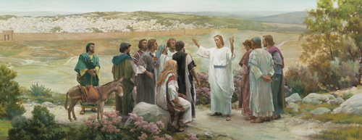
The Great Commission
Before He ascended into Heaven, Jesus gave His disciples to jobs:
Teach everything that Jesus had taught them
Baptize in the name of the Father and of the Son and of the Holy Spirit

Slide 18
Jesus is King!
Forty days after Easter, Jesus ascended into Heaven.
He is now King of heaven and Earth.

