Slide 1
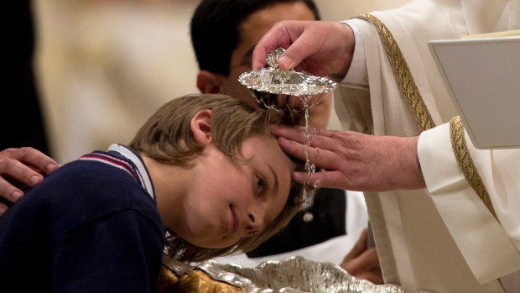
Our Life in the Church
3rd Grade
Chapter 28
Our Life in the Church

Slide 2

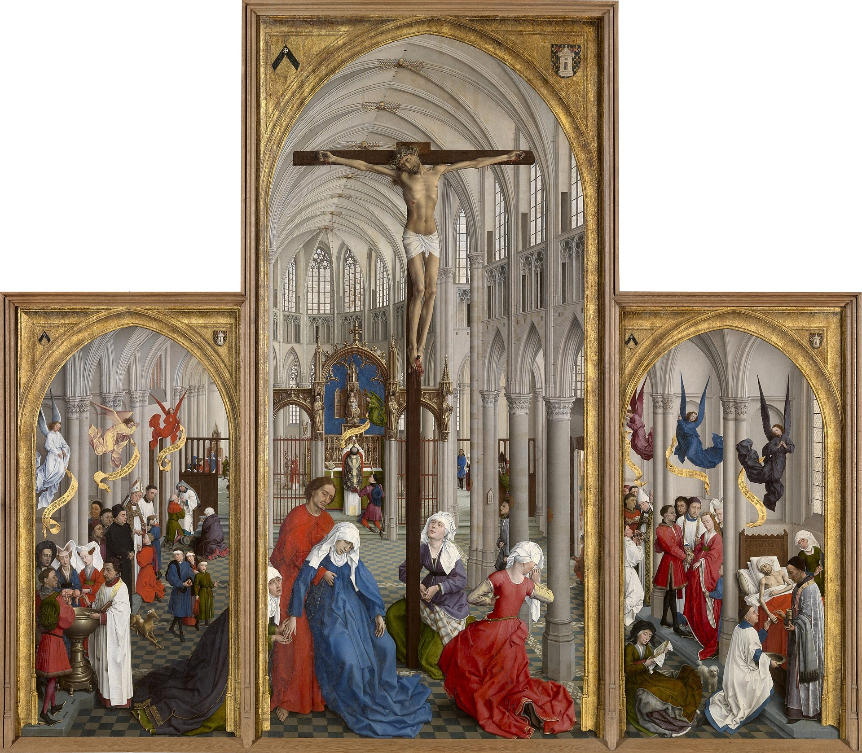

Lesson 1 – Sacraments
A Sacrament is an outward sign, instituted by Christ to give grace.
Can you find all seven Sacraments in this painting?

Slide 3
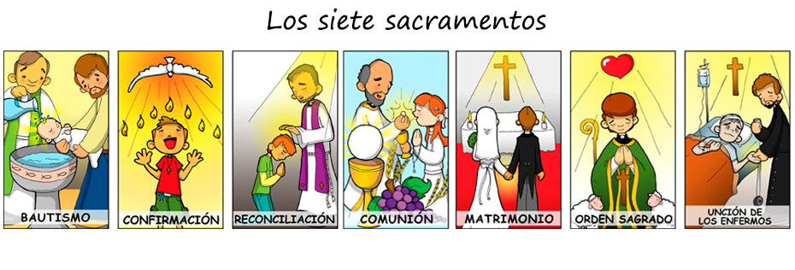
What is a Sacrament?
There are seven Sacraments.
Baptism, Confirmation, Reconciliation, Holy Communion, Matrimony, Holy Orders, and Anointing of the Sick

Slide 4
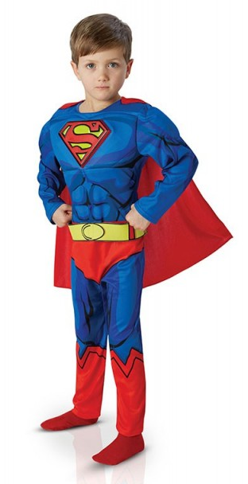
What is a Sacrament?
Sacraments are different from other things we do like praying the rosary or Stations of the Cross, blessing ourselves with Holy Water or going to adoration. The seven Sacraments are special and POWERFUL.

Slide 5

What is a Sacrament?
Sacrament-An outward sign instituted by Christ to give grace.

Slide 6
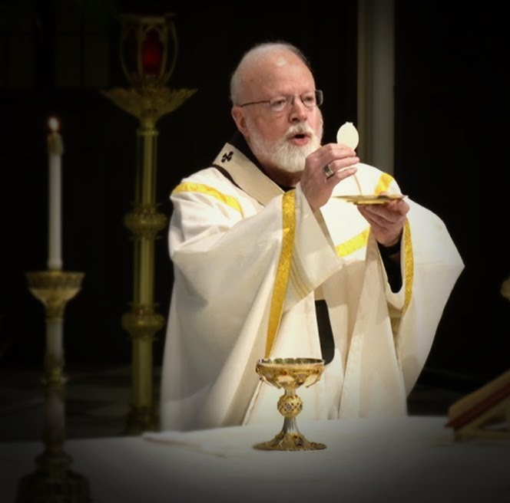
Outward Sign
The outward sign of a Sacrament is the part that you can see, hear, touch, taste, or smell.
Form-The part of the Sacrament that you can hear
Matter-The part that you experience with the rest of your senses.
Form
“This is my body.”
and
“This is my blood.”
Matter unleavened bread and wine.

Slide 7

Instituted by Christ
Instituted-Started
Jesus gave the Sacraments to the Church while He was on earth. You can read about Jesus instituting the Sacraments in the Gospels.

Slide 8
To Give Grace
Grace-God’s life in us
Through each Sacrament God gives Himself to us. When we receive a Sacrament, God pours His life and love into our hearts.
Some Examples
Reconciliation-God forgives our sins
Eucharist-Jesus really is present with us and in us
Baptism-We become a child of God

Slide 9
The Seven Sacraments
The seven Sacraments fit into three categories.
Initiation
Healing
Vocation
Baptism
Holy Eucharist
Confirmation
Reconciliation
Anointing of the Sick
Holy Orders
Matrimony

Slide 10
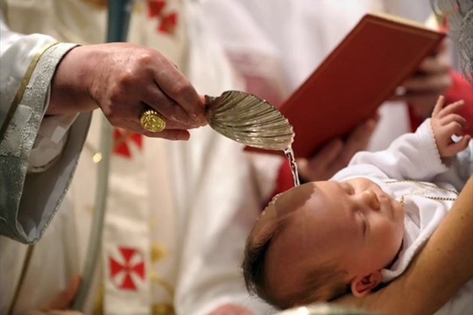
Lesson 1 - Covenant
Lesson 2 – Baptism
Through the Sacrament of Baptism, you become a child of God.

Slide 11
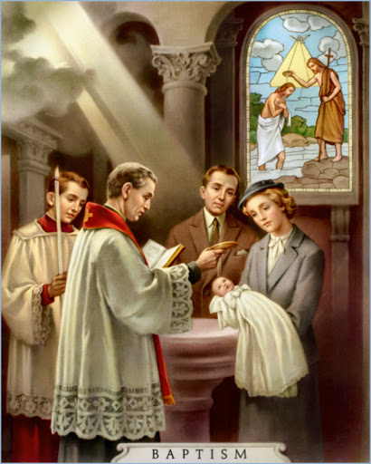
Outward Signs of Baptism
Matter- Water poured three times, candle and white garment
Form-”I baptize you in the name of the Father, and of the Son, and of the Holy Spirit.

Slide 12
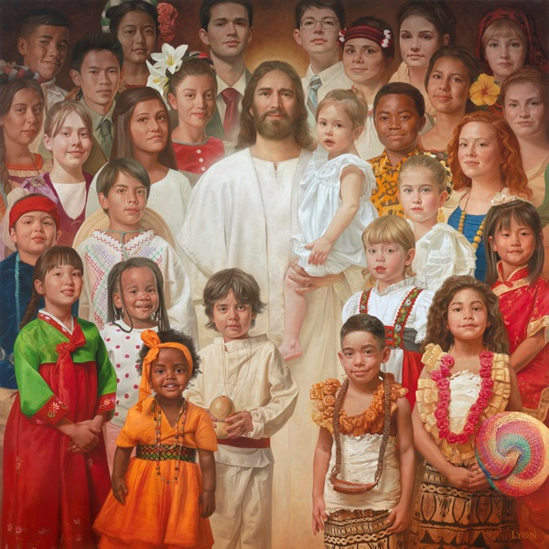
Graces of the Sacrament of Baptism
As the water is poured during Baptism, original sin and all other sin is washed clean from the person’s soul.
The soul is clean and becomes a place for the Trinity to live. The light of having God in their soul is symbolized by the candle.
When God is in your soul you are filled with grace. This means you are a child of God.

Slide 13

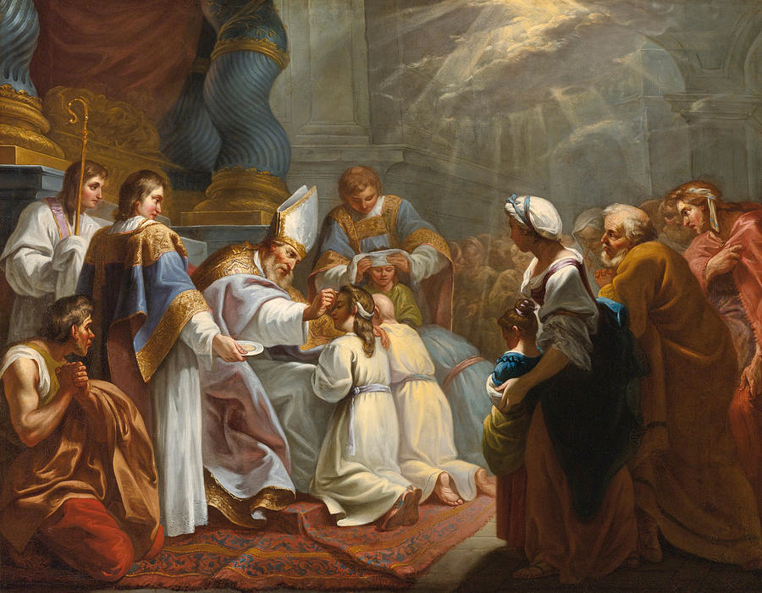
Lesson 3 – Eucharist, Confirmation, Penance
The Sacraments of Holy Eucharist, Confirmation, and Penance are ways God shares His life with us.

Slide 14
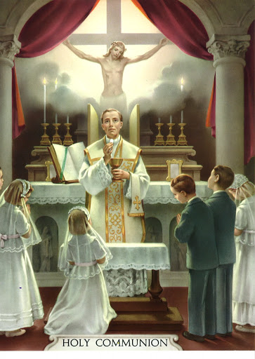
Holy Eucharist
Sacrament of Initiation
Bread and wine become the Body and Blood of Jesus
When we receive the Sacrament of Holy Eucharist, Jesus nourishes our soul like food nourishes our body.

Slide 15
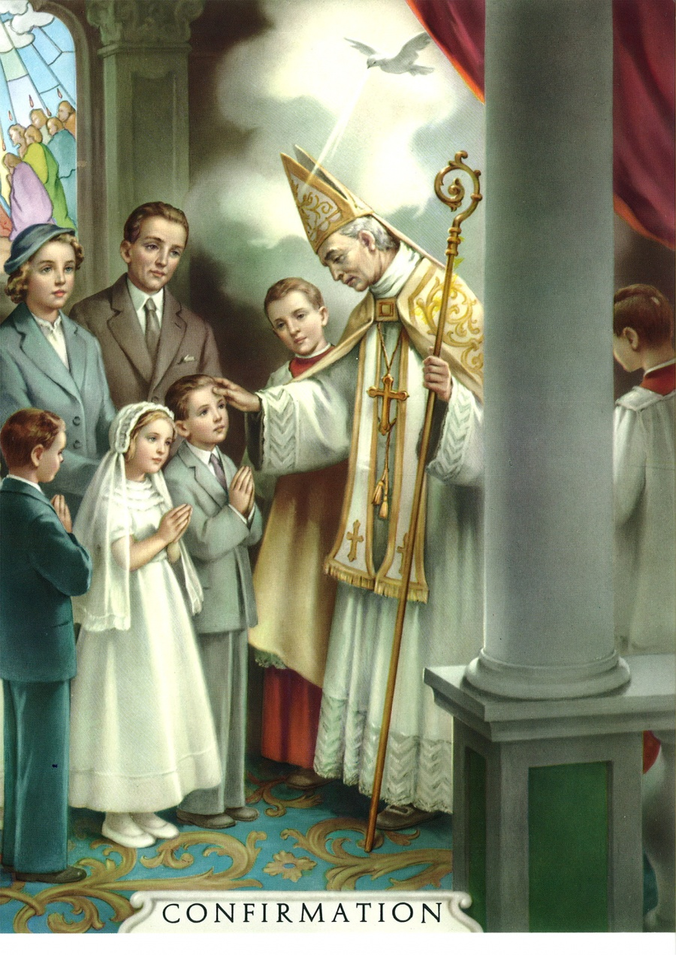
Confirmation
Sacrament of Initiation
Receive a full outpouring of the Holy Spirit
The Holy Spirit gives us His sevenfold gift
These gifts enable us to do God’s will and share His love with people.

Slide 16
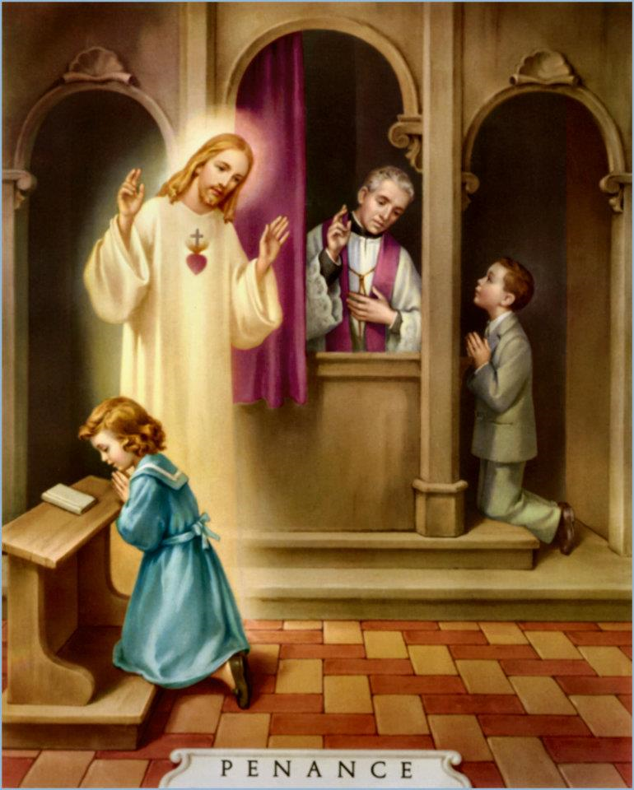
Penance
Sacrament of Healing
God forgives all sin
Given the strength to resist sinning again

Slide 17

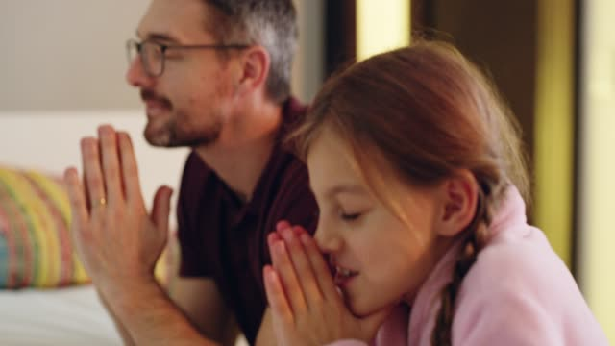
Lesson 4 – Life of Grace
God gives us His life through the Sacraments of Anointing of the Sick, Holy Orders, and Matrimony.

Slide 18
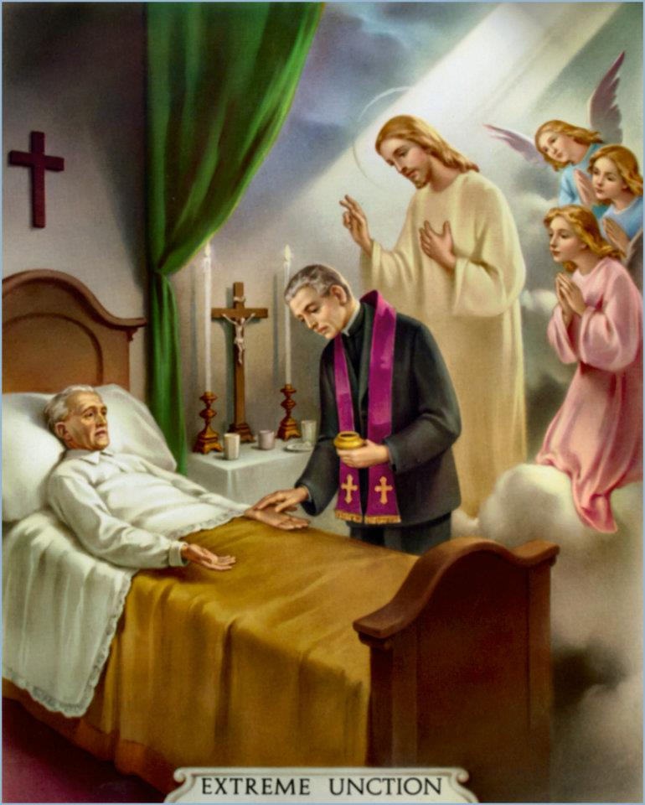
Anointing of the Sick
Sacrament of healing
Strengthens those who are sick
Helps us to unite our sickness to the suffering of Jesus on the cross
Prepares us for a happy death

Slide 19
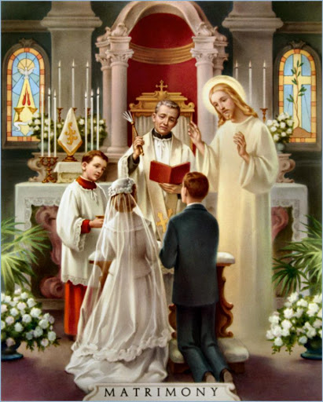
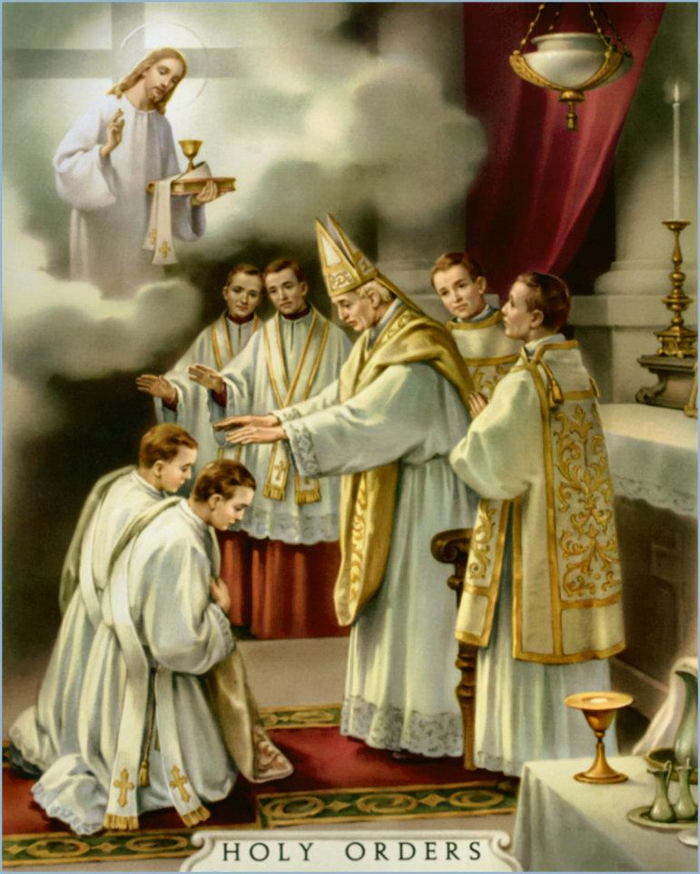
Holy Orders and Matrimony
Sacraments of Vocation
Helps to serve the Church

Slide 20
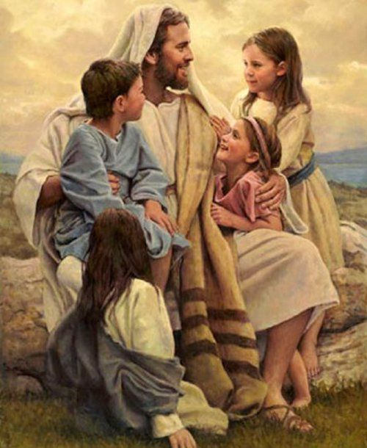
Life of Grace
God gives us His grace through each Sacrament.
We can make sure His grace continues to grow in us and change us by:
  Obeying the Ten Commandments
  Praying every day
  Paying close attention during religion class
  and at Mass

