Slide 1
Chapter 16: Jesus Grows in Age and Wisdom – Lesson 1
“And Jesus increased in wisdom and in stature, and in favor with God and man.” --Luke 2:52

Slide 2
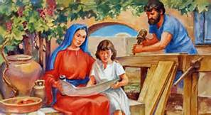
Jesus led an ordinary life.
Grew up in Nazareth
Even though He was God, He was also human so His life was similar to yours
He learned Jewish customs and traditions
Did chores, helped His parents, learned carpentry, had friends

Slide 3
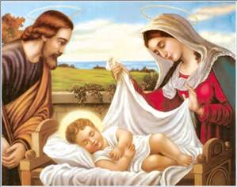
The Holy Family
Made up of Jesus, Mary, and Joseph
Jesus obeyed His parents
Joseph was a skilled carpenter
  taught Jesus
  Jesus watched and helped pick up wood
  How can we imitate Jesus in our own lives?

Slide 4
Jesus’ “hidden life”
The first 30 years of His life
This was the time before He made known to the world that He was God
God the Father still saw all of Jesus’ “hidden life”
God can see every moment of our lives as well

Slide 5
The Presentation
This is a Jewish tradition recognizing the firstborn son as a gift from God and a commitment to raising him in the faith. It is similar to Baptism.
Read Luke 2:21-40
Draw a picture of the Holy Family at the Presentation in the Temple
https://safeshare.tv/x/ss5894bf9feb38f

Slide 6
Closing
Pray the 4th Joyful Mystery, the Presentation in the Temple

Slide 7
Chapter 16: Jesus Grows in Age and Wisdom – Lesson 2
“And Jesus increased in wisdom and in stature, and in favor with God and man.” --Luke 2:52

Slide 8
God is all-knowing
He saw all of Jesus’ “hidden life”
He sees everything we do
He knows all of our thoughts and actions
He sees and knows everything about our hidden lives
How can we live lives that would be pleasing to God?

Slide 9
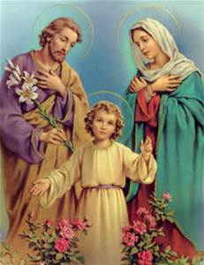
The Holy Family is our Model
They are a model of virtue for all families
Our family should imitate the Holy Family
We should strive to follow the 4th Commandment
We can imitate the Holy Family:
  Pray together
  Share with our siblings
  Listen to our parents, teachers, babysitters
  Do chores without being asked

Slide 10
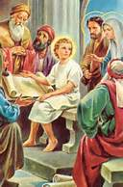
The Finding in the Temple
Read the Bible and learn about the Finding of Jesus in the Temple
Luke 2:41-52
Do Activity Book p. 61
https://safeshare.tv/x/9f2qZqOZ-y0

Slide 11
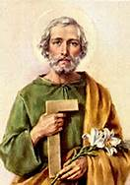
Closing
Pray together
Oh, St. Joseph, whose protection is so great, so strong, so prompt before the throne of God. I place in you all my interests and desires. Oh, St. Joseph, do assist me by your powerful intercession, and obtain for me from your Divine Son all spiritual blessings, through Jesus Christ, our Lord. So that, having engaged here below your heavenly power, I may offer my thanksgiving and homage to the most loving of Fathers. Oh, St. Joseph, I never weary of contemplating you, and Jesus asleep in your arms; I dare not approach while He reposes near your heart. Press Him in my name and kiss His fine head for me and ask him to return the Kiss when I draw my dying breath. St. Joseph, Patron of departing souls - Pray for Me. Amen.

Slide 12
Chapter 16: Jesus Grows in Age and Wisdom – Lesson 3
“And Jesus increased in wisdom and in stature, and in favor with God and man.” --Luke 2:52

Slide 13
John the Baptist
A prophet sent by God to prepare the way for the Savior
“Get ready! The Promised One is coming! Be sorry for your sins.”
Baptism of repentance for those who were sorry for their sins
Baptized Jesus in the Jordan River

Slide 14
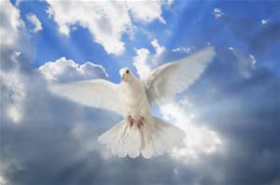
Baptism of Jesus
Baptized at age 30 although He was sinless
John the Baptist baptized Jesus and God gave a sign as Jesus came out of the water.
The Holy Spirit came down upon Jesus and anointed Him in the form of a dove
God’s voice from Heaven said, “This is My Beloved Son with whom I am well pleased.”
Now Jesus was ready to start his public life of preaching the Good News

Slide 15
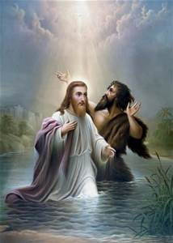
The Baptism of Jesus
Read Luke 3:1-22; 4:1
Read and color
Activity Book p. 62
https://safeshare.tv/x/ss5894ca89c4eed

Slide 16
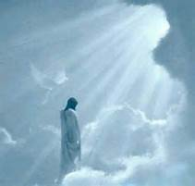
Closing
Pray together
Come, Holy Spirit, fill the hearts of Your faithful
and kindle in them the fire of Your love.
V: Send forth Your Spirit and they shall be created.
R: And You shall renew the face of the earth.
Let us pray: O God, who did instruct the hearts of the faithful by the light of the Holy Spirit, grant that by the gift of that same Spirit, we may be truly wise and ever rejoice in His consolation. Through Christ our Lord. Amen.

Slide 17
Chapter 16: Jesus Grows in Age and Wisdom – Lesson 4
“And Jesus increased in wisdom and in stature, and in favor with God and man.” --Luke 2:52

Slide 18
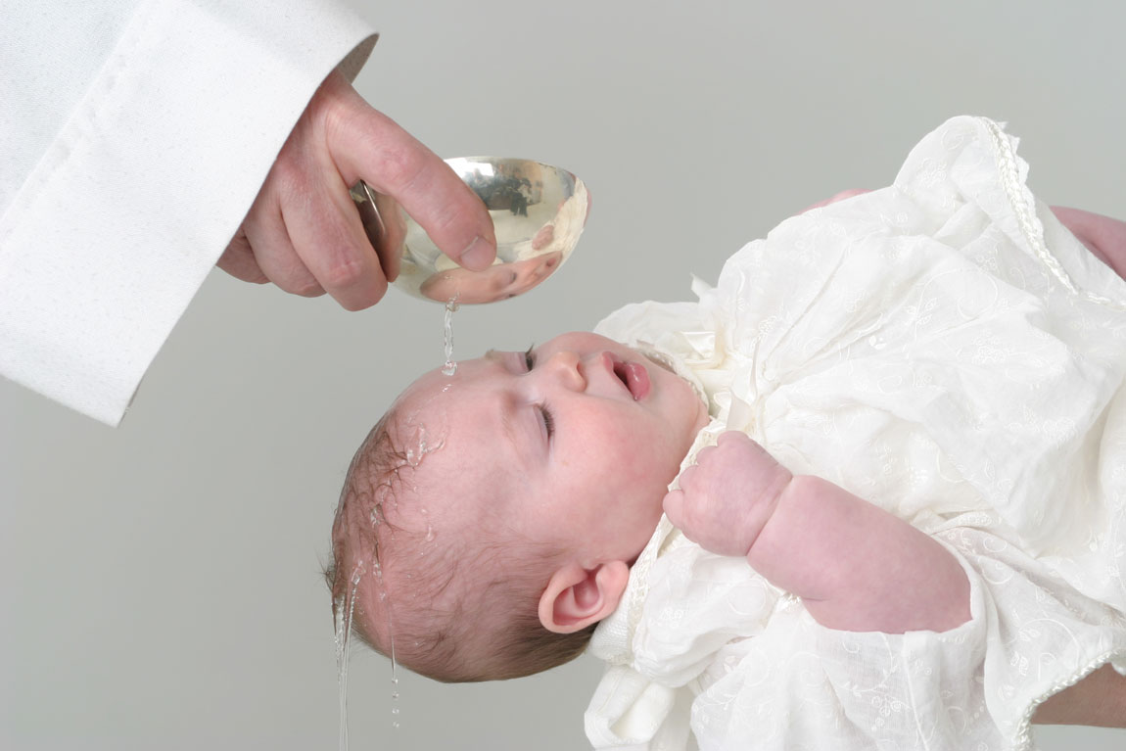
Our Baptism
The Holy Spirit comes down upon us just as He did to Jesus at His baptism
Brings us the life of God and sanctifying grace
Prepares us for our mission
  Love God and our neighbor
  Love the unborn, weak, sick, those with special needs, and aged people

Slide 19
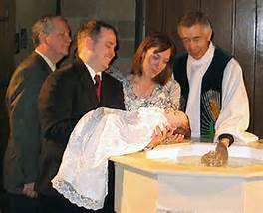
Symbols of Our Baptism
Water—washes away all sin (Original Sin and actual sin)
Words—”I baptize you in the Name of the Father and of the Son and of the Holy Spirit.”
White Garment—reminds us that our souls are clean and filled with grace.
Oil of Catechumens—is blessed to make us strong in our faith and protect us from the temptation of the devil
Oil of Chrism—is consecrated by the bishop and a sign that we share in the ministry of Christ as Prophet, Priest, and King
Candle—we receive the light of Christ in our hearts

Slide 20

Baptismal Promises
Do you renounce Satan?
And all his works?
And all his empty show?
Do you believe in God, the Father Almighty, Creator of Heaven and earth?
Do you believe in Jesus Christ, His only Son, our Lord, who was born of the Virgin Mary, suffered death and was buried, rose again from the dead and is seated at the right hand of the Father?
Do you believe in the Holy Spirit, the holy Catholic Church, the communion of saints, the forgiveness of sins, the resurrection of the body, and life everlasting?

Slide 21
Questions to know
Q. 74 Who is John the Baptist?
John the Baptist is the last of the prophets. He prepared the way for Jesus and baptized Him in the Jordan River (CCC 523)
Q. 75 What special event happened at Jesus’ Baptism in the Jordan?
When Jesus was baptized in the Jordan, the Holy Spirit came down upon Him in the form of a dove and God the Father spoke from Heaven, saying, “This is My Beloved Son, in Whom I am well pleased.” (CCC 535)
Q. 76 How is your Baptism like the Baptism of Jesus?
At my Baptism, the Holy Spirit came upon me to bring God’s Life of grace into my soul and to prepare me for the work God has planned for me to do (CCC 1265, 1268, 1270)

Slide 22
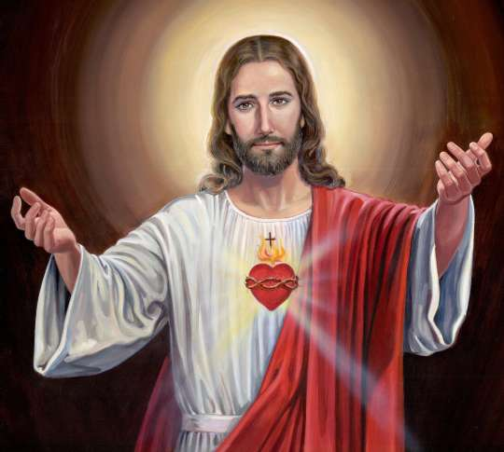
The Litany of the Most Sacred Heart of Jesus
Activity Book p. 63
https://safeshare.tv/x/xBDB12zJWRY

Slide 23

Closing
Pray together
Our Father
Hail Mary

