Slide 1
Chapter 18: The Last Supper, Our First Mass Lesson 1
“This is my body which is for you. Do this in remembrance of me.”
--1 Corinthians 11:24

Slide 2
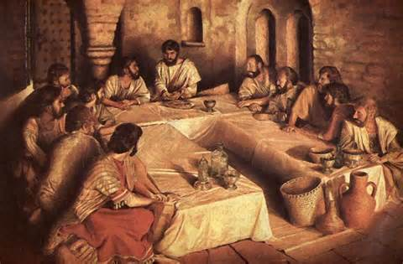
The Passover
Jesus celebrated with His Apostles
Held the night before Jesus died
This is referred to as the Last Supper
Jesus anticipated His death on the Cross through the gift of His Body and Blood at the Last Supper
Jesus was sad about the thought of leaving His friends, but He wanted them to be strong and holy when He was gone.

Slide 3
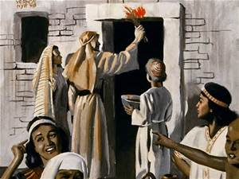
The Passover
A holy meal held once a year
Honors the sacred memory of the time God saved Moses and His people from slavery
Families killed a spotless lamb and ate it for the meal
They sprinkled the blood of the lamb on their doorposts
Everyone ate as if they were ready to leave in a moment’s notice

Slide 4
Questions about the Passover
If Jesus was celebrating a holy meal with His friends, why was He sad?
Why was Jesus going to pay such a great price?
Who did He pay the price for?
What did Jesus want for His disciples?
What does Jesus want for each of us?
Pretend Jesus is coming to your house for dinner…
What would you eat?
What would you wear?
How would you prepare your house?
How would you act and what would you talk about?

Slide 5
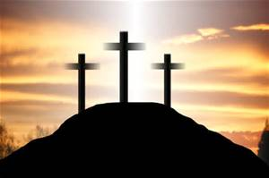
Liturgical Celebrations of Holy Week
Palm Sunday—We remember the triumphal entry of Jesus into Jerusalem
—At Mass, we read the Passion of Christ
Holy Thursday—We remember the Last Supper/Passover
Good Friday—We remember the day of Christ’s Passion, Death, and Burial
Holy Saturday—The Great and Holy Sabbath/Easter Vigil Mass
Easter Sunday—The Resurrection of Jesus

Slide 6
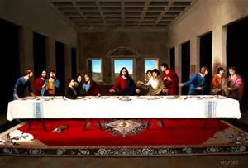
The Last Supper
Do Activity Book p. 69
The Last Supper
https://safeshare.tv/x/5azZ1s21HhI

Slide 7
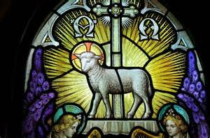
Closing
Pray the Agnus Dei for Mass:
Lamb of God, who takes away the sins of the world, have mercy on us.
Lamb of God, who takes away the sins of the world, have mercy on us.
Lamb of God, who takes away the sins of the world, grant us peace.

Slide 8
Chapter 18: The Last Supper, Our First Mass Lesson 2
“This is my body which is for you. Do this in remembrance of me.”
--1 Corinthians 11:24

Slide 9
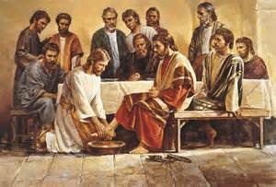
Jesus taught the Apostles
Taught them holiness, humility, and service
Jesus washed the feet of His Apostles at the Last Supper
He told them, “If I, the Lord and Master, have washed your feet, you also ought to wash the feet of one another. For I have given you an example; that as I have done to you, so you should also do.”
Humility—this virtue enables us not to be proud, and to see things as they really are and to act upon them
Service—it helps us to recognize Christ in our neighbor and love Him - may involve words, deeds, or prayers

Slide 10
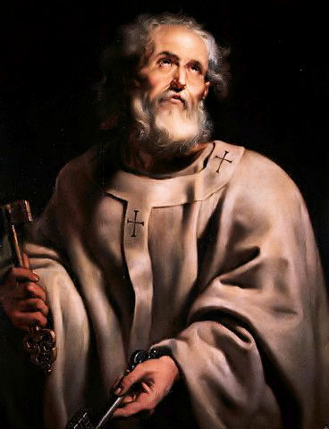
The Apostles
Peter
  Head of the Apostles
  He was a fisherman
  Walked on water with Jesus
  Was present at the Transfiguration and Agony in the Garden
  Denied Jesus 3 times and then later professed his love for Him 3 times
  Jesus named him “Rock,” head of the Church
  Crucified upside down because he felt unworthy to die in the same manner as the Lord

Slide 11
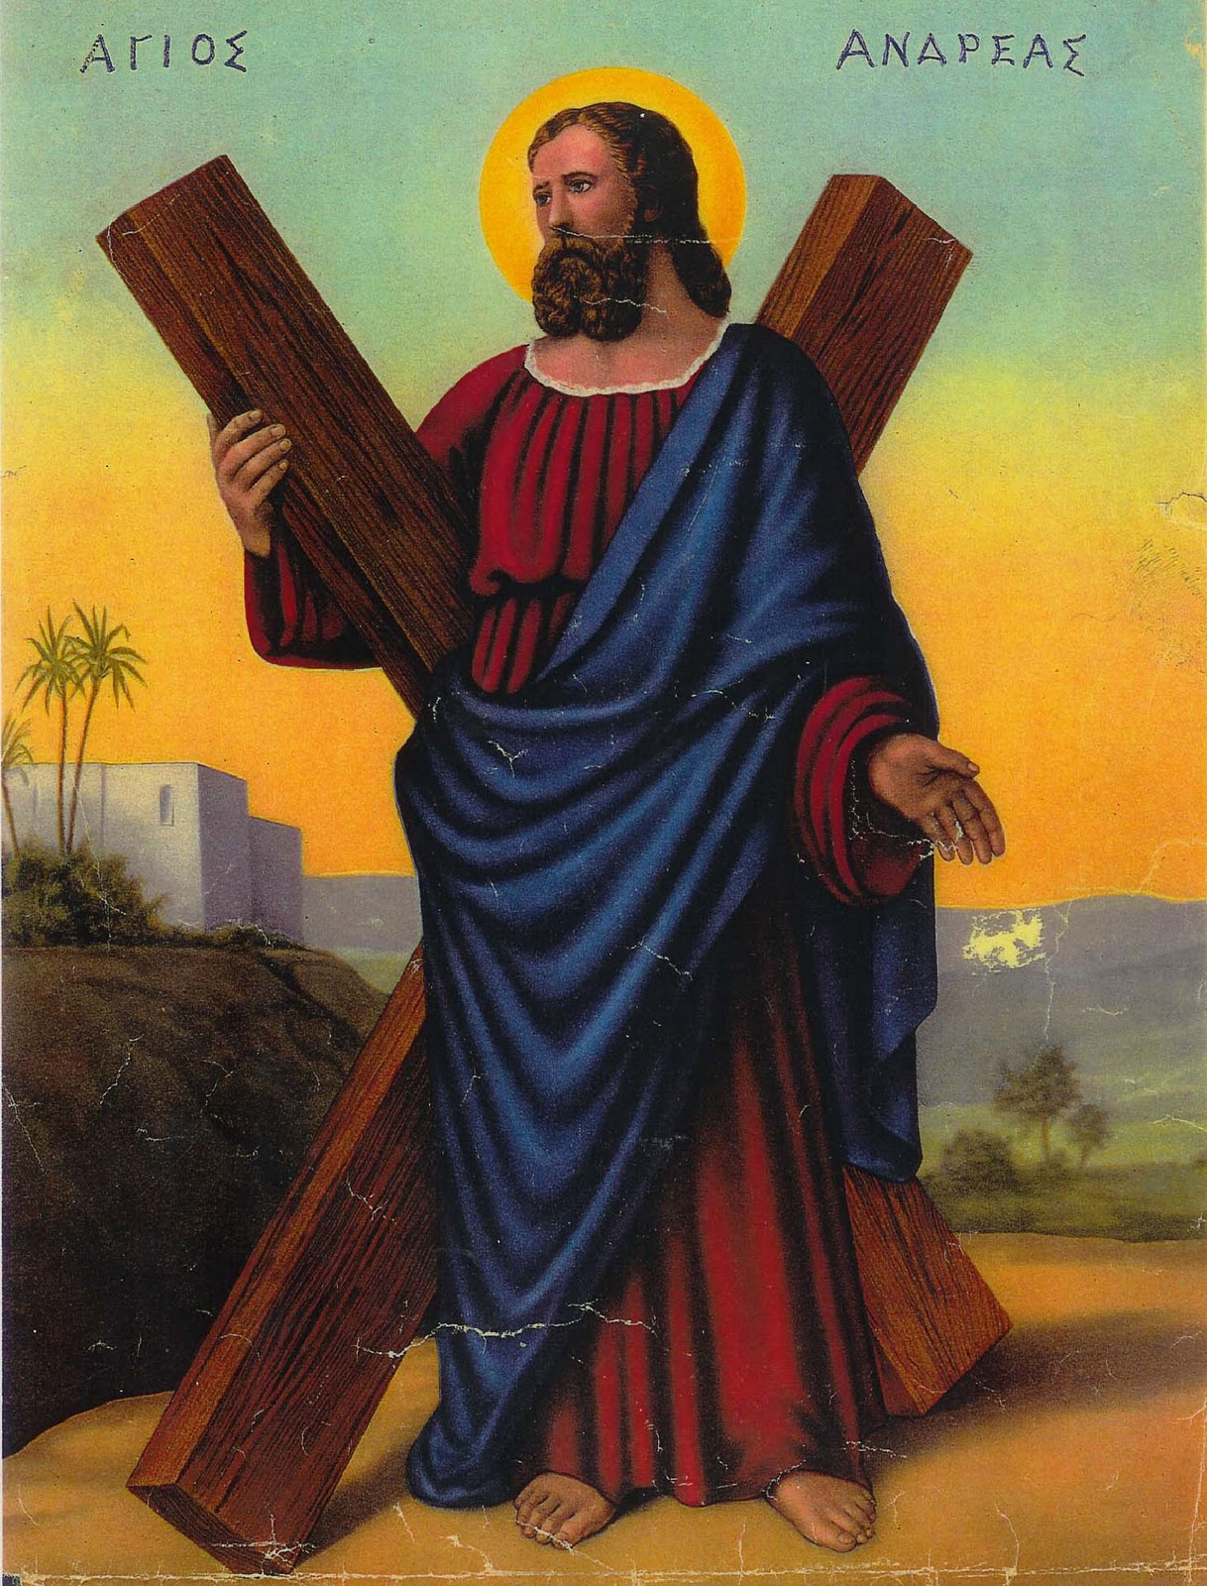
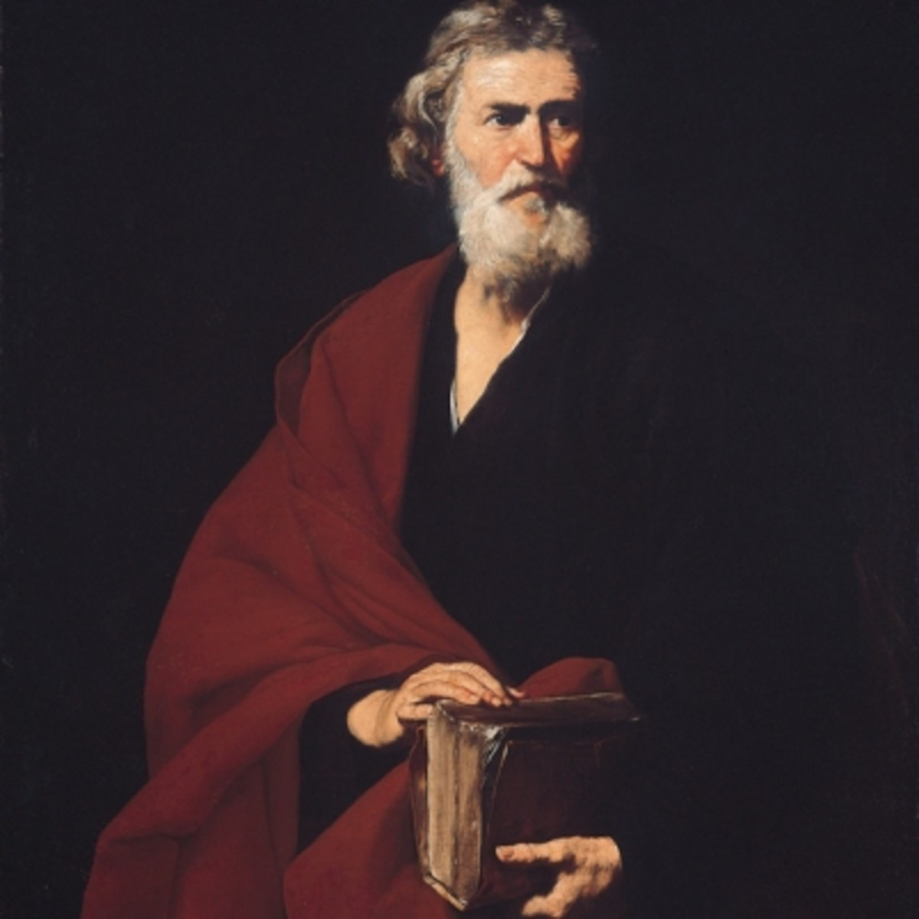
The Apostles
Andrew
  Disciple of John the Baptist; First apostle to follow Jesus
  Brother of Peter and introduced Peter to Jesus
  Martyred in Greece on an x-shaped cross
Matthew
  Was a tax collector
  Wrote a Gospel
  Martyred in Ethiopia

Slide 12
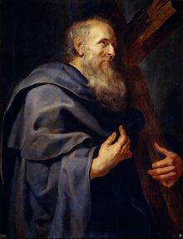
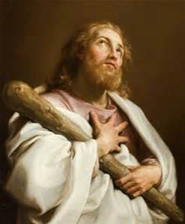
The Apostles
Philip
    From Bethsaida in Galilee
    Called to follow Jesus the day after Peter and Andrew
James the Less
  Author of the first Catholic Epistle
  His mother was a close family friend with Mary, the Mother of Jesus
  Sometimes called the brother of our Lord
  First bishop of Jerusalem
  Was martyred

Slide 13
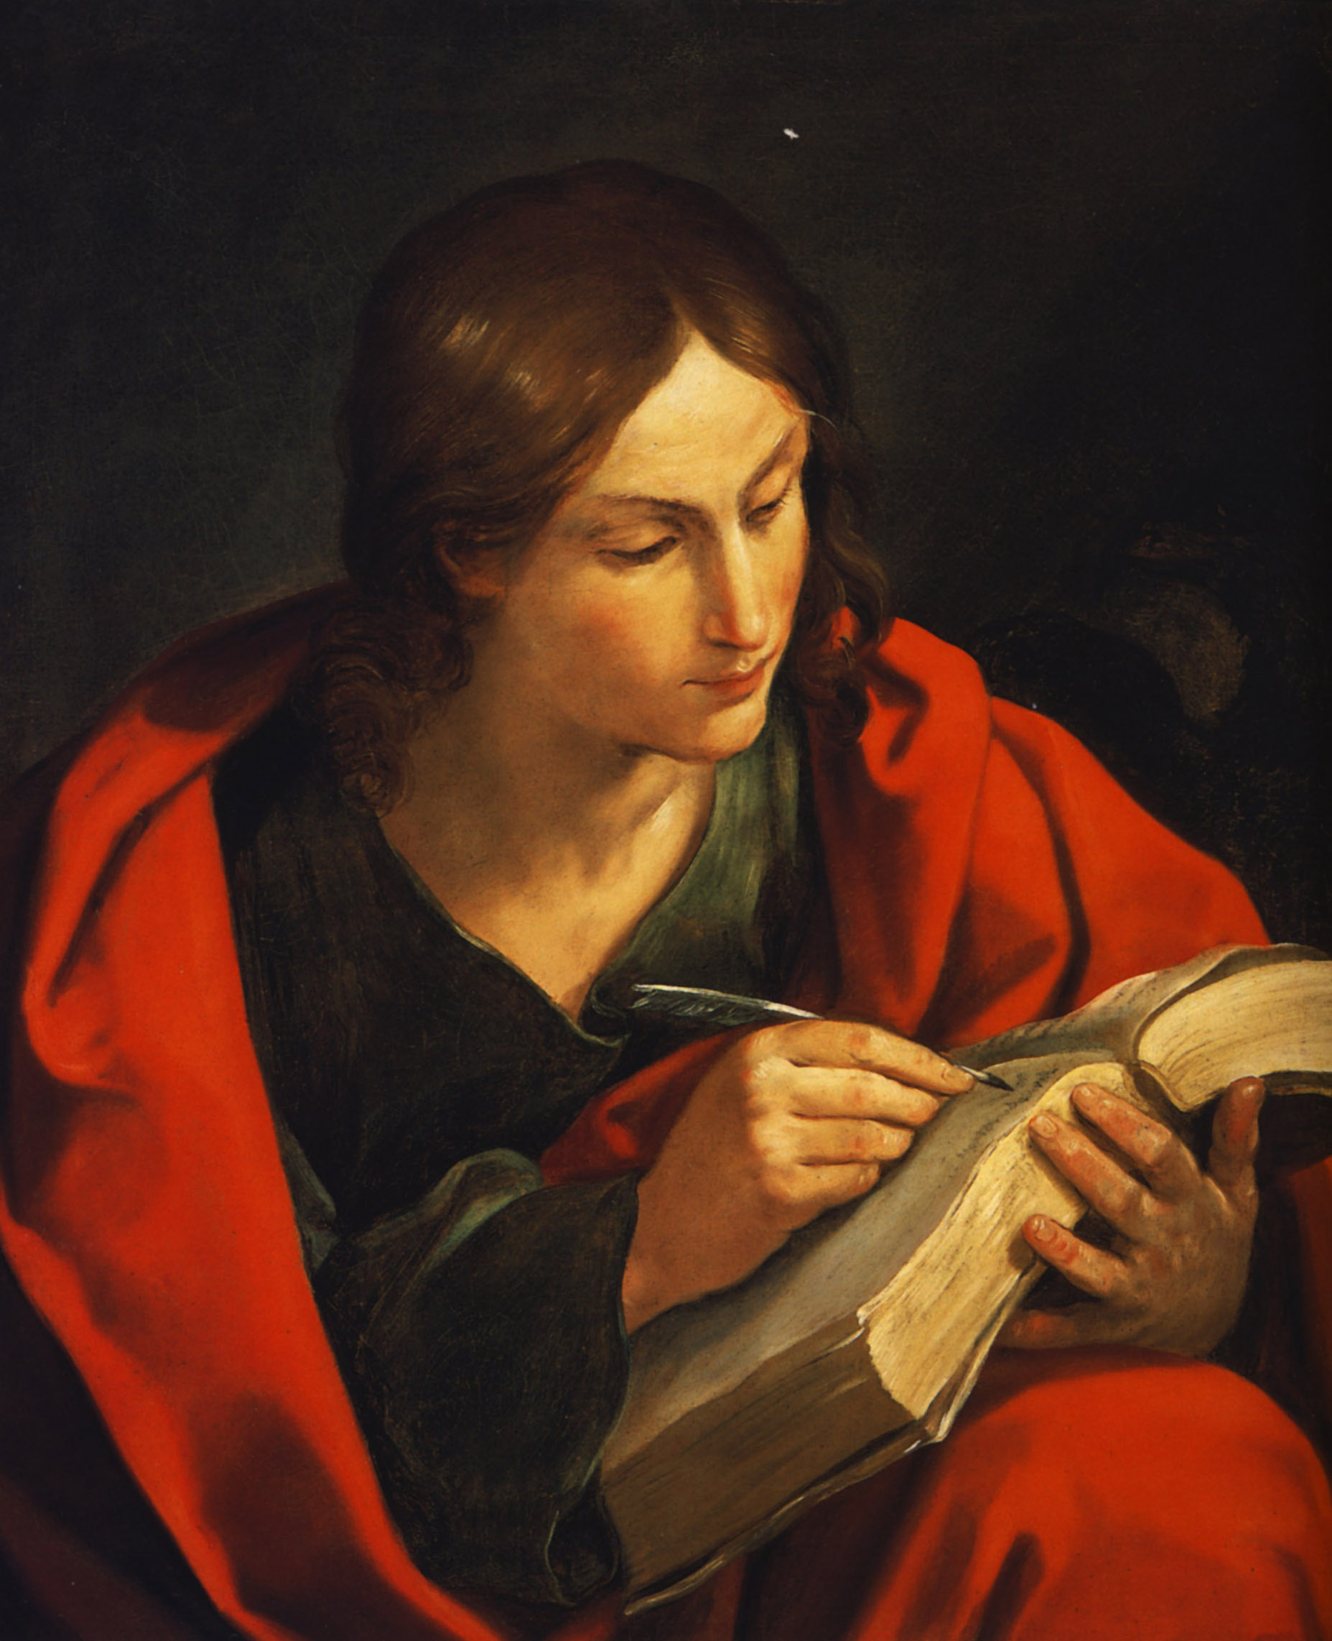
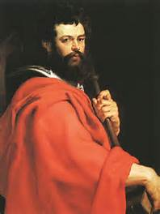
The Apostles
John
    Called “the beloved disciple”
  Was present at the Transfiguration and Agony in the Garden
    Wrote a Gospel, 3 letters and Book of Revelation in the New Testament
    Only apostle not martyred
James the Greater
  Brother of John and they were known as the Sons of Thunder
  Was present at the Transfiguration and Agony in the Garden
  Preached the Gospel in Spain

Slide 14
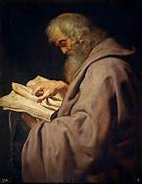
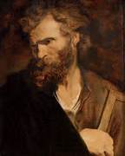
The Apostles
Bartholomew
  Also called Nathaniel; known for his pure heart
  Preached the Gospel in the East as far as India
  Martyred for his faith
Simon
  Was a zealot
  Originally followed Christ hoping for political victories
  Martyred in Persia

Slide 15
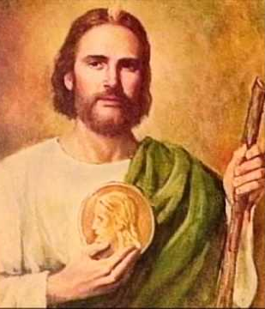
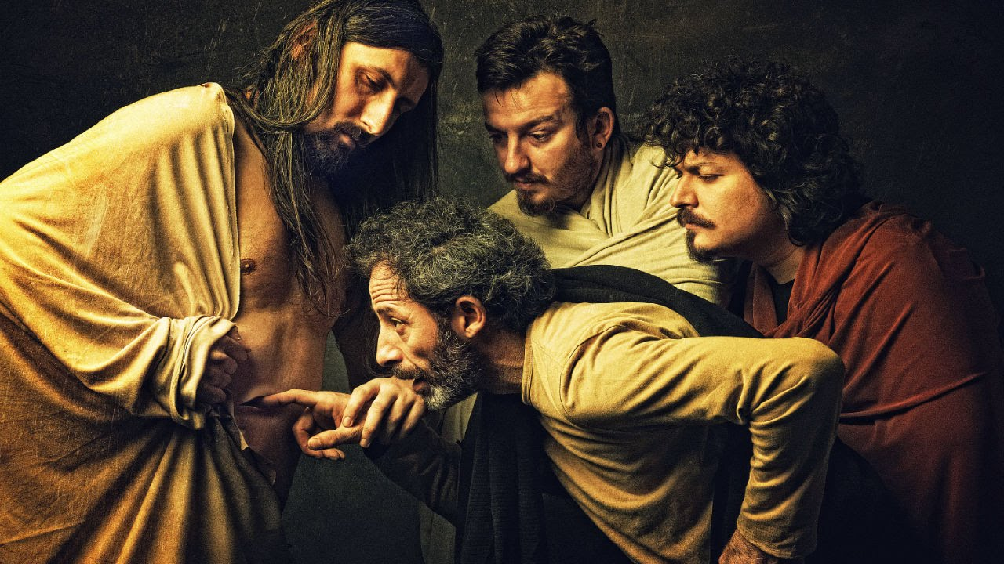
The Apostles
Jude
  Also called Thaddeus
  Patron of hopeless causes
  Preached the Gospel in Judea, Mesopotamia, and Libya
  He is the author of an Epistle
  Was martyred in Armenia
Thomas
  Known as the doubter
  He was given the gift of placing his hands in Christ’s wounds after the Resurrection
  Was martyred in the East

Slide 16
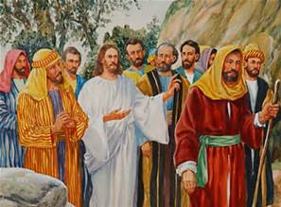
The Apostles
Do Apostles Matching Worksheet found in Appendix pp B-20-21
The Call of the Original 12 Apostles
https://safeshare.tv/x/ss5898dd823a42f

Slide 17
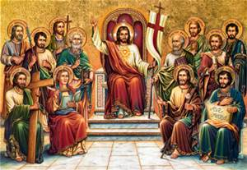
Closing
Pray a litany of the Apostles:
St. Simon Peter, Rock of the Church, pray for us.
St. Andrew, first-called of the apostles, pray for us.
St. James and St. John, sons of thunder, pray for us.
St. Philip, apostle of Greece and Turkey, pray for us.
St. Bartholomew, apostle without guile, pray for us.
St. Thomas, whose doubt was turned to joy, pray for us.
St. Matthew, apostle and evangelist, pray for us.
St. James, son of Alphaeus, apostle to Egypt, pray for us.
St. Simon, zealous for the victory of righteousness, pray for us.
St. Jude Thaddeus, apostle for the hopeless, pray for us.
St. Matthias, apostle to the East, pray for us.

Slide 18
Chapter 18: The Last Supper, Our First Mass Lesson 3
“This is my body which is for you. Do this in remembrance of me.”
--1 Corinthians 11:24

Slide 19
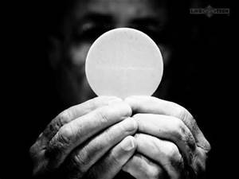
Institution of the Eucharist
The Institution of the Eucharist happened at the Last Supper
Teachings on the Eucharist:
  Matter—bread and wine
  Form—”This is my Body,” “This is the chalice of my Blood…”
  Minister—ordained priest who has the power conferred on the Apostles, and through them to their successors when Jesus said, “Do this in remembrance of Me.”
Read accounts of the Last Supper in the Bible:
Matthew 26:26-28; Mark 4:22-25; Luke 22:15; John 13:1-20

Slide 20
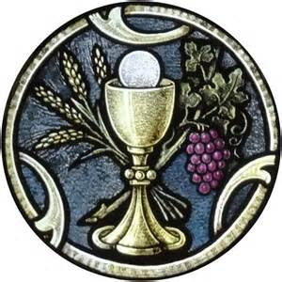
Transubstantiation
The changing of bread and wine into Body and Blood of Christ
Jesus is wholly present in the Eucharistic Hosts, Body, Blood, Soul, and Divinity and in the consecrated wine
Jesus gave the power to consecrate the Eucharist to His Apostles at the Last Supper
“Trans-”= means change or action
“-substanti” = means substance, what it is
“-ation” = means from an action
    The action of changing the substance of something

Slide 21
Activity and Video
Go to church and visit the tabernacle for a silent prayer
Reminders:
  Be Silent
  Genuflect
  Be aware Jesus is truly present
The Last Supper
https://safeshare.tv/x/H-PGK4WGmLU

Slide 22
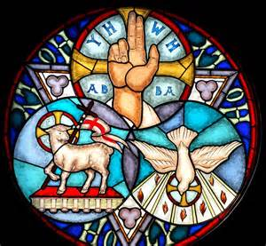
Closing
Pray together:
Most Holy Trinity, Father, Son and Holy Spirit, I adore Thee profoundly. I offer Thee the most precious Body, Blood, Soul and Divinity of Jesus Christ, present in all the tabernacles of the world, in reparation for the outrages, sacrileges and indifferences by which He Himself is offended. And through the infinite merits of His Most Sacred Heart and those of the Immaculate Heart of Mary, I beg of Thee the conversion of all poor sinners. Amen.

Slide 23
Chapter 18: The Last Supper, Our First Mass Lesson 4
“This is my body which is for you. Do this in remembrance of me.”
--1 Corinthians 11:24

Slide 24
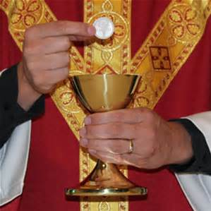
Holy Communion
Jesus gives Himself to US in Holy Communion
This gift is made possible through the celebration of Mass
Consecration of the Eucharist is done by the priest
The priest says the same words Jesus said over the bread and wine
Whenever we receive the Eucharist Jesus comes into our hearts

Slide 25
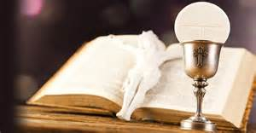
Holy Communion
Every time we receive Holy Communion certain things happen:
  We are cleansed and separated from venial sin
  We become more loving and committed to serving the poor
  We are in union with Jesus in the Blessed Sacrament
  We are united with the whole Church
  We have a foretaste of Heaven
  We grow in Christian life and receive an increase in the life of grace and God’s life within us
  We have a source of conversion to God and penance
  Our souls are fed with spiritual food
  We become more like Jesus
  We are united with Christ and participate in His sacrifice
  We are united in heavenly Liturgy with the angels and saints

Slide 26
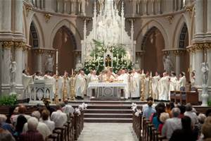
Catholics show reverence at Mass
Quiet atmosphere
Sitting standing, and kneeling in a proper manner
Genuflecting on the right knee toward the tabernacle when entering or leaving church
Blessing ourselves with holy water with the right hand

Slide 27
Questions to know
Q. 82 When was the first Mass celebrated?
Jesus celebrated the first Mass with his Apostles on Holy Thursday, the night before he died. (CCC 1340)
Q. 83 What is the Sacrament of the Holy Eucharist?
The Holy Eucharist is the Sacrament in which Jesus us present under the appearance of bread and wine. (CCC 1337, 1374)
Q. 84 What does the priest say over the bread and wine?
The priest says the same words Jesus said at the Last Supper. Over the bread he says, “This is my Body, which will be given up for you.” Over the wine he says, “This is the chalice is my Blood, the Blood of the new and eternal covenant, which will be poured out for you and for many for the forgiveness of sins.” (CCC 1333, 1339, 1375)

Slide 28
Questions to know
Q. 85 What happens to the bread and wine when the priest says the words of Jesus?
When the priest says the words of Jesus over the bread and wine, by the power of the Holy Spirit, the bread and wine change entirely into the Body, Blood, Soul, and Divinity of Jesus. The appearance of bread and wine remain, but Jesus is truly present. (CCC 1374-75)
Q. 86 What is Holy Communion?
Holy Communion is the way we unite ourselves to Jesus by receiving Him into ourselves. He comes into us and gives us His life and grace. By Holy Communion, Jesus makes us sharers in His Body and Blood to form one single Body in Christ. (CCC 1331)

Slide 29
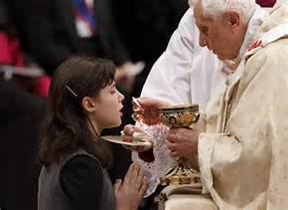
Holy Communion
Review the proper way to receive Holy Communion on the tongue and by hand.
  Bow, genuflect, or make the Sign of the Cross before receiving
  Say, “Amen.” after receiving
  Open your mouth and stick out tongue or make a throne with your hands (one underneath the other)
Remembrance - Communion Song
https://safeshare.tv/x/ss5898df85139a6

Slide 30

Closing
Pray a Spiritual Communion together:
Jesus, I believe You are truly here in the Most Blessed Sacrament. But since I cannot now receive You sacramentally, I welcome You spiritually into my soul. I unite myself to You now as I do when I actually receive You. Never let me be separated from You. Amen.
Spiritual Communion song

