Slide 1
Chapter 20: Offering Gifts of Love Lesson 1
“This chalice which is poured out for you is the new covenant in My blood. “
--Luke 22:20

Slide 2
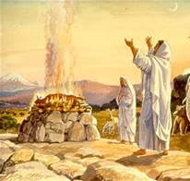
Sacrifices
Were burnt offerings or sacrifices of oblation to God in the Old Testament
They showed that God was more valuable than His gifts
Abraham and Old Testament priests made sacrifices
3 Main Types of Sacrifices:
Gifts—in these offerings they rejoiced in God’s power, rule, and goodness to them
Atonement—the people asked God to forgive their sins and were meant to express their sorrow
Peace Offering—the people shared a feast of thanksgiving and communion with one another and God

Slide 3
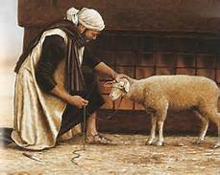
Old Testament Sacrifices and Offerings
Offered up bloody sacrifices of animals
Used cows, sheep, doves
Animals were placed on an altar
Killed it, shed its blood, and burned it
Many times they offered their best animals
How can we make sacrifices every day to show our love of God?
During which liturgical season do we offering things up to God? Why?

Slide 4
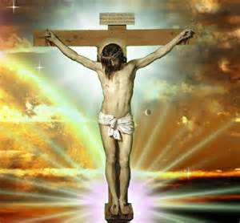
Jesus, My Lord
Do Activity Book p. 77
Jesus, my Lord, my God, my All
https://safeshare.tv/x/1fGlVwXOTaU

Slide 5
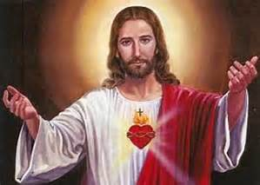
Closing
Pray together the Our Father after asking the students to offer their own intentions.

Slide 6
Chapter 20: Offering Gifts of Love Lesson 2
“This chalice which is poured out for you is the new covenant in My blood. “
--Luke 22:20

Slide 7
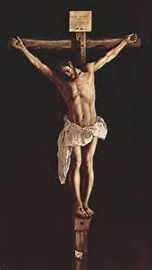
Jesus was a gift
He was the perfect sacrifice, the perfect offering to God
He offered Himself by dying on the Cross
He died for our sins so we could be reunited with Him one day
The gates of Heaven were opened as a result
The sacrifice was so perfect and so true
It washed away Adam's sin and all sin and thus saved the whole human race

Slide 8
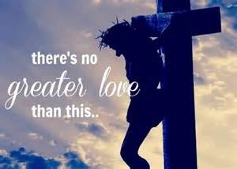
Jesus is the perfect sacrifice
He is God the Son
He is Man
He is sinless
He loves perfectly
He freely gave up His life
He died once for ALL our sins and His sacrifice is good for all eternity
How can we show our appreciation to Jesus for making the ultimate sacrifice for us?
How can we make sacrifices to show our love?

Slide 9
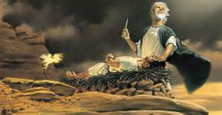
Sacrifices
Do Activity Book p. 78
Abraham and Isaac
https://safeshare.tv/x/ss589b980f49102

Slide 10
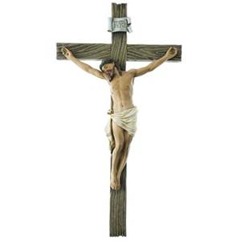
Closing
Pray together the Prayer Before the Crucifix:
Look down upon me, good and gentle Jesus, while before Your face I humbly kneel, and with burning soul pray and beseech You to fix deep in my heart lively sentiments of faith, hope, and charity, true contrition for my sins, and a firm purpose of amendment; while I contemplate with great love and tender pity Your five wounds, pondering over them within me, and calling to mind the words which, long ago, David the prophet spoke in Your own person concerning You, my Jesus: "They have pierced My hands and My feet; they have numbered all My bones." Amen.

Slide 11
Chapter 20: Offering Gifts of Love Lesson 3
“This chalice which is poured out for you is the new covenant in My blood. “
--Luke 22:20

Slide 12
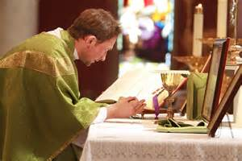
The Sacrifice of the Mass
Jesus’ Body and Blood are offered in the one perfect sacrifice through Mass
The sacrifice at Mass and on the Cross are the same
This happens every day all over the world in the same way
We share in the sacrifice by actively participating at Mass
We hear the priest say the same words Jesus used at the Last Supper
What makes the sacrifice of the Mass so special?

Slide 13
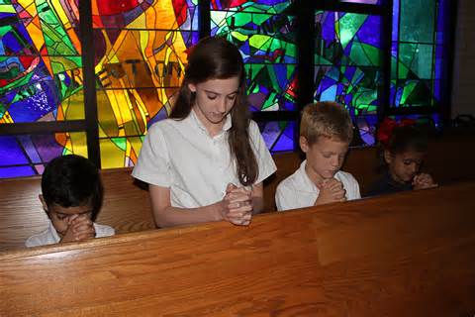
Mass Participation and Etiquette
Listen attentively and be silent
Do not disturb the people around you
Say all the responses
Sing the songs
Think about the priest’s homily and how we can live his message
Offer ourselves to the Father united with Jesus on the altar
Worthily receive our Lord in Holy Communion and give thanksgiving
Genuflect towards the tabernacle when entering and leaving the pew
Bow to the altar when passing in front of it
Always walk when in church
Dress well as a sign of respect

Slide 14
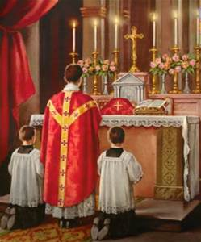
The Holy Mass
Do Activity Book p. 79
Draw a picture of the priest celebrating Mass
The Catholic Mass
https://safeshare.tv/x/ss589b9862f2d36

Slide 15
Closing
Pray together the Nicene Creed:
I believe in one God, the Father almighty, maker of heaven and earth, of all things visible and invisible. I believe in one Lord Jesus Christ, the Only Begotten Son of God, born of the Father before all ages. God from God, Light from Light, true God from true God, begotten, not made, consubstantial with the Father; through him all things were made. For us men and for our salvation he came down from heaven, (bow) and by the Holy Spirit was incarnate of the Virgin Mary, and became man. For our sake he was crucified under Pontius Pilate, he suffered death and was buried, and rose again on the third day in accordance with the Scriptures. He ascended into heaven and is seated at the right hand of the Father. He will come again in glory to judge the living and the dead and his kingdom will have no end. I believe in the Holy Spirit, the Lord, the giver of life, who proceeds from the Father and the Son, who with the Father and the Son is adored and glorified, who has spoken through the prophets. I believe in one, holy, catholic and apostolic Church. I confess one Baptism for the forgiveness of sins and I look forward to the resurrection of the dead and the life of the world to come. Amen.

Slide 16
Chapter 20: Offering Gifts of Love Lesson 4
“This chalice which is poured out for you is the new covenant in My blood. “
--Luke 22:20

Slide 17
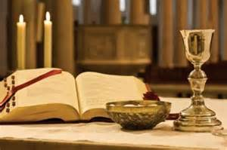
The Sacrifice of the Mass
Reminds us of Jesus on the Cross without the shedding of blood
Jesus’ sacrifice is made present in a real and sacramental way during Mass
We unite ourselves with Jesus and the priest
Perfect sacrifice to the Father as the most pleasing and powerful offering
Jesus is the Lamb of God being offered continually to save our world
How are the Mass and Jesus’ death on the Cross related?
How can we show God how much we love Him while at Mass?

Slide 18
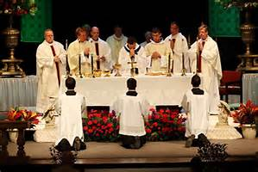
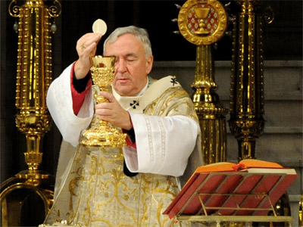
Parts of the Mass
The Introductory Rite—includes the Confiteor and the Gloria
Entrance song and greeting
Penitential Rite and Kyrie Eleison
Opening Prayer
The Liturgy of the Word (in the first part of the Mass)— includes the Creed, and the Prayers of the Faithful
Readings from the Old Testament, the psalms, and the New Testament
Reading from the Gospel
Homily from the pulpit
The Liturgy of the Eucharist (the second part of the Mass)
Preparation of the Gifts
Eucharistic Prayer
Consecration
Holy Communion

Slide 19
Questions to know
Q. 91 What is the Holy Mass?
The Holy Mass is the sacrifice of the Body and Blood of Jesus Christ. The Holy Mass is offered on the altar by the priest of God, under the appearance of bread and wine, in memory of the Sacrifice of the Cross. (CCC 1364-65)
Q. 92 Is the Sacrifice of the Mass the same sacrifice as the Sacrifice of the Cross?
The Sacrifice of the Mass is the Sacrifice of the Cross, the only difference is in the manner of performing it. (CCC 1366-67)

Slide 20
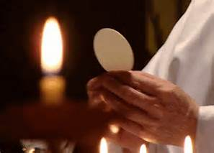
The Holy Mass
Do Activity Book pp. 80
Take the students to church and show them the parts of the Mass in the daily missal.
Catholic Mass—The Consecration
https://safeshare.tv/x/ss589b9905e48d6

Slide 21
Closing
Pray together the Gloria:
Glory to God in the highest, and on earth peace to people of good will. We praise you, we bless you, we adore you, we glorify you, we give you thanks for your great glory, Lord God, heavenly King, O God, almighty Father. Lord Jesus Christ, Only Begotten Son, Lord God, Lamb of God, Son of the Father, you take away the sins of the world, have mercy on us; you take away the sins of the world, receive our prayer; you are seated at the right hand of the Father, have mercy on us. For you alone are the Holy One, you alone are the Lord, you alone are the Most High, Jesus Christ, with the Holy Spirit, in the glory of God the Father. Amen.

