Slide 1
Chapter 21:The Holy Mass
Lesson 1
“Then they told what had happened on the road, and how He was known to them in the breaking of the bread.” --Luke 24:35

Slide 2
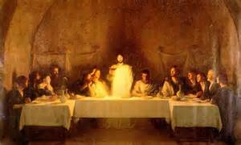
The Holy Mass
It is truly the Sacrifice of the Cross
The sacrifice of Christ on the Cross reconciled man with God
At the Last Supper, Jesus gave us a way to share in His sacrifice for all time
At every Mass we celebrate the miracle of the Last Supper
Jesus gave His Apostles – and all priests – the power to consecrate the Eucharist
How are the Last Supper and the Mass related?

Slide 3
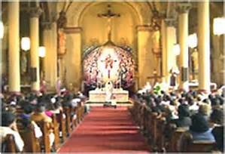
The Holy Mass
Jesus’ gift to us of His life was so powerful that He wants us to continue offering it to the Father at Mass until the end of time
We gather as a parish family and share in Christ’s sacrifice at Mass to celebrate the Passion, Death, Resurrection and Ascension of Jesus
Christ’s sacrifice reunited God and man’s friendship in full, (repaired Adam and Eve’s disobedience) which we celebrate at Mass

Slide 4
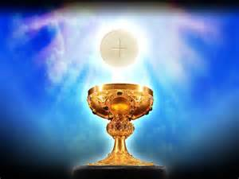
The holy Mass
The Consecration of the Mass
https://safeshare.tv/x/RGEuCJF_nmM
Do Activity Book pp. 81

Slide 5
Closing
Pray together the Nicene Creed:
I believe in one God, the Father almighty, maker of heaven and earth, of all things visible and invisible. I believe in one Lord Jesus Christ, the Only Begotten Son of God, born of the Father before all ages. God from God, Light from Light, true God from true God, begotten, not made, consubstantial with the Father; through him all things were made. For us men and for our salvation he came down from heaven, (bow) and by the Holy Spirit was incarnate of the Virgin Mary, and became man. For our sake he was crucified under Pontius Pilate, he suffered death and was buried, and rose again on the third day in accordance with the Scriptures. He ascended into heaven and is seated at the right hand of the Father. He will come again in glory to judge the living and the dead and his kingdom will have no end. I believe in the Holy Spirit, the Lord, the giver of life, who proceeds from the Father and the Son, who with the Father and the Son is adored and glorified, who has spoken through the prophets. I believe in one, holy, catholic and apostolic Church. I confess one Baptism for the forgiveness of sins and I look forward to the resurrection of the dead and the life of the world to come. Amen.

Slide 6
Chapter 21:The Holy Mass
Lesson 2
“Then they told what had happened on the road, and how He was known to them in the breaking of the bread.” --Luke 24:35

Slide 7
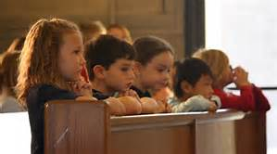
The Holy Mass
We are obliged to participate at Mass every Sunday and on Holy Days of Obligation
Children should attend Mass every Sunday if they can
Children who cannot attend Mass because nobody will take them are not guilty of sin.
If the child could attend Mass on his/her own, but does not do so, the child is guilty of sin.

Slide 8
Important Parts of the Mass
The Mass begins with the Sign of the Cross, the Kyrie, and the Gloria
    Sign of the Cross
    https://safeshare.tv/x/ss589e1cf2e6b6c
    Kyrie
    https://safeshare.tv/x/aah_ITLw3R8
    Gloria
    https://safeshare.tv/x/30344167
Strike one’s breast during the ‘Confiteor’ at the words: “through my fault, through my fault, through my most grievous fault.”

Slide 9
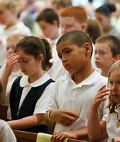
Holy Days of Obligation
They should be treated as you would a Sunday Mass:
January 1—The Solemnity of Mary, Mother of God
Thursday of the 6th Week of Easter (40 days after Easter)—The Solemnity of the Ascension
August 15—The Solemnity of the Assumption of the Blessed Virgin Mary
November 1—The Solemnity of All Saints
December 8—The Solemnity of the Immaculate Conception
December 15—The Solemnity of the Nativity of our Lord Jesus Christ

Slide 10
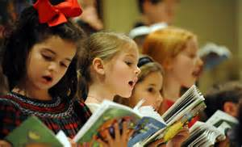
The Parts of the Mass
The Kyrie and the Gloria explained
https://safeshare.tv/x/qmMMkqB-7QM
Do Activity Book pp. 82

Slide 11
Closing
Pray together the Nicene Creed:
I believe in one God, the Father almighty, maker of heaven and earth, of all things visible and invisible. I believe in one Lord Jesus Christ, the Only Begotten Son of God, born of the Father before all ages. God from God, Light from Light, true God from true God, begotten, not made, consubstantial with the Father; through him all things were made. For us men and for our salvation he came down from heaven, (bow) and by the Holy Spirit was incarnate of the Virgin Mary, and became man. For our sake he was crucified under Pontius Pilate, he suffered death and was buried, and rose again on the third day in accordance with the Scriptures. He ascended into heaven and is seated at the right hand of the Father. He will come again in glory to judge the living and the dead and his kingdom will have no end. I believe in the Holy Spirit, the Lord, the giver of life, who proceeds from the Father and the Son, who with the Father and the Son is adored and glorified, who has spoken through the prophets. I believe in one, holy, catholic and apostolic Church. I confess one Baptism for the forgiveness of sins and I look forward to the resurrection of the dead and the life of the world to come. Amen.

Slide 12
Chapter 21:The Holy Mass
Lesson 3
“Then they told what had happened on the road, and how He was known to them in the breaking of the bread.” --Luke 24:35

Slide 13
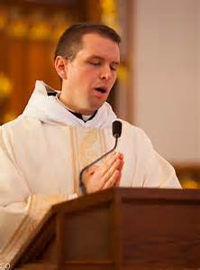
Liturgy of the Word
This part includes readings from the Scriptures.
Scripture is known as the Word of God.
The Gospel contains Jesus’ own words.
We stand, as a sign of respect, to listen to the Gospel as the priest reads it.
The priest explains the Gospel during the homily.

Slide 14
Liturgy of the Word Responses
After reading the first and second readings the reader says, “The word of the Lord.”
We respond, “Thanks be to God.”
Before reading the Gospel the priest says, “The Lord be with you.”
We respond, “And with your spirit.”
The priest says, “A reading from the holy Gospel according to __________.”
We respond, “Glory to you, O Lord.” (make small Sign of the Cross on forehead, lips, chest)
After reading the Gospel, the priest says, “The Gospel of the Lord.”
We respond, “Praise to you, Lord Jesus Christ.”

Slide 15
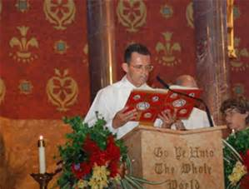
Liturgy of the Word
Catholic Mass—The Gospel
https://safeshare.tv/x/aLRbGR0Ll3w
Do Activity Book pp. 83

Slide 16
Closing
Pray together the Nicene Creed:
I believe in one God, the Father almighty, maker of heaven and earth, of all things visible and invisible. I believe in one Lord Jesus Christ, the Only Begotten Son of God, born of the Father before all ages. God from God, Light from Light, true God from true God, begotten, not made, consubstantial with the Father; through him all things were made. For us men and for our salvation he came down from heaven, (bow) and by the Holy Spirit was incarnate of the Virgin Mary, and became man. For our sake he was crucified under Pontius Pilate, he suffered death and was buried, and rose again on the third day in accordance with the Scriptures. He ascended into heaven and is seated at the right hand of the Father. He will come again in glory to judge the living and the dead and his kingdom will have no end. I believe in the Holy Spirit, the Lord, the giver of life, who proceeds from the Father and the Son, who with the Father and the Son is adored and glorified, who has spoken through the prophets. I believe in one, holy, catholic and apostolic Church. I confess one Baptism for the forgiveness of sins and I look forward to the resurrection of the dead and the life of the world to come. Amen.

Slide 17
Chapter 21:The Holy Mass
Lesson 4
“Then they told what had happened on the road, and how He was known to them in the breaking of the bread.” --Luke 24:35

Slide 18
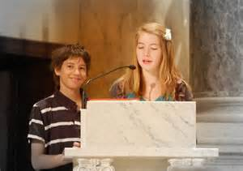
Mass Readings
Jesus teaches us through the readings
He comes into our hearts at Mass
When we read at Mass, we should…
  Practice the readings ahead of time
  Read slowly so we are understood by all
  Speak clearly
  Bow before going into the sanctuary
  Be attentive and participate—you are in the sanctuary and everyone can see you
  Be reverent

Slide 19
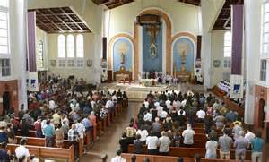
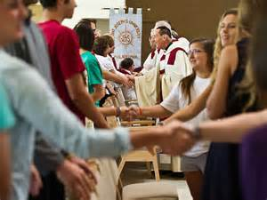
After the Homily
We stand to profess our faith by saying the Creed
Bow or kneel when we say “and by the Holy Spirit was incarnate of the Virgin Mary, and became man” in the Creed
We offer each other the Sign of Peace
During the Sign of Peace we shake the hands of the people around us saying, “Peace be with you.”
The Sign of Peace is intended to demonstrate religious communion and charity towards one another—it's about acceptance of your neighbor in the full spirit of Christ

Slide 20
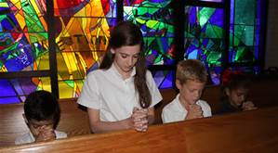
Questions to know
Q. 74 Are we obliged to go to Mass?
We are obliged to go to Mass on Sunday and on the Holy Days of Obligation. (CCC 2176-77)
Q. 75 What is the most proper way of taking part in the Mass?
The most proper way of participating in Mass is to offer it to God in union with the priest. We should remember the sacrifices of Jesus, His life, death, and Resurrection. We should receive Holy Communion. (CCC 1391, 2180)

Slide 21
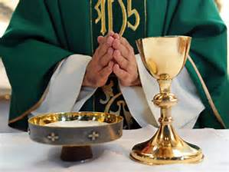
Mass Parts
Joy in the Mass Part 6: The Our Father and The Sign of Peace
https://safeshare.tv/x/1hGwoqtI6BM
Do Activity Book pp. 84

Slide 22
Closing
Pray together the Nicene Creed:
I believe in one God, the Father almighty, maker of heaven and earth, of all things visible and invisible. I believe in one Lord Jesus Christ, the Only Begotten Son of God, born of the Father before all ages. God from God, Light from Light, true God from true God, begotten, not made, consubstantial with the Father; through him all things were made. For us men and for our salvation he came down from heaven, (bow) and by the Holy Spirit was incarnate of the Virgin Mary, and became man. For our sake he was crucified under Pontius Pilate, he suffered death and was buried, and rose again on the third day in accordance with the Scriptures. He ascended into heaven and is seated at the right hand of the Father. He will come again in glory to judge the living and the dead and his kingdom will have no end. I believe in the Holy Spirit, the Lord, the giver of life, who proceeds from the Father and the Son, who with the Father and the Son is adored and glorified, who has spoken through the prophets. I believe in one, holy, catholic and apostolic Church. I confess one Baptism for the forgiveness of sins and I look forward to the resurrection of the dead and the life of the world to come. Amen.

