Slide 1
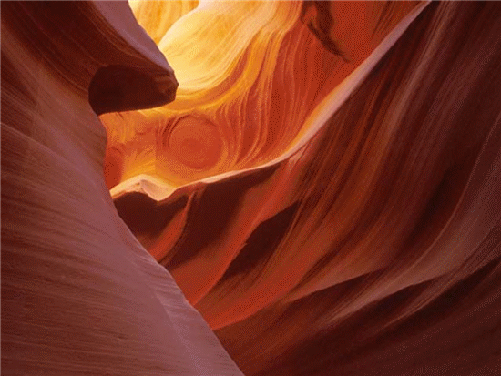
Chapter 10
Great Things Happen on the Way to the Promised Land.

Slide 2
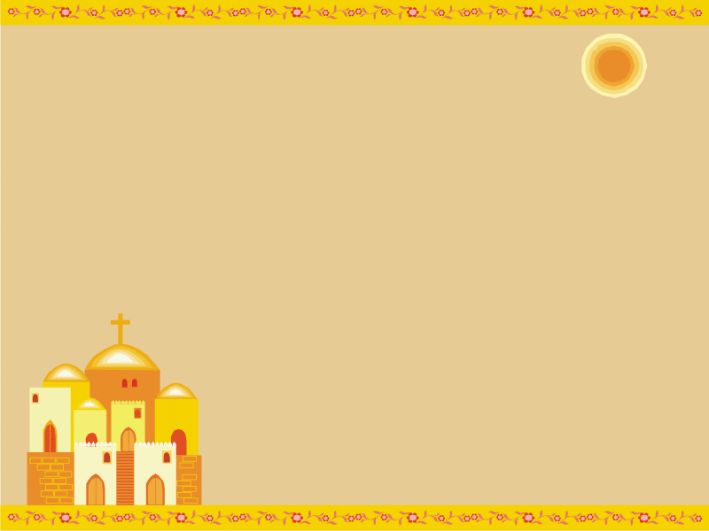
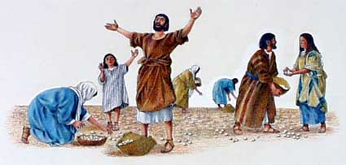
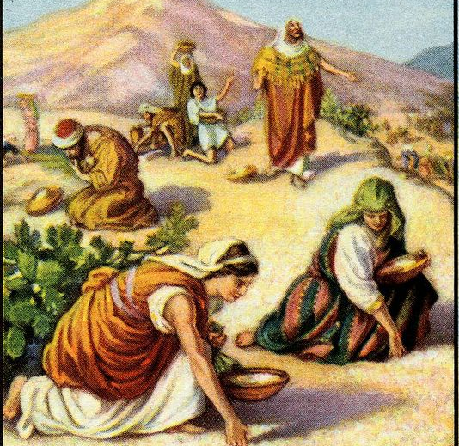
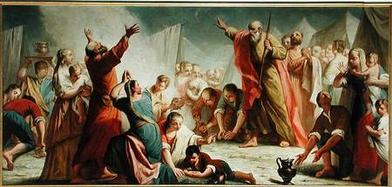
God’s loving care
Discuss what it must have
been like leaving Egypt.
Read p. 48, paragraphs 1-2
Instead of being thankful to God the Hebrews often _________________.
Bread from Heaven
Old Testament =
New Testament =
Manna
Eucharist

Slide 3
Comparing Manna and the Eucharist
Manna
Bread from heaven, nourishes body
Gave strength to body
Tastes like honey
Bread from God
Given 6 days a week
Could receive if desiring it to eat
Eucharist
Bread from heaven nourishes soul
Gives strength to soul
Tastes like bread
Jesus is present
(God from God)
Available daily at Mass
We can receive,
if prepared

Slide 4
The Ten Commandments
I am the Lord your God, you shall not have other gods besides me
You shall not take the name of the Lord in vain
Remember to keep holy the Lord’s Day
Honor your mother and father
You shall not kill
You shall not commit adultery
You shall not steal
You shall not bear false witness against your neighbor (lie)
You shall not covet your neighbor’s wife
You shall not covet your neighbor’s goods
Love of
God
Love of
Neighbor

Slide 5
Covenant with Moses
Why did God give Moses these Commandments for us?
When Moses came to give the Commandments to the people, they were sinning by worshipping a golden calf.

Slide 6
Worship
Read p. 49-50 “The Covenant Is Renewed” and “The Ark of the Covenant”
Tent tabernacle – where the Ark containing
the presence of God was kept.
Ark of the covenant = held the presence of God
New Covenant – The Church is the Ark of
the Covenant and Mary is the Ark
Tabernacle – Where Jesus in the Blessed Sacrament is reserved in Catholic Churches.

Slide 7
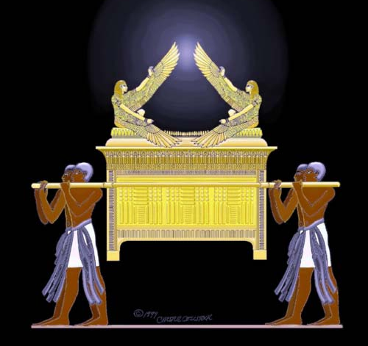
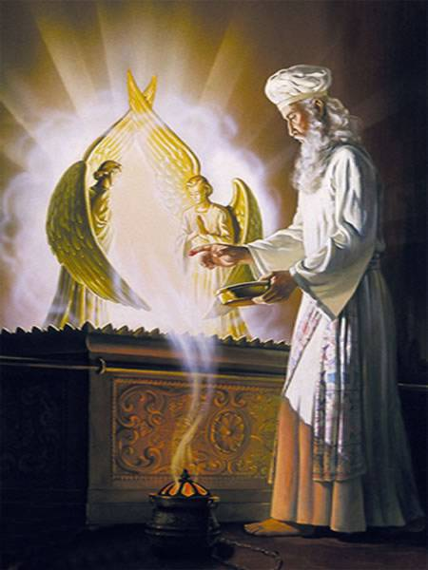
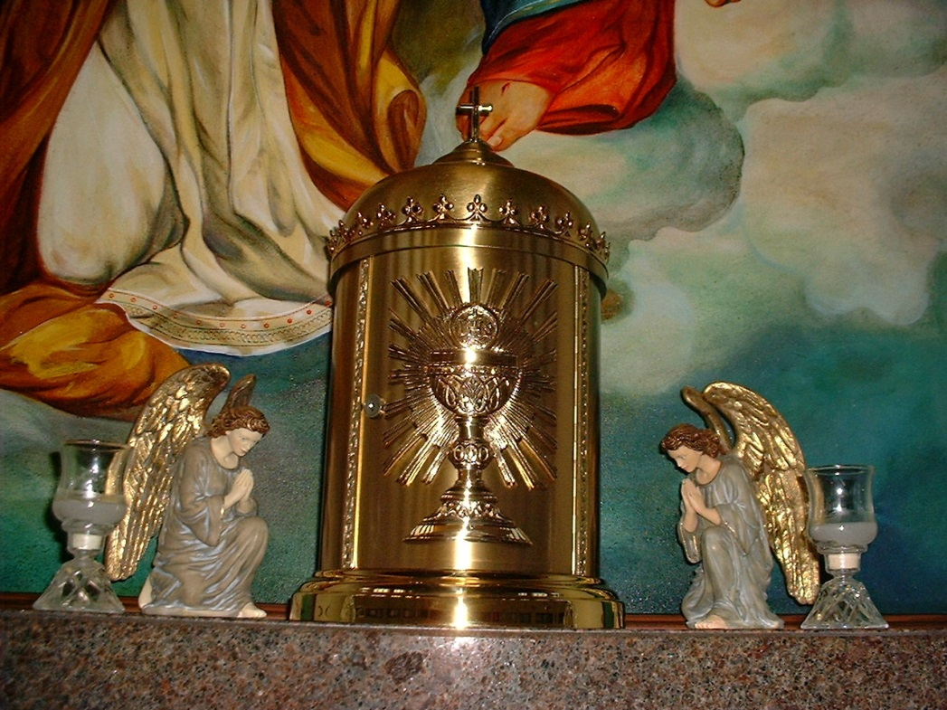

Slide 8
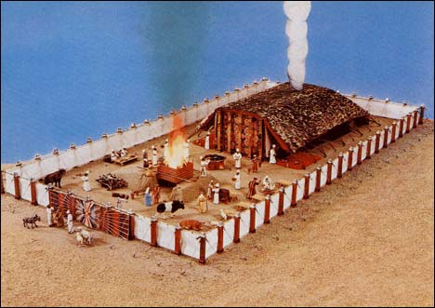

Slide 9
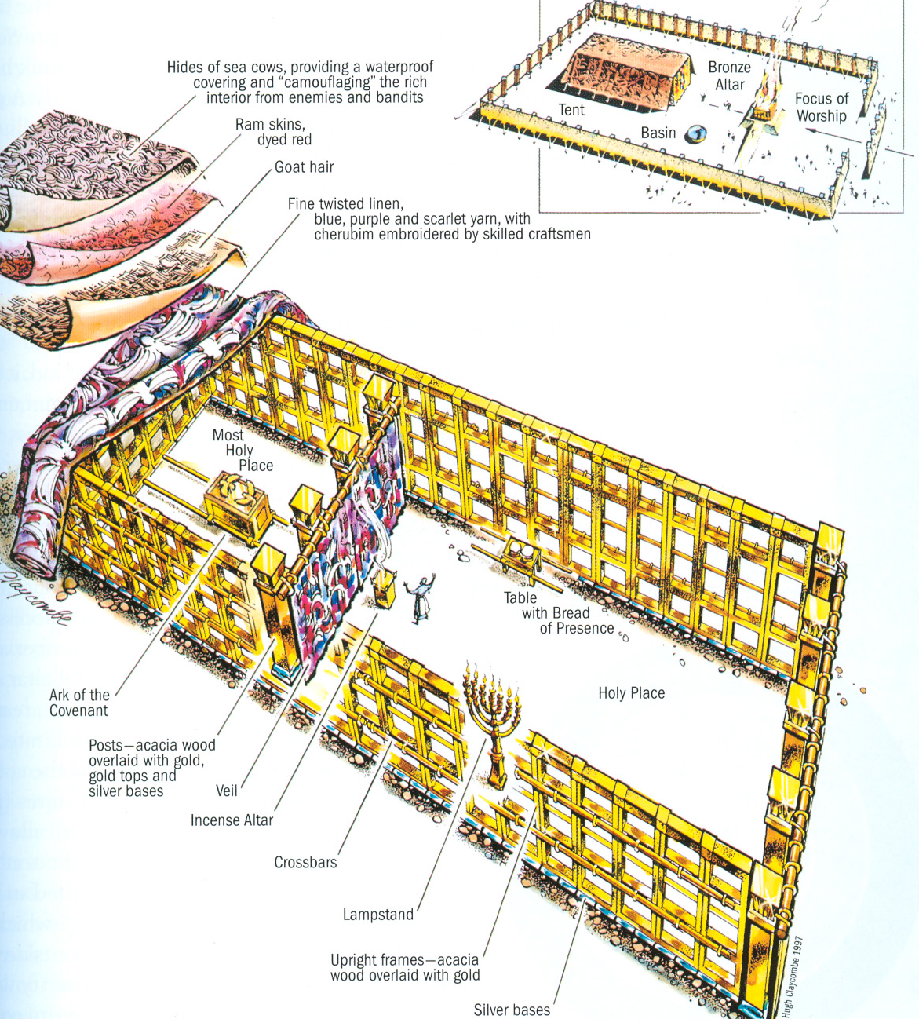

Slide 10
Jewish worship
Priests (Levites) – specially chosen and consecrated to offer sacrifices to God for the atonement of sin. Sacrificed animals
Catholic Church – consecrated priests offer a sacrifice to God for the atonement of our sins. Our sacrifice is Jesus, the Lamb of God

Slide 11
Forty Years
Pilgrimage = a journey of faith to help grow closer to God
Why did the Israelites wander in the desert for so long? How can we build our trust?
Promised Land –
1. Land God gave to Abraham and his descendants
2. Where Jesus was born and preached
3. Heaven

Slide 12
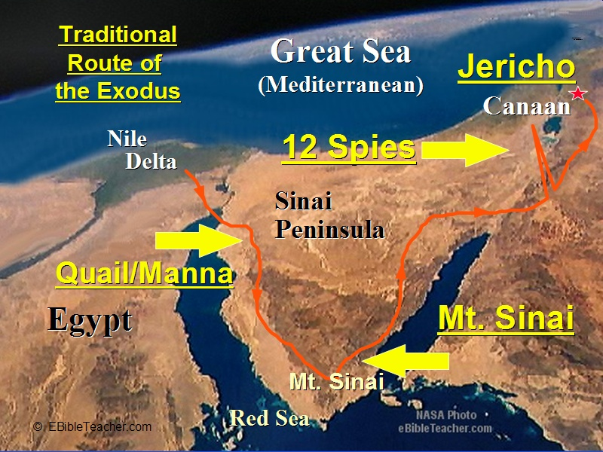

Slide 13
Moses
Descended from Israel
Shepherd
Prophet
Gave God’s Law
Led people from slavery to freedom
Mediated between God and Israelites
Suffered and died among his people
God established Old Covenant through him
Jesus
Descended from Israel
The Good Shepherd
Our Prophet
Completed God’s Law
Led people out of slavery to sin
Mediates between God and all men
Suffered and died for all men
God established New Covenant through him

Slide 14
Tour the Sacristy with Father
The Levite priests had special instructions, vestments, and vessels to use.
Catholic priests have special instructions to say the Mass with special vestments and vessels.
Take a tour of the sacristy with Father. Ask him to show you the vessels and vestments.

Slide 15
In front of the tabernacle, pray!
Go together to Church in front of the tabernacle. Notice ways that the Ark of the Covenant is like the tabernacle.
The Israelites forgot about God’s gifts and complained. Instead of complaining, close with a list of things everyone is grateful for. Do this in front of the tabernacle.

