Slide 1
Life in the Promised Land
Chapter 11

Slide 2
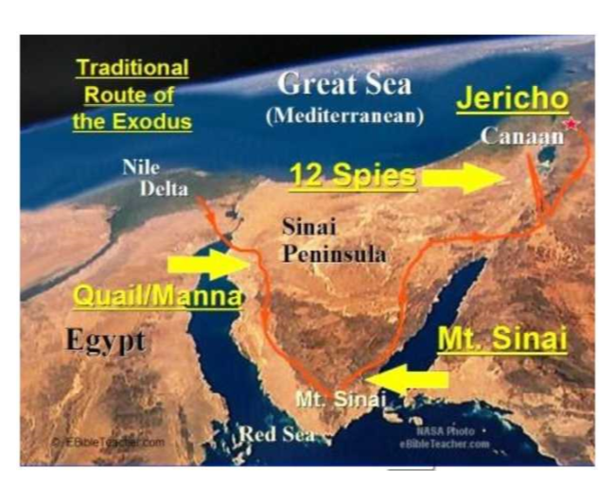
This is the route the Israelites took through the desert.

Slide 3
After Moses died, Joshua was the leader.
Joshua trusted God to take care of the Israelites.
He led the people across the Jordan River to take the Promised Land.
The first city they had to conquer was Jericho.
Act out the fall of Jericho!
After they conquered Jericho, the Israelites divided the Promised Land into sections for each of the 12 tribes. Look at the next slide.

Slide 4
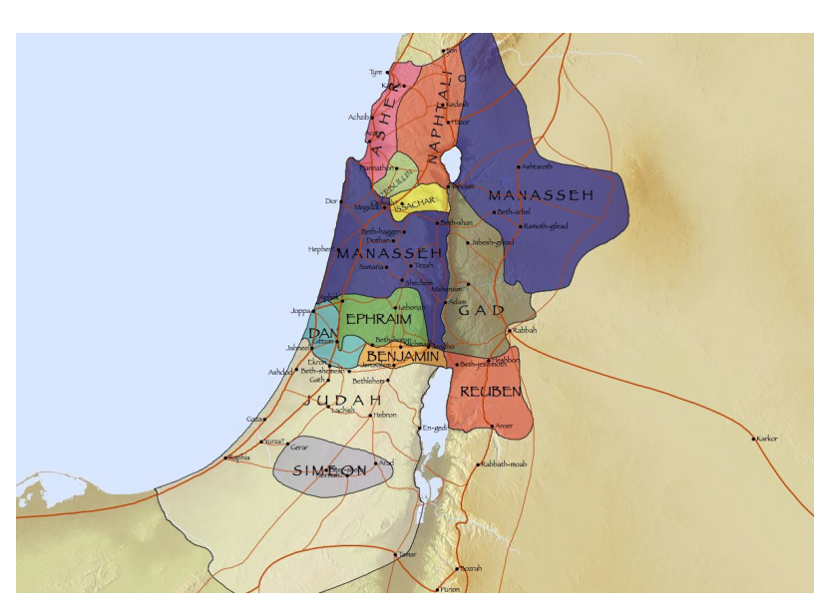
12 Tribes of Israel

Slide 5
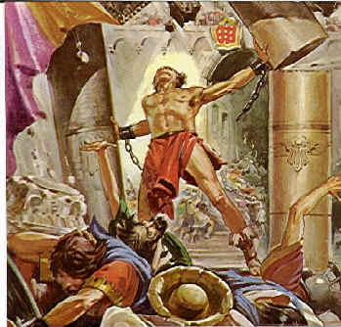
Samson
Begin acting out the story of Samson. After each paragraph in “God Sends Samson” (p 53) is read, act out what just happened.
How did God use Samson to protect his people?
What gifts do you have for God and
for others?

Slide 6
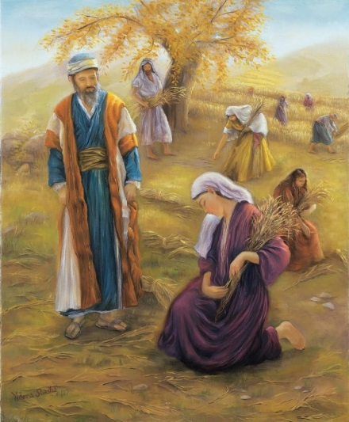
Ruth and Boaz
Why might Naomi have told Ruth she could leave?
Why did Ruth stay? Did she believe in God or want to believe in God?
How did Ruth meet Boaz? Why is it important that Ruth and Boaz were married?
What very important people were their children and grandchildren?

Slide 7
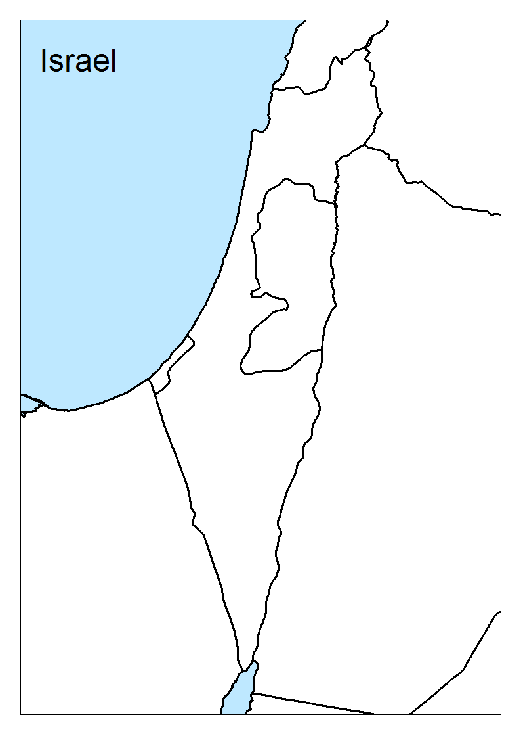
Your map to fill out:

Slide 8
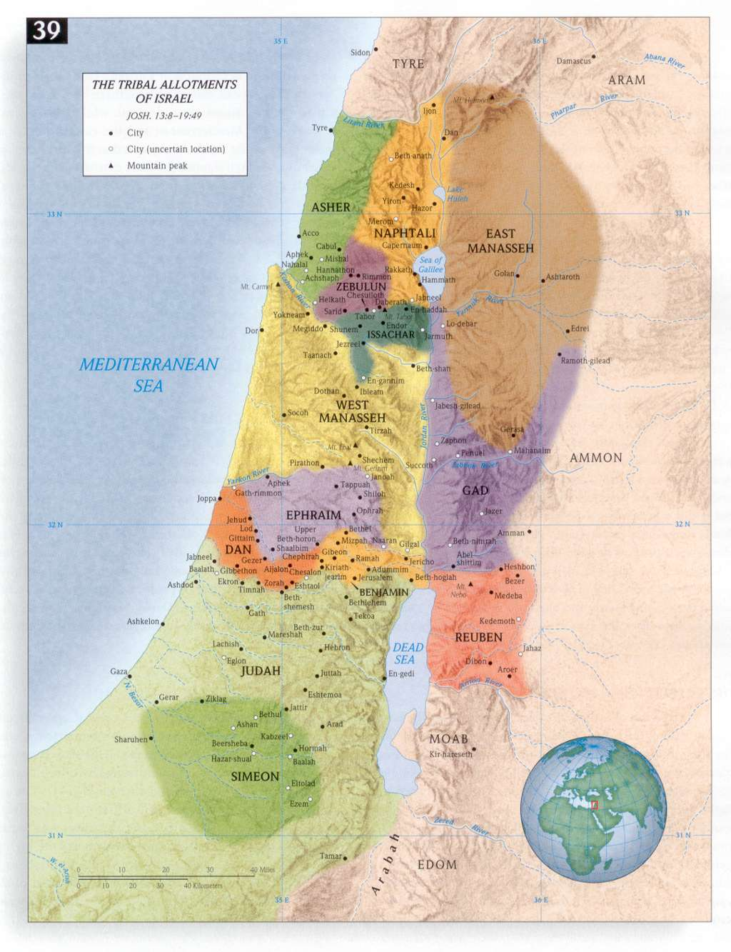

Slide 9
