Slide 1
King David
Chapter 13

Slide 2
David and Goliath
1 Sam 17
  Goliath challenged the Israelites to send one man against to fight against him.
  The Israelites, including Saul, were frightened.
  David brought supplies to his brothers at the camp.
  David volunteered to fight Goliath
    “The Lord, who delivered me from the claws of the lion and the bear, will also keep me safe from the clutches of the Philistine.” 1 Sam 17:37
  David slung a stone at Goliath hitting him in the head.
  David ran to Goliath, who was unconscious, took his sword and cut off his head.

Slide 3
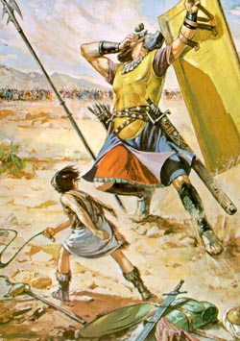
David and Goliath
The stone from David's sling strikes the giant Goliath on the forehead and knocks him down

Slide 4
David’s virtues
What virtues did David show in volunteering to fight Goliath and defeating him?
How can you live those virtues in your own life?

Slide 5
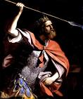
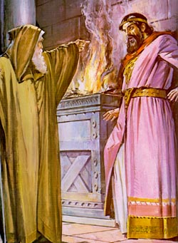
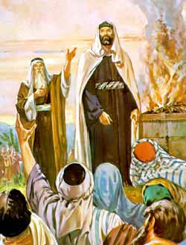
Saul Disobeys God
Samuel tells Saul that God will take away his kingdom because of his disobedience

Slide 6
Discussion Questions
Why was Saul jealous?
Why did David leave? Where did he go?
How did David know that Saul wanted to kill him?
Why did David not kill Saul when he had the chance?
How did David show Saul that he did not want to harm him?
How did David show his love and forgiveness toward Saul?
What Commandments did Saul break?
Why is it wrong to consult a sorceress?
What did Samuel foretell Saul? Was he right?
Now that Saul and his sons were dead, who would take the throne?

Slide 7
Events leading to David becoming king
_____David had the opportunity to kill Saul but didn’t
_____Saul and his sons die in battle
_____David killed Goliath
_____Saul wanted to kill David
_____David became king
_____Saul no longer wanted to kill David
_____David became commander of Saul’s army

Slide 8
Answers
__4___David had the opportunity to kill Saul. but didn’t
__6___Saul and his sons die in battle
__1___David killed Goliath
__3___Saul wanted to kill David
__7___David became king
__5___Saul no longer wanted to kill David
__2___David became commander of Saul’s army

Slide 9
David as King
David became the king of Jerusalem. He made it his capital city.
David brought the Ark of the Covenant into Jerusalem after he offered sacrifices to God.
David fell in love with Bathsheba. David arranged to have Bathsheba's husband killed in battle.
God was displeased with David's sin.
David repented and he suffered the punishment of ongoing war.

Slide 10
Act it out!
Act out the battle between the Philistines and the Israelites as written on page 61 of the text.
Cut a piece of butcher paper between 9 and 10 feet tall. This is how tall (6.5 cubits) Goliath was. Trace a fourth-grade student on the paper with feet at the bottom. This is how tall David probably was. See how much taller was Goliath!
Trace the family tree from David to Jesus.

Slide 11
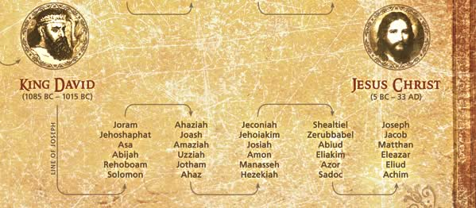
From David to Jesus

