Slide 1
The Perfect Sacrifice
Chapter 22

Slide 2
People who made sacrifices
Who are some people who made sacrifices?
  Abel, Abraham, Noah, Moses,
What did they sacrifice?
  Sheep (animals), their reputation, their comfort, their will, Abraham would have sacrificed his own son

Slide 3
Why sacrifice?
Old Testament
To ask for blessings (petition)
Out of thanksgiving to God
For forgiveness of sins (atonement)
Requires giving something entirely to God.
  Giving the best of everything back to God

Slide 4
Atonement
At-one-ment
  To reconcile or make one
  The satisfaction of Christ, whereby God and the world are reconciled or made to be at one. (www.newadvent.org)
Why is atonement necessary?
  Because our relationship with God was broken with Original Sin

Slide 5
Atonement in the Old Testament
Sacrifices for sins were animal sacrifices
They were prized possessions and the best thing they could offer to God
The priest would put his hands on the animal’s head as a sign he was transferring the sins to the animal.
The animal was killed and the blood sprinkled on the altar.
The blood is the life of the body so the animal was giving his life to atone for the sins.

Slide 6
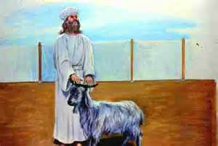
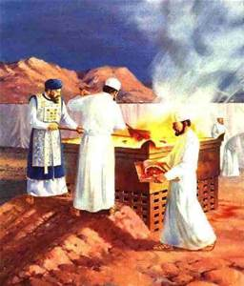
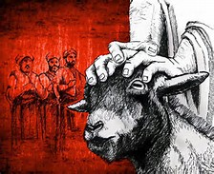
Atonement in the Old Testament

Slide 7
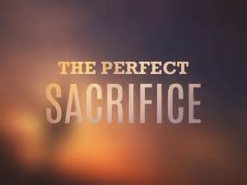
The Perfect Sacrifice
Who is the perfect sacrifice that could atone for sins?
  Jesus

Slide 8
The Perfect Sacrifice
How do we know Jesus was the perfect sacrifice?
  Sacrifice involving blood was needed
    Jesus shed His blood on the Cross
  The lamb had to be the best
    Jesus is perfect and sinless, God Himself
  Priest put his hands on the head of the animal as a sign of transferring the sins
    Jesus really took our sins on Himself
  He freely gave everything out of love for us and with the great love of God made man.

Slide 9
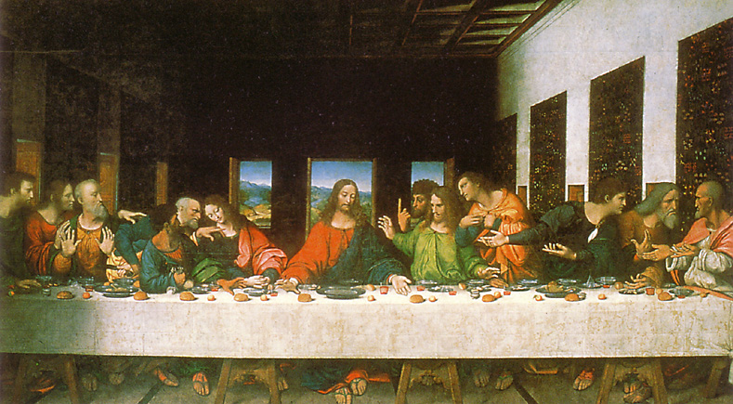
Jesus’ sacrifice made present
“Do this in remembrance of me…”
Remember=make present now
“Do this…” ~ priests
At Mass…
  We are at the Last Supper,
  With Jesus on the Cross,
  And at the Resurrection

Slide 10
Jesus’ sacrifice made present
Calvary
Mass
Victim: Jesus Jesus
Priest: Jesus Jesus
Manner: bloody unbloody

Slide 11
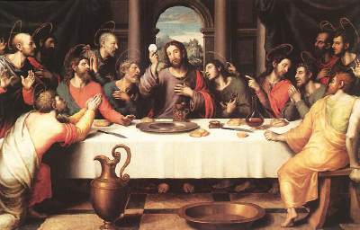
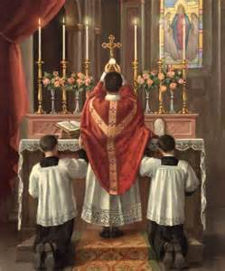
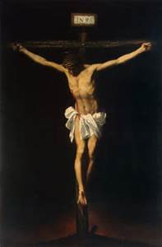
Jesus is not bound by time.
The sacrifice of the Last Supper and Calvary are re-presented at the Mass.
We are present at the Last Supper and Calvary when we attend Mass.
Notes:
it is important to remember that the Lord's Passion transcends time. It covers all those who lived before Jesus came to earth and all those who were to come. The Mass simply allows us to be present at the Passion by the Eucharistic elements on the altar. It is impossible to understand the Eucharist without the Passion since it is the living sign of the Passion. The sign of the body of Christ on the altar, separate from the sign of His blood in the chalice tell us, without words, that He died. We don't see His body and his blood as people saw them on Calvary, but we see them nonetheless under the form of bread and wine. (Fr. Vincent Serpa, Catholic Answers)

Slide 12
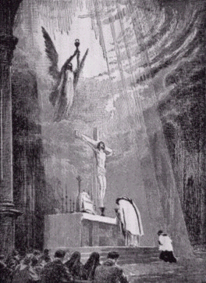
The Perfect Priest
A priest offers worship to God for other people.
(He is God’s representative to the people)

Slide 13
Activity
One student is in big trouble. He is trapped on the other side of a canyon with fires and wolves.
Other students try to sacrifice their own stuff (games, clothes, Oreos) to help him across, but they don’t help completely.
One student finally comes to stretch himself across the canyon so the trapped student can escape.
This is like Christ laying down his life for us in the perfect sacrifice of the Mass.

