Slide 1
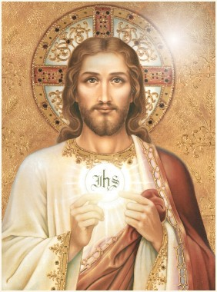
Bread From Heaven
Ch. 23
Chapter 23-24

Slide 2
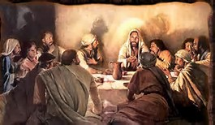
Last Supper
Matthew 26:26-29
Mark 14:22-25
Luke 22:17-20
What words are the same in each passage?
When else do you hear these words?
Why does Jesus give us His Body and Blood?

Slide 3
Consecration
Who consecrates? (minister)
  A priest
What are the words of Consecration? (Form)
  “This is my Body”
  “This is my Blood”
What does Father use? (Matter)
  Bread and wine
What happens?
  The bread and wine become the Body and Blood of Jesus

Slide 4
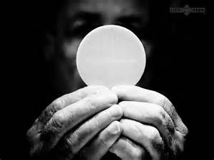
Transubstantiation
Before Consecration:
Appearance –
  Bread
  Wine
Substance –
  Bread
  Wine
John 6:35-59 ~ Bread of Life
After Consecration:
Appearance –
  Bread
  Wine
Substance –
  Christ’s Body, Blood, Soul, and Divinity

Slide 5
The Holy Eucharist is…
The Body, Blood, Soul and Divinty of Jesus under the appearances of bread and wine.

Slide 6
5 steps to a worthy Communion
We should have a healthy soul – no mortal sins, show in our lives we love Jesus
We should fast- not eat or drink for 1 hour before communion. (You can have medicine and water, but not gum!)
We must believe we are receiving Jesus and desire to receive Him. Participate in the Mass, say the prayers and responses, and sing the hymns.
We should receive our Lord reverently- stay focused on Jesus not looking around or talking.
We should thank Jesus for coming to us in Holy Communion- Spend the time after Communion with Jesus who is a guest in your body.

Slide 7
Holy Communion changes our souls
Holy Communion gives us God’s life (grace).
It makes us strong to resist temptation.
We are forgiven of venial sin.
We receive a pledge of Heaven.
Holy Communion helps us become saints and prepares us for Heaven.
Helps us do what is right.
We are united with Jesus and His Church.
Strengthens the unity of the mystical body of Christ.

Slide 8
Fruits of Mass and Holy Communion
Fruits of the Mass
Those who attend are graced
The universal Church is graced
The person/intention for whom the Mass is offered is graced
The priest who offers the Mass is graced
Fruits of Communion
United with Jesus
Receive an increase of grace
Forgiveness of venial sins and strength not to sin again
Strengthens unity of the Mystical Body of Christ
Increases our love for the poor

Slide 9
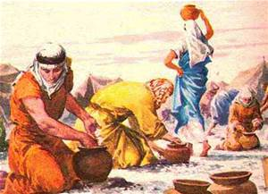
Activity
Scripture search
  John 6: 1-13
  Mark 8:1-9
  Matthew 15:32-37
  Exodus 16:4-5, 14-35
  Answer the questions

Slide 10
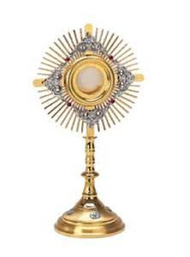
Video
“The Beginning and the End” by Matt Maher
What stood out to you?
What is he saying in this song?

