Slide 1
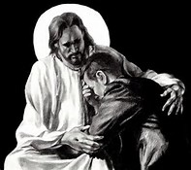
Mistakes along the Way
Ch. 24

Slide 2
Original Sin
Gen 3: 1-24
Who committed the first sin?
  Adam and Eve
Who tricked them into it?
  The serpent
What they thought would happen if they ate it?
  They would become like God

Slide 3
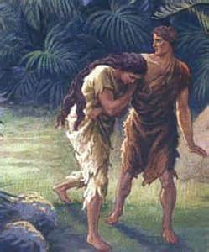
Original Sin (cont.)
Was it a sin of eating fruit?
  No!
What was it a sin of?
  Disobedience, caused by pride
What did they do after they ate it?
  They hid
Why did they hide?
  They were ashamed
How are we like Adam and Eve?
  We sin and often hide from God

Slide 4
In the beginning before the Fall
God gave Adam and Eve preternatural gifts and the supernatural gift of grace!
Preternatural Gifts
No sickness or death/bodily immortality
Infused knowledge
Had everything to live and be happy
Perfect harmony with nature
Walked with God, in his friendship

Slide 5
Humanity: Before and after the Fall
Before
Had grace
With God in Garden
Adam and Eve = friends
Knew everything
Never sick
No death
Naked (no shame)
No arduous work
Knew good
After
Lost grace
Out of garden
Blame each other
Need to learn
Pain and suffering
Death
Need clothes (shame)
Hard work for food
Know good and evil and have a hard time choosing the good

Slide 6
Conscience
Conscience = one’s ability to judge how he/she ought to act
We must inform our conscience by learning…
  The Ten Commandments
  Virtues/vices
  Works of Mercy
  Commandments of Love
  From the example of others (Jesus and the saints)
We must form our conscience well and NEVER act on an uncertain conscience!
We must obey our well-formed conscience, even when it is difficult.
It helps us to choose what is right

Slide 7
Types of Sin
Original
Actual
Committed by Adam and Eve
Sin we commit
Offense against God
Can be mortal or venial
Inherited from Adam and Eve
Washed away at Baptism
Taken away in confession

Slide 8

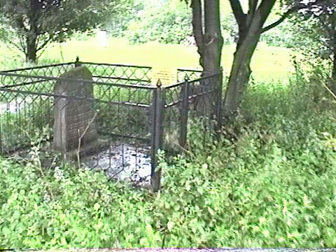
Venial Sin
Mortal Sin

Slide 9
Two types of actual sin:
Mortal sin:
  Know it is wrong
  Serious sinful action (grave matter)
  Freely choose to do it anyway
Venial sin:
  Must not be a serious sinful action (not grave matter)
  You know it is wrong and choose to do it anyway
  You commit a serious sinful action, but you truly do not know what you are doing.

Slide 10
Confiteor
I confess to almighty God and to you, my brothers and sisters, that I have greatly sinned in my thoughts and in my words, in what I have done and in what I have failed to do, through my fault, through my fault, through my most grievous fault; therefore I ask blessed Mary ever-Virgin, all the Angels and Saints, and you, my brothers and sisters, to pray for me to the Lord our God. Amen.

Slide 11
How can we disobey God?
Thought: God even knows our inward thoughts.
  We must always keep our thoughts pure and loving.
Word: Words are powerful – can hurt and cause much damage.
  We must not lie, gossip, or slander others
Deed: Our actions are very important
  the most visible sins we can commit.
Omission: If we know the right thing to do and choose not to do it, we are not following God’s will.
What are examples of each of these?

Slide 12
Activity
Conscience scenarios
Divide into 5 groups
Read the conscience scenario from your teacher
Act out what you would do if you had a well formed conscience

