Slide 1
Channels of Grace
Chapter 28

Slide 2
Grace
Grace = a share in God’s life
  Necessary for us to go to Heaven
  2 Kinds of Grace
Sanctifying grace = given at Baptism; permanent and supernatural disposition that perfects the soul and enables it to live with God and act by God’s love
Actual grace= this is God’s intervention at the beginning of conversion and in the work of sanctification. Happens in our daily life

Slide 3
Nine things to know about grace
Can’t see or touch it, but its real
Not something God owes to us
Given as a free gift because He loves us
Does it’s work in our souls if we say “yes”
Heals our souls from sin
Gives us the power to break bad habits and say no to temptation
Without we are unable to love or do good
Can and should increase the grace in our souls
Raises us up to be able to live a higher life in Heaven

Slide 4
The sacraments and the Natural Life
Natural | Supernatural (Sacraments)
Birth | Baptism
Food | Eucharist
Healing | Confession
Adulthood | Confirmation
Family | Marriage
Service | Holy Orders
Death | Anointing of the Sick

Slide 5
Sacraments
Jesus on the cross All grace flowing from Christ
Church
Sacraments as channels through which we receive grace

Slide 6
Three Categories of Sacraments
Initiation- Baptism, Eucharist, Confirmation
Healing-Confession, Anointing of the Sick
Vocation-Marriage, Holy Orders

Slide 7
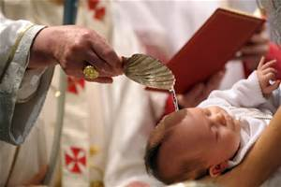
Baptism
Institution: Mt 28:19-20; Mk 16:15
Form: “I baptize you in the name of the Father and of the Son and of the Holy Spirit”
Matter: water
Minister: deacon or priest or anyone in an emergency
Who can receive: anyone who has not been baptized already

Slide 8
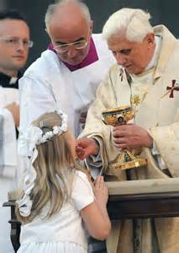
Eucharist
Institution: Last Supper; Mt 26:26-30; Mk 14:22-25
Form: “This is my body…this is my blood”
Matter: bread and wine
Minister: priest
Who can receive: any baptized Catholic who has reached the age of reason and is in the state of grace

Slide 9
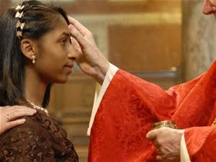
Confirmation
Institution: Acts 2:1-4
Form: “…be sealed with the gift of the Holy Spirit.”
Matter: chrism on forehead and laying on of hands
Minister: bishop, or for grave reasons, a priest delegated by him
Who can receive: any baptized Catholic who has not received the sacrament already

Slide 10
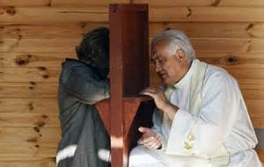
Confession
Institution: John 20:19; first Easter Sunday
Form: “…I absolve you from your sins…” (prayer of absolution)
Matter: contrite sinner, confession of sin, penance
Minister: priest
Who can receive: any baptized Catholic who has sins and is contrite

Slide 11
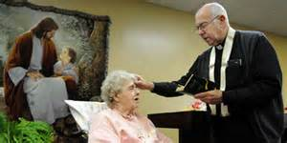
Anointing of the Sick
Institution: Mk 6: 12-13 (Jesus sends apostles to anoint the sick)
Form: prayer of anointing
Matter: anointing with the oil of the sick on forehead and hands and laying on of hands
Minister: priest
Who can receive: any baptized Catholic who has is seriously ill and in danger of death

Slide 12
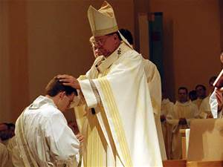
Holy Orders
Institution: Last Supper; Mt 26:26-30; Mk 14:22-25; Lk 22:19
Form: prayer of consecration
Matter: anointing with Chrism oil and laying on of hands
Minister: bishop
Who can receive: any baptized Catholic man

Slide 13
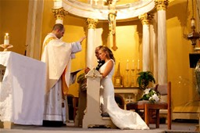
Matrimony
Institution: at creation, blessed and wedding feast of Cana; John 2:1-11
Form: marriage vows
Matter: bride and groom
Minister: bride and groom; priest or deacon witnesses in the name of the Church
Who can receive: baptized man and woman

Slide 14
Effects
Baptism:
  Purification from sin
  Receive grace and the Holy Spirit
Holy Eucharist:
  Intimate union with Christ
  Increases grace
  Cleanses past sins and preserves from future sins
  Strengthens unity of members of the Mystical Body of Christ
  Increases commitment to the poor

Slide 15
Effects
Confession:
  Reconciliation with God
  Grace restored
  Remission of eternal punishment for mortal sin
Confirmation:
  Outpouring of the Holy Spirit
  Increase in grace
  Unites us more closely to Christ and His Church

Slide 16
Effects
Matrimony
  Perfects the spouses’ love for one another
  Sanctifies their lives
  Strengthens the unity of the spouses
Holy Orders
  Consecrates a man as a bishop, priest or deacon
  Confers an indelible seal on the soul making a man as a minister of Christ
Anointing of the Sick
  Joins the sick person to the Passion of Christ

Slide 17
Prayer
Radiating Christ by John Henry Newman
Dear Jesus, help me to spread Your fragrance wherever I go. Flood my soul with Your spirit and life. Penetrate and possess my whole being so utterly, that my life may only be a radiance of Yours. Shine through me, and be so in me that every soul I come in contact with may feel Your presence in my soul. Let them look up and see no longer me, but only Jesus! Stay with me and then I shall begin to shine as You shine, so to shine as to be a light to others. The light, O Jesus, will be all from You; none of it will be mine. It will be you, shining on others through me. Let me thus praise You the way You love best, by shining on those around me. Let me preach You without preaching, not by words but by my example, by the catching force of the sympathetic influence of what I do, the evident fullness of the love my heart bears to You. Amen.

