Slide 1
Joseph Goes to Egypt
Chapter 6
Son of Israel (Jacob) and Rachel
Grandson of Issac
Great-grandson of Abraham

Slide 2
Commandments
Think of a time you’ve felt envious (when you didn’t want someone else to have something good they had). How did it feel?
9th Commandment
You shall not covet your neighbor’s wife
Envy
10th Commandment
You shall not covet your neighbor’s goods
Envy
Bad thoughts and feelings
lead us to sin in action as well.
Envy makes us miserable.

Slide 3

How can we fight envy?
Be grateful!
Make a list of things to be grateful for every day.
You will be a happier person by realizing what God has given you.

Slide 4
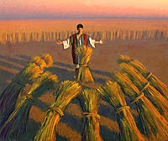
Joseph’s Dreams
Read page 33, “The Brothers’ Hatred”, the first column
Wheat
His brothers’ wheat bundles bowed to his!
Sun, moon, and eleven stars were bowing to him!
Represent his father, mother, and brothers
Act them out?!
Bad thoughts lead to bad actions
What’s going to happen in this story?

Slide 5
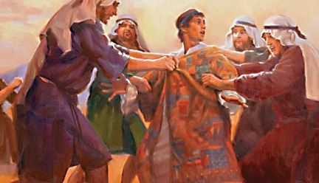
Joseph’s Brothers Sell Him
Act out Joseph’s brothers selling him while or after reading the second column of page 33 into page 34.

Slide 6
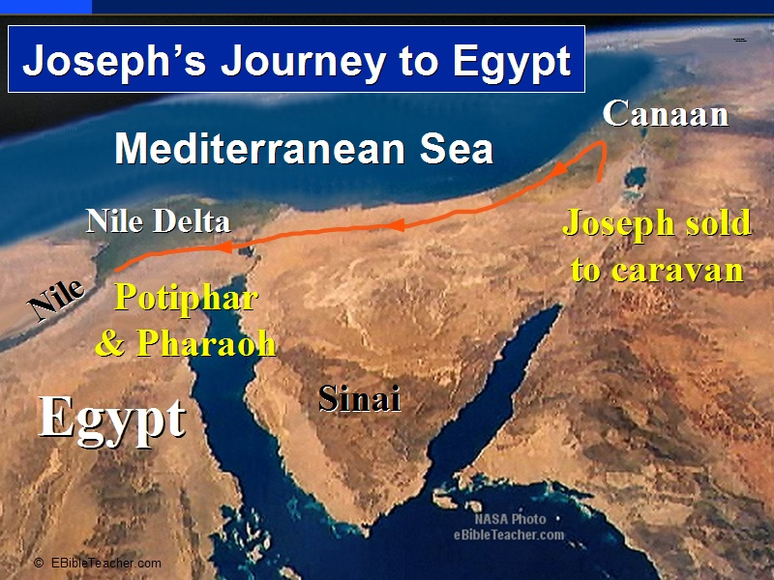
The photo of Joseph’s journey into Egypt shows the fertile Nile delta as the Nile empties into the Mediterranean Sea.

Slide 7
While Joseph was in an Egyptian prison…
Pharaoh had a bad dream, but none of his wise men could help him.
Pharaoh’s butler remembered Joseph’s gift of interpreting dreams.
Pharaoh brought Joseph from prison. Joseph told Pharaoh that God would interpret Pharaoh’s dream through Joseph.
What were the dreams?

Slide 8
Pharaoh’s Dream
Dream: Seven beautiful, fat cows came to the edge of the Nile River to eat and drink. Seven ugly, skinny cows came up behind them and ate up the fat cows!
God’s advice through Joseph: there will be 7 years of plentiful food and then 7 years of famine. Save up food during the first 7 years for the second 7 years.
Watch this video clip and/or act out the dream. https://www.youtube.com/watch?v=uPqvcLSXJAk

Slide 9
How did God bring good from the brothers’ envy?
Because Joseph was in Egypt, he was able to save thousands of people from starvation!
How could God bring good out of troubles in your life?

Slide 10
Joseph The Dreamer and
Jesus the Christ
Joseph
  Beloved Son
  Family will bow down
  Brothers betrayed
  Sold for 20 pieces
  Went to Egypt
  Prophecied truth
  Served God faithfully
  Saved his family
  Brought to choice land
Jesus
  Beloved Son
  God’s family will worship
  Apostles betrayed
  Sold for 30 pieces of silver
  Went to Egypt
  Prophecied/taught truth
  Served God faithfully
  Saved God’s family
  Opened gates of heaven

