Slide 1
Called to Holiness
You, therefore, must be perfect,
as your heavenly Father is perfect.
-Matthew 5:48

Slide 2
Do your parents love you?
How do you know? (Write 5 ways)
They tell me they love me
They provide for me (food, clothes, a home, medicine…)
They teach me things I need to know in life.
The want what’s best for me.
Want me to be safe and healthy
Give freedoms and responsibilities
Sacrifice for me (work hard and go without)

Slide 3
How do you show love for your parents?
(Write 5 ways)
Tell them I love them
Obey them
Learn from their example
Talk to them about my life
Give them gifts

Slide 4
How does God show His love for You? (Write 5 ways)
He gives us the sacraments so we can share his life of grace.
He gives us free will and calls us to responsibility.
He sacrificed his only beloved Son for us so we can be with him.
He wants us to be with him in heaven.
Consolation in Prayer
Beautiful nature and people in our lives.
Forgiveness

Slide 5
*We show our love for God by:
*Live a sacramental life
*Keep God’s Commandments
*Pray
*Love others
*Sacrifice
*Serve

Slide 6
*The sacraments and the Natural Life
Natural | Supernatural (Sacraments)
Birth
Food
Healing
Adulthood
Family
Service
Death

Slide 7

Outward__________
instituted by ____________
to give us ________________.

Slide 8
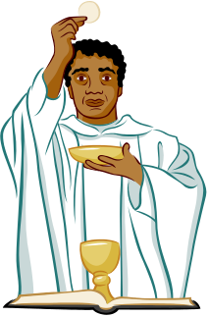
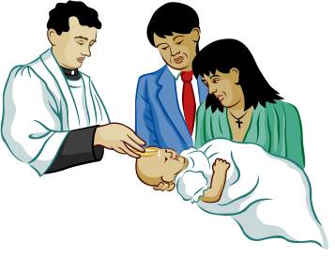
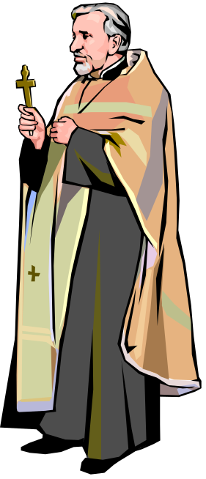

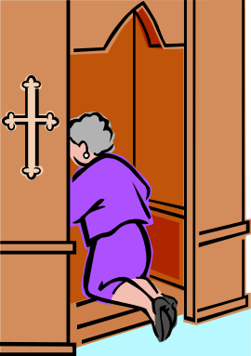
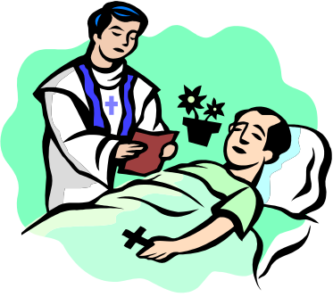
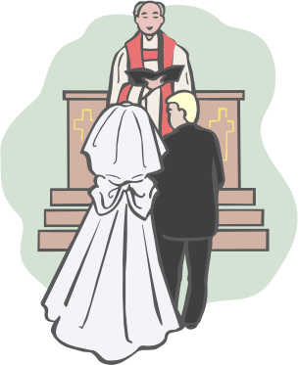
Three Categories
Initiation
Healing
Vocation

Slide 9
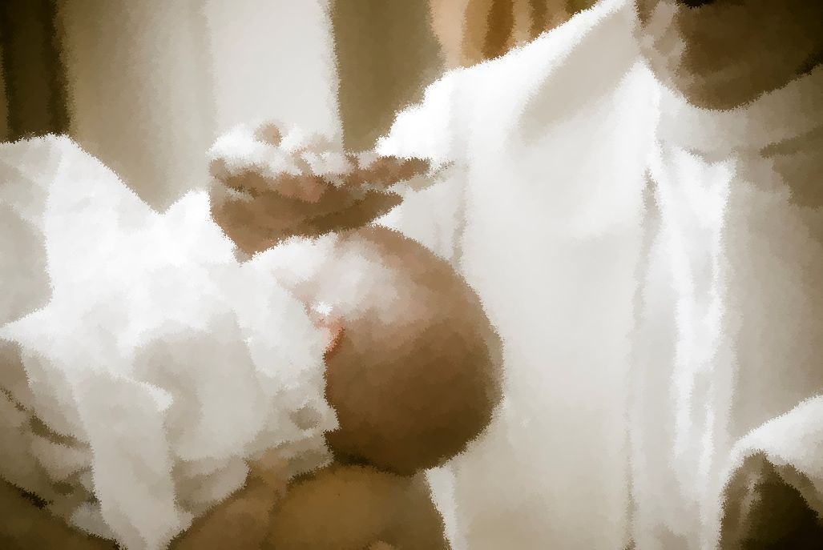
Initiation
Baptism
Eucharist
Confirmation

Slide 10
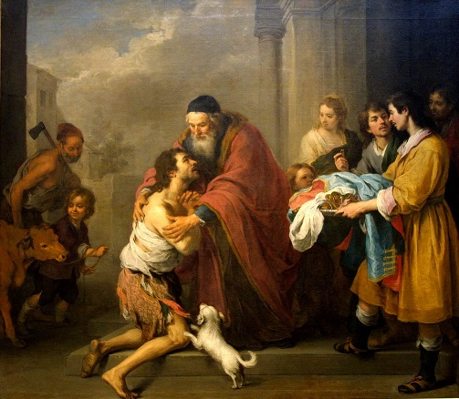
Healing
Confession/Reconciliation/Penance
Anointing of the Sick

Slide 11
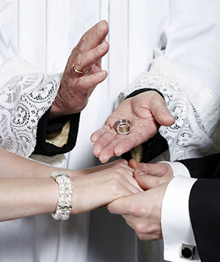
Vocation
Marriage
Holy Orders

Slide 12
Sacraments
Jesus on the cross All grace flowing from Christ
Church
Sacraments as channels through which we receive grace

Slide 13
5 Steps to a good Confession:
Examine Your Conscience:
Role of the Holy Spirit:
Look into our hearts
Know what Jesus taught (10 commandments, beatitudes, parables).
Tell right from wrong.
Be sorry.
Do what is right.
Love God and others

Slide 14
5 Steps to a good Confession:
Sorrow for your sins:
To be forgiven you must:
Confess what you did,
Be truly sorry, and
amend your life.

Slide 15
5 Steps to a good Confession:
Confess your sins:
Tell the priest:
What you did.
Why you did it.
How often you did it.

Slide 16
5 Steps to a good Confession:
Penance:
Are you really sorry you hurt Jesus?
Do your penance right away!
Amend your life = try not to do the same things again.
Tell Jesus, “THANK YOU!”

Slide 17
5 Steps to a good Confession:
Absolution:
Jesus acts through the priest.
Any Catholic priest can forgive your sins!
The priest can tell your sins to NO ONE!

