Slide 1
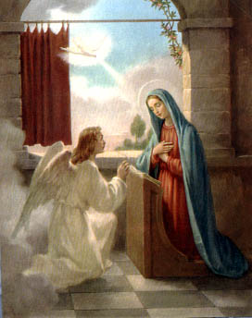
The Blessed Virgin Mary:
The Mother of God in Our Lives

Slide 2
The New Eve
Jesus is called the “new Adam”
Mary is called the new Eve.
Jesus gave Mary to us to be our mother and model.

Slide 3

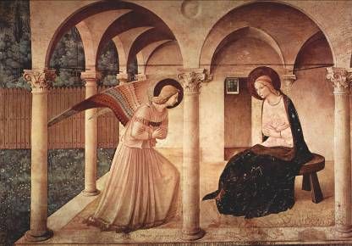
Eve’s disobedience brought original sin
Mary’s “yes” brought salvation.

Slide 4
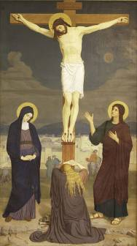
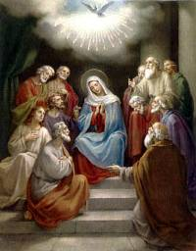
Mary was given the grace to love and suffer with Jesus.
She prayed at the foot of the cross and prayed with the disciples at Pentecost.

Slide 5
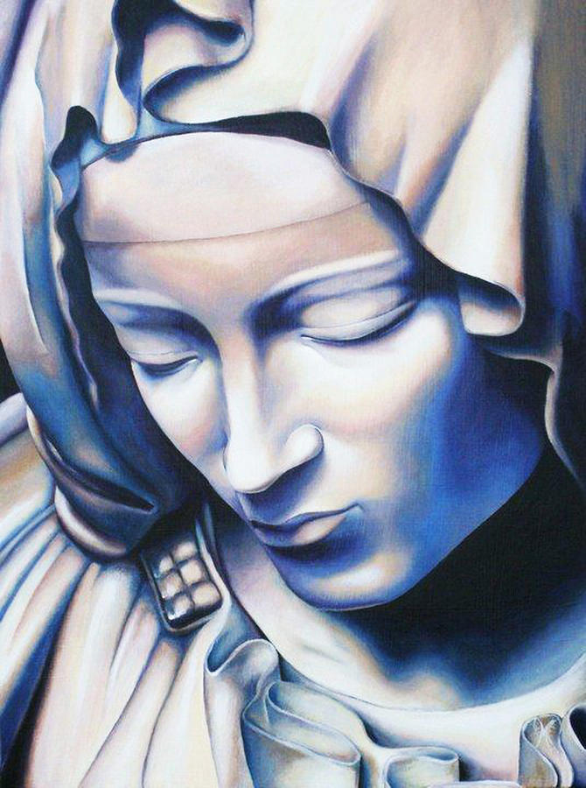
Mary intercedes for us.
She prays for us before the throne of God.
Mary is very close to God, and will ask Jesus for what is truly good for us.

Slide 6
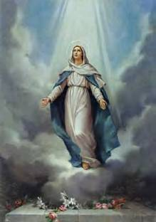
After she died she was taken, body and soul, into heaven.
This mystery is called the Assumption.
We celebrate the Assumption on August 15.

Slide 7
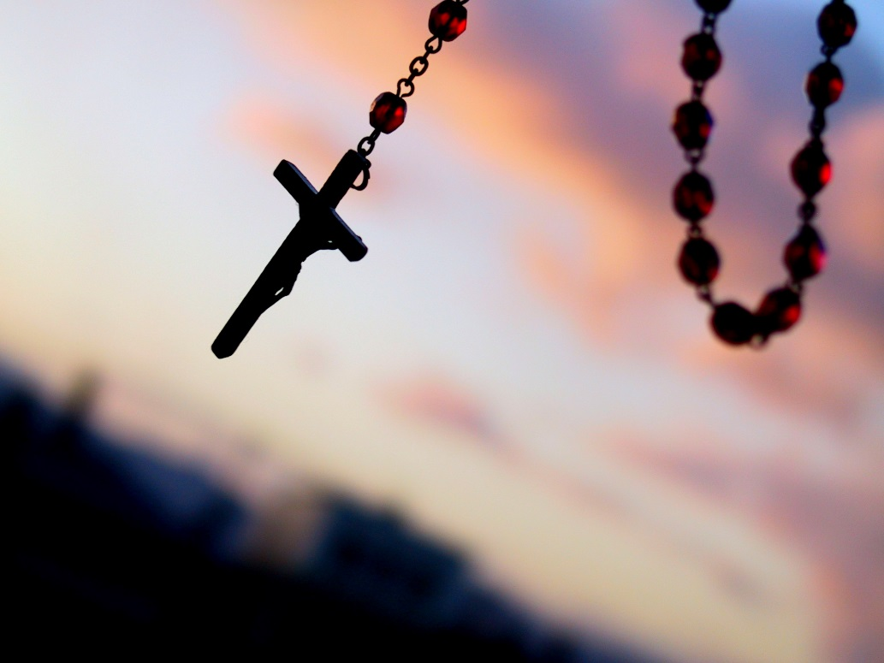
The Rosary is a prayer that helps us to know Jesus and Mary better.
Take time to pray together a decade of the Rosary!

Slide 8
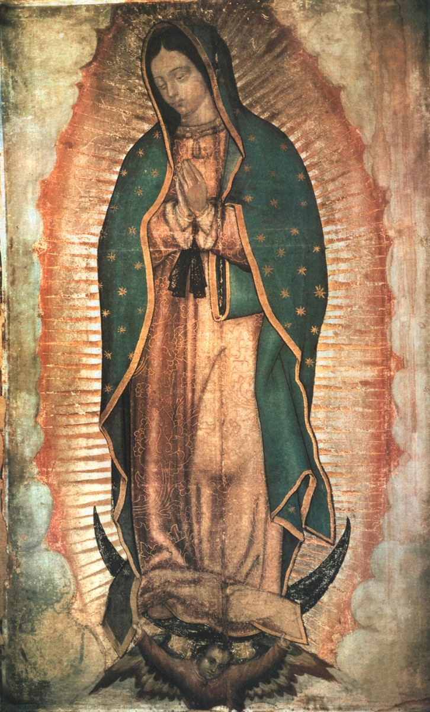
Our Lady of Guadalupe
In 1531, Mary appeared to Juan Diego on Tepeyac Hill near Mexico City.
The miraculous image of Our Lady on Juan Diego’s tilma can still be seen in Mexico City.
Click on image
for more information.

Slide 9
Words of Our Lady of Guadalupe
Listen, place it in your heart, my littlest son, that what frightens you, afflicts you, disturbs your face, your heart, is nothing. Do not fear this illness, nor anything else which is painful or hurtful. Am I not here, I who am your mother? Are you not under my shadow and watch? Am I not the source of your joy? Are you not in the fold of my mantle, in the crossing of my arms? Do you have need of anything else?

Slide 10
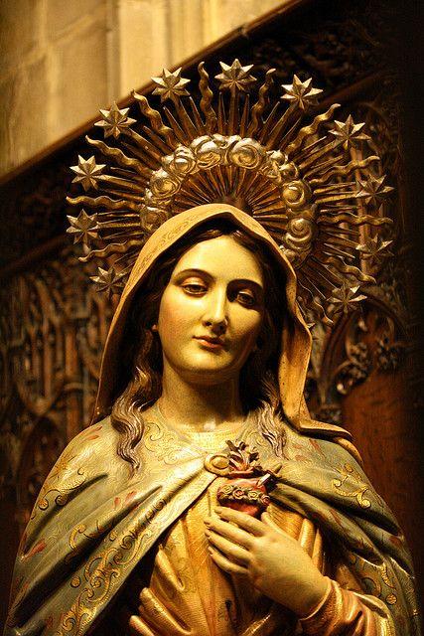
Activity:
Students will make a framed image of Mary. Encourage them to keep the pictures in a place at home where they will see it often and be reminded of Mary’s motherly care for them.

Slide 11

Video: Mary In Two Minutes
https://youtu.be/j7AQGyqtoK0

