Slide 1
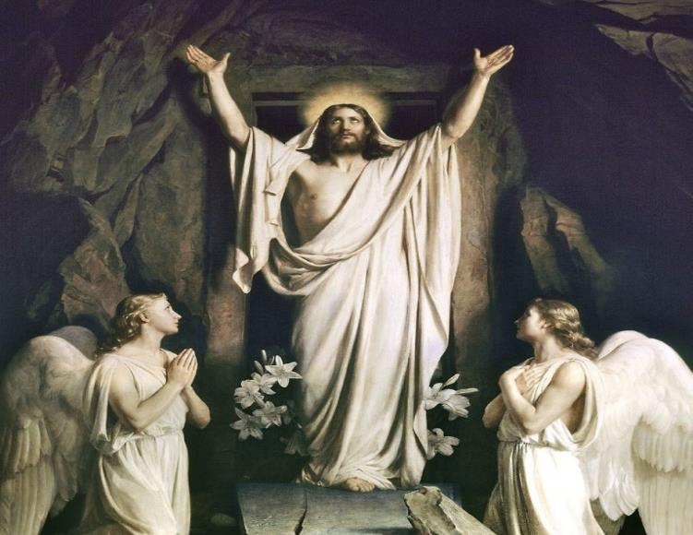
He is Risen!

Slide 2
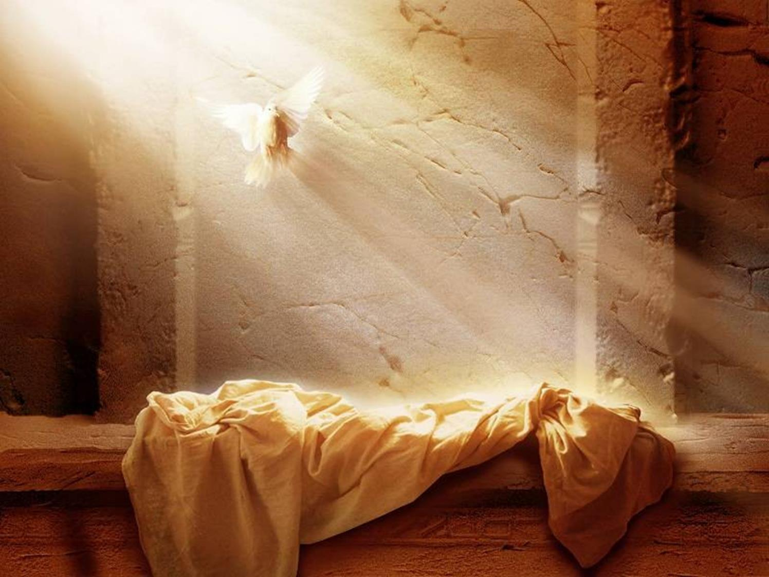
The story of Jesus’ resurrection. L1
*Mary Magdalene, Peter and John saw the empty tomb.
*Mary saw Jesus after He had risen.
*The soldiers who had been guarding the tomb fell into a trance.

Slide 3
Key Points
The story of Jesus’ resurrection. L1
  See TM p. 254, especially Develop #1-4
The Resurrection tells us that Jesus is God and that those who follow Jesus and die in His friendship will be raised from the dead and live forever in Heaven. L3
Qualities of a glorified body: a) the body is subject to the will; b) the body is beautiful and spiritual; c) the body will no longer suffer and die. L3
The Easter Vigil Mass teaches us about the new life of Christ offered to us all. L4

Slide 4
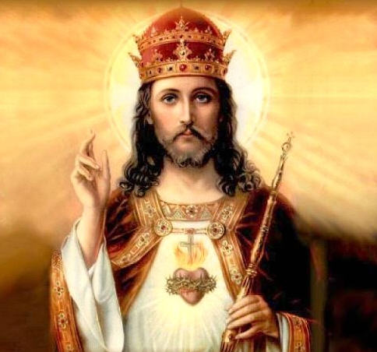
The resurrection showed all of Jesus’ followers that He was truly the Son of God, King of kings and Lord of lords.

Slide 5
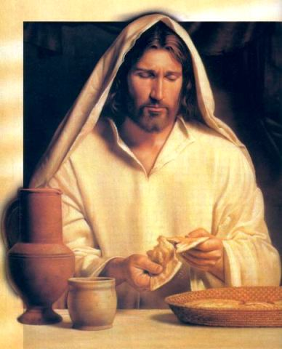
All that He said while He was on earth was true, even this amazing promise.

Slide 6
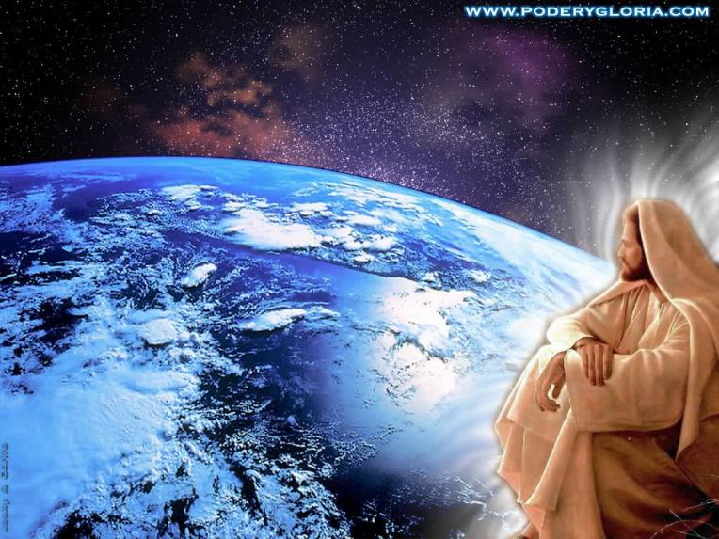
Jesus won the greatest victory of all, He defeated sin and conquered death, the punishment for sin.

Slide 7
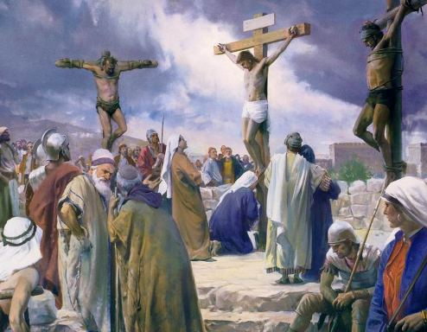
The resurrection was a sign that God had accepted the sacrifice of Jesus which redeemed us.

Slide 8
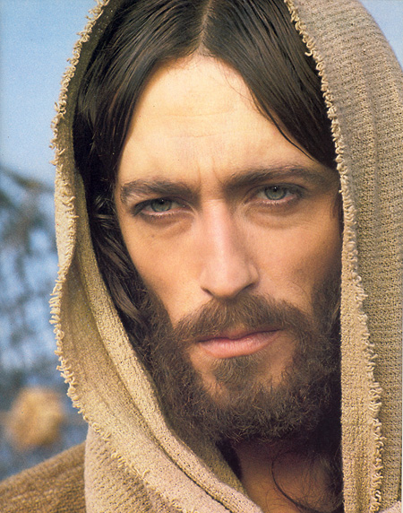
Where’s that in the Bible?
*Mt 27:62-66 → Guards placed at the tomb and stone rolled over the front
*Jn 20:3-8 → The tomb was empty
*Lk 24:13-31 → Jesus appeared to Mary Magdalene and the other apostles
*1 Cor 15:3-8 “Over 500 people saw the risen Christ.”
Yes, you “have to write all of these down”.

Slide 9
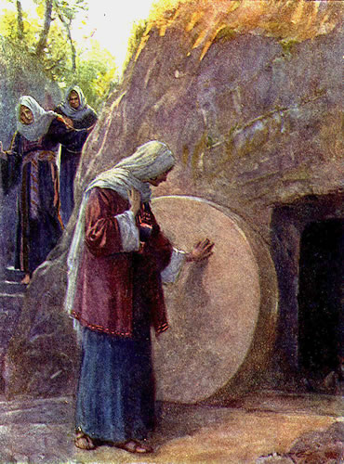
*Resurrection of the Body
Why was Mary unable to recognize Jesus?

Slide 10
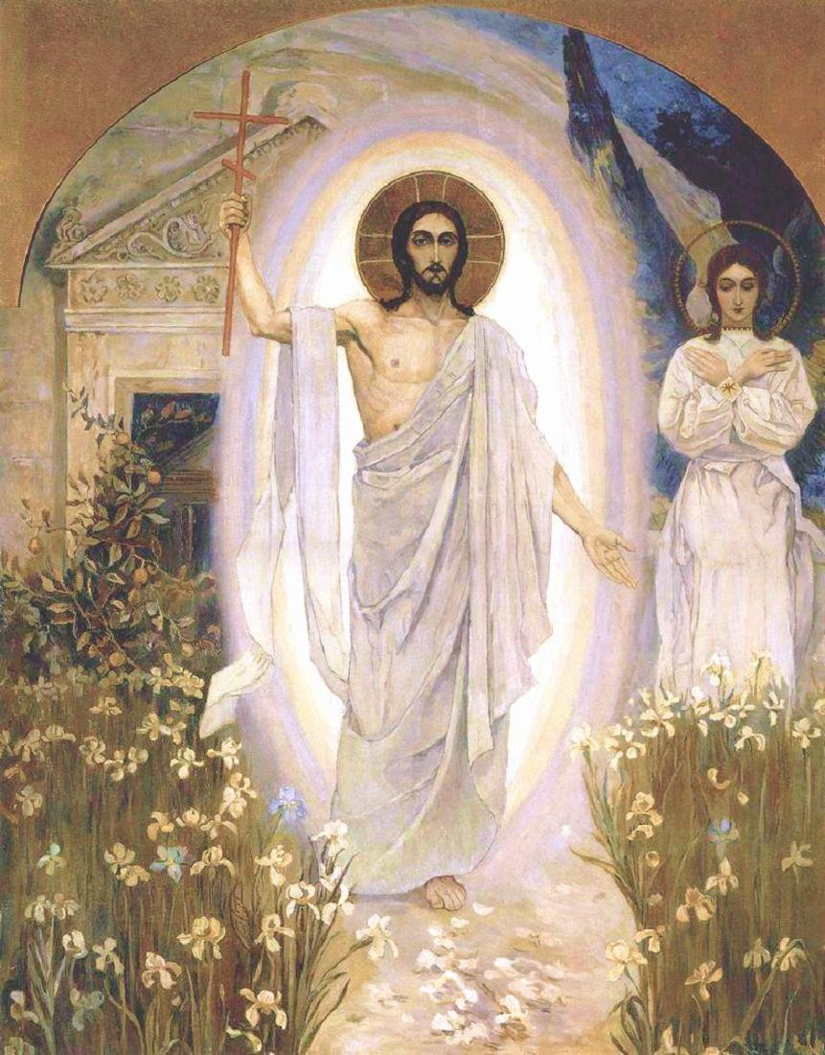
After the Resurrection, the body of Jesus was glorified.
This is called his “Resurrected Body”

Slide 11
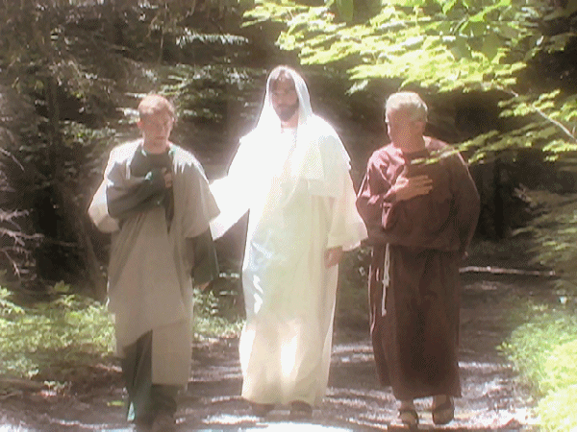
Differences
Not bound by space
  He could walk through locked doors
Not bound by time
  He met disciples leaving the city then moments later was in the city.
No pain or death
  His wounds were not painful and He went directly to heaven after he left earth

Slide 12
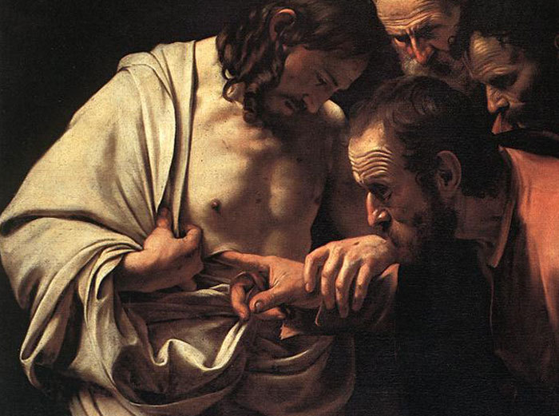
Similarities
*A real, physical body
*He ate fish, built a fire and his disciples could touch him.
*He was not a ghost.

Slide 13

Video

