Slide 1
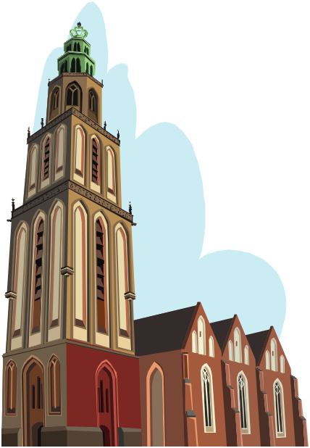
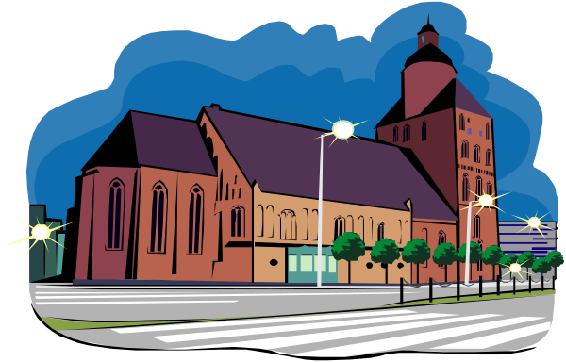

The Identity of the Church
(Who is She???)

Slide 2

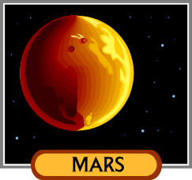


Can you identify these objects?
Round
Spinning
Revolves around the sun
Red
Round
Spinning
Revolves around the sun
Blue
Round
Spinning
Toy
Has a string
Round
Spinning
Toy
Has a point
Notes:
Ask students to identify these 4 objects as you click on the characteristics. At first the characteristics all seem the same, but as you go there are differences until they are able to identify each individually. So, too, only the Catholic Church has all 4 “marks” while other churches may have some, but not all 4.

Slide 3
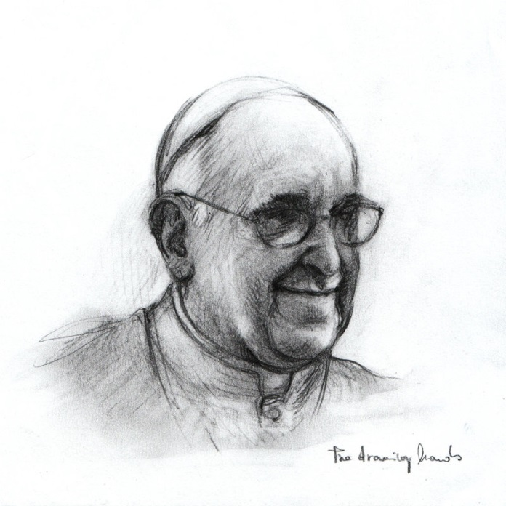

Can you identify this object?
One
Holy
Catholic
Apostolic

Slide 4
Four Marks of the True Church
Four marks (qualities or characteristics) which help to identify the true Church of Jesus Christ
Council of Nicaea in A.D. 325 in response to the Arian heresy: “We believe in one, holy, catholic, and apostolic Church” (Nicene Creed)

Slide 5

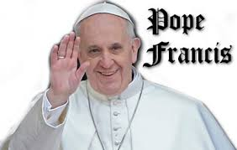
The Church is One
Jesus founded one Church with one visible leader - the Pope.

Slide 6
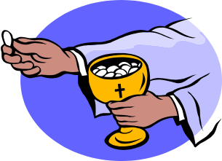
The Church is One
The Church is One: in belief, worship and leadership
Unity in belief – Same teachings and traditions that were given to the Twelve Apostles (does every church have the same beliefs?)
Unity in worship – At the Last Supper Christ prayed “that they may be one”
Unity in government or leadership – One visible head, the Pope

Slide 7
The Church is Holy
The Church is Holy: in her Founder, members and saints.
Holiness in its founder - Jesus Christ is God and He is holy!
Holiness in its members-–His own sheep who have been purified for Him as an acceptable people (Titus 2:14)
  – There will be both holy and unholy people in the Church until the end of time (Mt 13:24-30)
Holiness in its saints – those who have persevered in living holy lives

Slide 8
The Church is Catholic
The Church is Catholic: from the Greek word katholikos meaning general or universal
“Go and make disciples of all the nations”
Mt. 28:19
She is for all people in all times and in all places

Slide 9
The Church is Apostolic
The Church is Apostolic: Her ministers receive their powers from the Apostles by an uninterrupted chain of succession
The true Church must always teach the identical doctrines that were originally delivered to it by Jesus through Peter and the Apostles (Mt. 28:18-20 “teach them to carry out everything that I have commanded you”)
Peter is the rock upon which Christ built His Church (Mt. 16:18) (the successor of Peter is the Bishop of Rome)
Any church claiming to be Christ’s own must be able to trace its lineage in unbroken continuity back to the apostles (only the Catholic Church can make this claim)

Slide 10
Apostolic succession
To “succeed” in this case means to take someone’s place.
So, Jesus is the leader of the church and He chose 12 apostles and gave them power to succeed Him as leaders, with Peter as the head.
Each apostle then could ordain other men to be bishops.
These bishops could ordain other men to be bishops…this continues on today!
Notes:
It is helpful to have students come forward to help act this out. Pick someone as Jesus and have three chairs in front of the classroom. The student then picks someone to “succeed” him as pope. Have this student also pick 2 others as apostles (they all sit in the chairs). Have these 3 students then pick others to take their place. A symbolic way of having them pick others is by going to that person and laying both hands on the head. This is a sign of ordination.

Slide 11
Four Marks in Scripture
Mt 24:14
Catholic
Mt. 5:48
Holy
1 Cor. 12:13
One
Acts 1:8
Catholic
Mt 16:18
Apostolic
Jn.17:18
Apostolic
Eph 4:3-6
One
1 Cor. 1:10
One
Eph. 5:25
Holy
Jn 20:21
Apostolic
1 Thess. 5:23
Holy
Jn 10:16
Apostolic
John 17:17
Holy
Mk 16:15
Catholic
Notes:
You can work this slide in multiple ways:
Have students look up the Scripture quote in the Bible as partners and guess which mark it is.
You read aloud the Scripture quote and have them guess which mark it is.
Make it a game or other variations.

Slide 12
Draw a symbol of the Church (You may add a scripture quote too.)
Mystical Body of Christ: 1 Cor. 12:12-26; Eph 1:22-23 and 4:15-16
Sheepfold: Mt. 9:36 and 18:12 and 26:31
Vineyard: Jn. 15:1-5
Bride: Rev. 21:1-3
Ship: Mk. 4:35-41
Ship: CCC # 845
To reunite all his children, scattered and led astray by sin, the Father willed to call the whole of humanity together into his Son's Church. The Church is the place where humanity must rediscover its unity and salvation. The Church is "the world reconciled." She is that bark (ship) which "in the full sail of the Lord's cross, by the breath of the Holy Spirit, navigates safely in this world." According to another image dear to the Church Fathers, she is prefigured by Noah's ark, which alone saves from the flood.
Notes:
This makes a good activity.
Look up and discuss the different images for the Church.
Assign different students or groups of students to draw a symbol of the Church using one of the examples given from Scripture. Have them describe why it is a good symbol for the Church. (this could be done as homework)

Slide 13
The Church is ONE, HOLY, CATHOLIC, APOSTOLIC (AB 100)
The Church is ONE in BELIEF, LEADERSHIP, and WORSHIP
The Church is HOLY in her Founder (Jesus); also in members, saints
The Church is CATHOLIC, which means for all times and all places.
The Church is APOSTOLIC.
There is an un-interrupted chain from the apostles to today!

Slide 14
Journal Reflection
Quiet your heart and listen to the words of Jesus to St. Peter. Read Matthew 16:16-18
Imagine yourself as Peter and Jesus speaking to you. He called Simon by a new name, “Peter.” What does Jesus call you?
What mission is Jesus entrusting to you?
Journal about your prayer.

