Slide 1
The Holy Family
Chapter 13

Slide 2
The Hidden Years
The time from Jesus’ birth to His Baptism are called The Hidden years because we do not know what happened during that time.
Joseph probably worked with Jesus in his shop, while Mary took care of the household.
They lived and followed the laws of the Jewish religion.

Slide 3
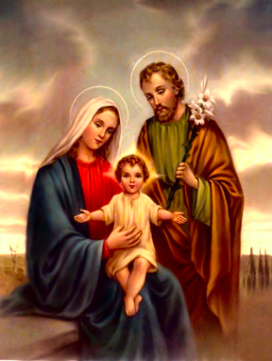
The Holy Family

Slide 4
The Sorrows of the Hidden Years
The Holy family had to flee into Egypt to save the Child Jesus from King Herod.
It was a hard, long, and dangerous journey
When Jesus was twelve years old, He went to Jerusalem with His family for the Passover, but stayed behind.
Mary and Joseph searched for him for three days.

Slide 5
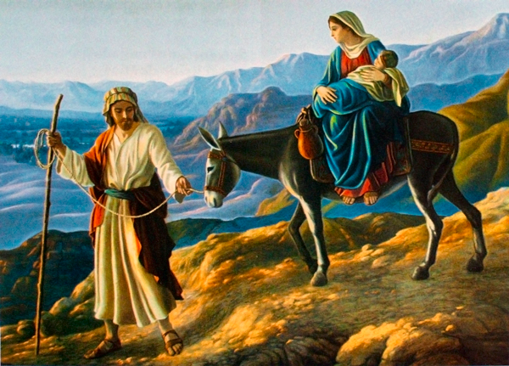
Flight into Egypt

Slide 6
A Model for Families
We can imitate the Holy family by:
  Accepting God’s will for us: The Holy family had to flee their home.
  Doing the job we are meant to do in our family: Jesus spent thirty years working with His family.
  Making God a member of our family: God was the center of the life of the Holy Family.
  Doing good for others as a family: Find ways to help those in need.

